Slide 1
Neuraxial Opioid Single Dose ADULT
NSW Pain Form
June 2023
Emily Edmonds | Co-ordinator NSW Pain Forms, CNC Acute Pain Service Blacktown Hospital

Slide 4
Neuraxial Opioid Single Dose NSW form - adult
The Neuraxial Opioid Single Dose Observation form for adult patients has been developed in NSW by a team of experts in the field of acute pain including clinical nurse consultants, anaesthetists and pharmacy representatives.
Standardisation of this form promotes best practice in pain assessment and management of adverse effects in those patients who have received an opioid (morphine) via the neuraxial route.
The term ‘neuraxial’ encompasses injections given in close proximity to the nerve roots of the central nervous system including spinal and epidural.

Slide 5
Aim of this presentation
This presentation aims to explain:
how to use the form to record the administration of morphine via the neuraxial route
how to complete the clinical observations
guidelines on the management of patients who have received an opioid (morphine) via the neuraxial route including the management of adverse effects.

Slide 6
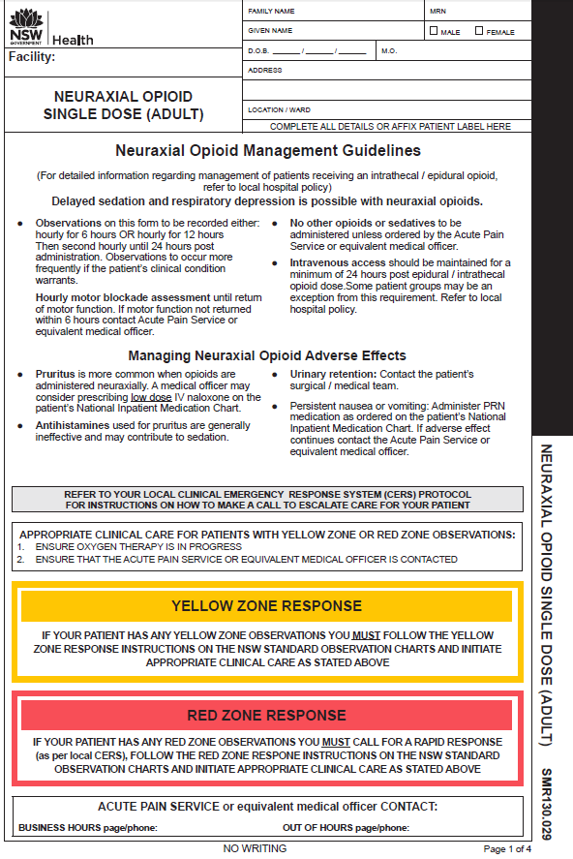
Neuraxial Opioid Single Dose Observation form – adult
Page 1:
neuraxial opioid management guidelines
managing neuraxial opioid adverse effects
instructions for observations in the Yellow Zone or Red Zone
Page 1

Slide 7
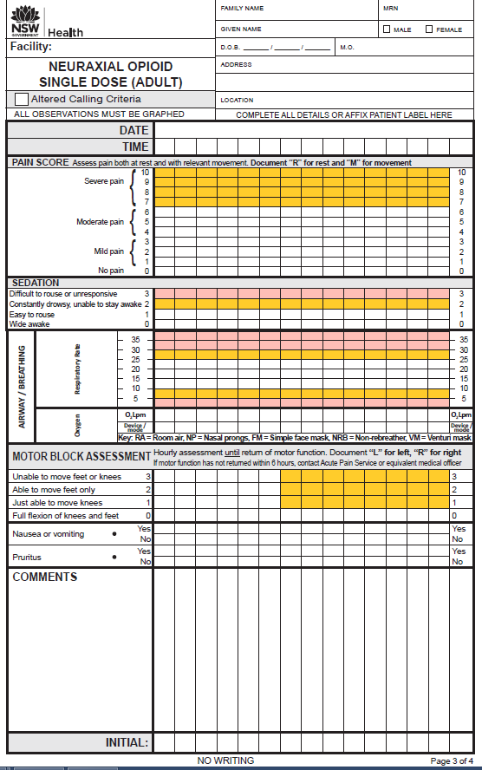
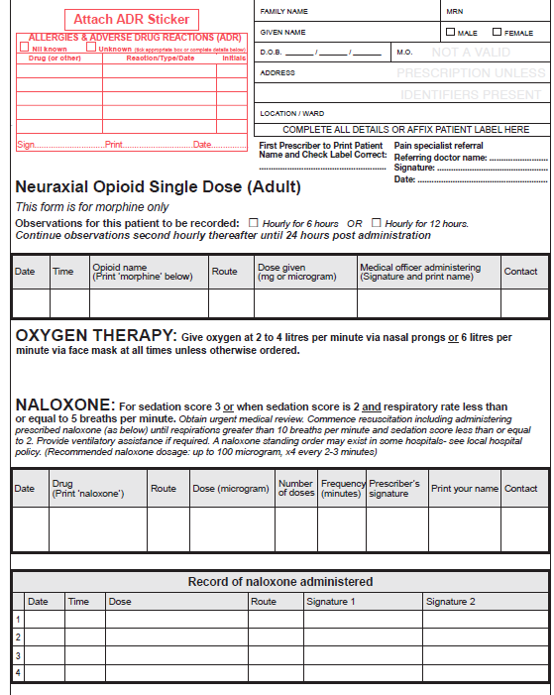
Neuraxial Opioid Single Dose Observation form – adult
Inside page (left):
documentation of neuraxial morphine administration
oxygen therapy
naloxone order
Inside pages
Inside page (right):
observations

Slide 8
Neuraxial Opioid Single Dose Observation form – adult
Inside page (right):
observations continued
Back page

Slide 9
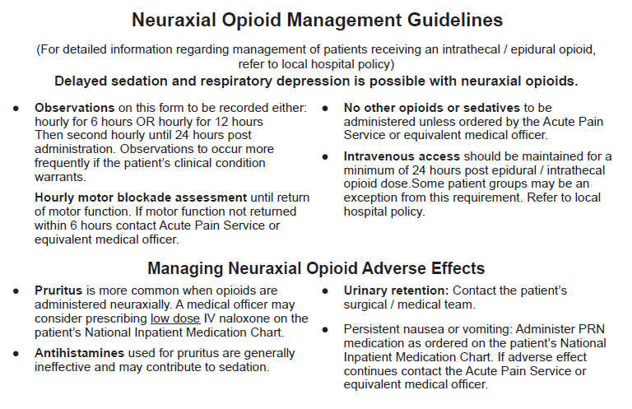
Neuraxial Opioid Single Dose Observation form – adult guidelines and managing adverse effects

Slide 10
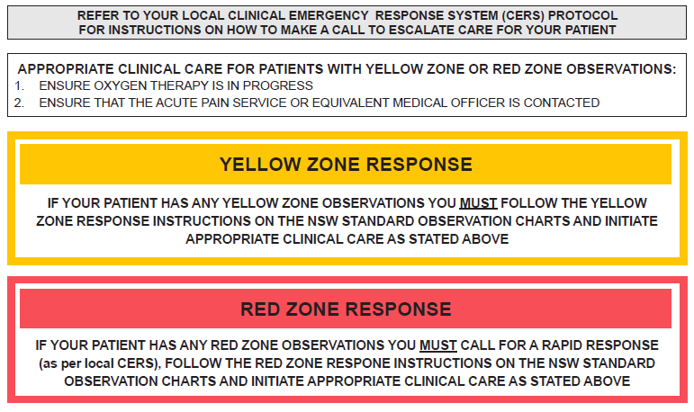
Neuraxial Opioid Single Dose Observation form – adult Yellow and Red Zone response

Slide 11
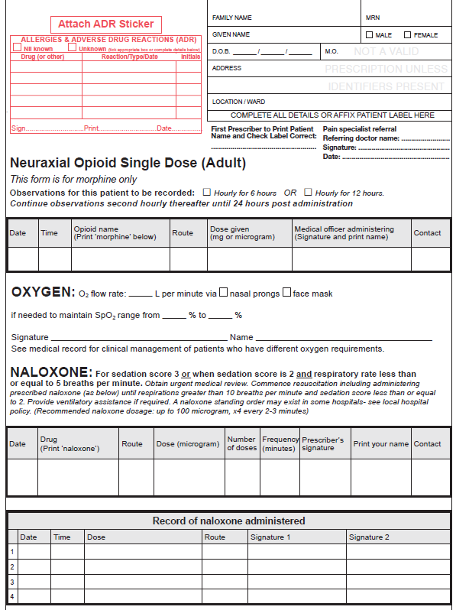
Displayed is an EXAMPLE of documenting the administration of neuraxial morphine.
Neuraxial Opioid Single Dose Observation form – page 2
Patient label and allergy adverse reactions
TSmith
SMITH 4/4/17

Neuraxial opioid administration information
Observations to be recorded hourly for 6 hours or hourly for 12 hours.
Date, time, morphine, route, dose given, medical officer administering signature, printed name, contact.
Private specialist referral for Medicare billing purposes: referring doctor (name), signature and date​
4/4/17 10:00 Morphine spinal 200 microgram TSmith (SMITH) 7511
2 - 4

92 96
TSmith SMITH
Oxygen prescription
Naloxone prescription for sedation score 3 or sedation score 2 and respiratory rate less than 5
4/4/17 Naloxone IV 100 microgram x4 2-3 TSmith SMITH 7511
minutes
Record of naloxone administration

Slide 12
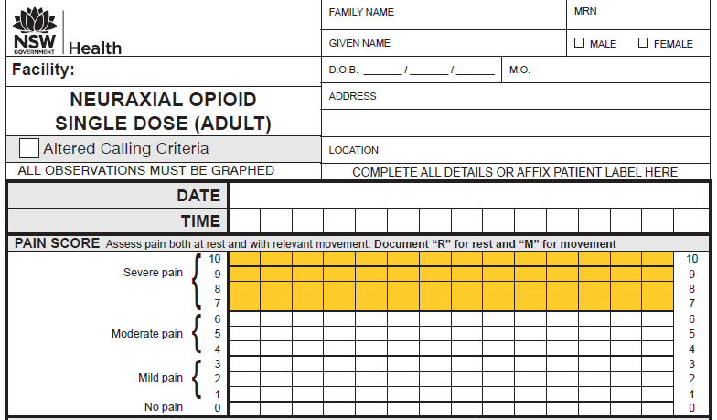
A patient label must be affixed or details written on each page that records observations
Neuraxial Opioid Single Dose Observation pages
Pain assessment:
Record ‘R’ for rest and ‘M’ for movement
Where a patient scores their pain 7 or above (in the Yellow Zone), the nurse or midwife must assess the current clinical pain management plan for the patient. For example:
Have pain scores previously been in the White Zone (0 to 6)?
Have additional prescribed analgesic medications been administered?
Has the patient been reviewed by the Acute Pain Service or equivalent medical officer?
The assessing nurse or midwife may need to consult with the NURSE IN CHARGE to decide whether a CLINICAL REVIEW (or other CERS – Clinical Emergency Response) call should be made.
15/10/14
11
00
12
00
13
00
14
00
15
00
M
R
RM
RM
RM
RM

Slide 13
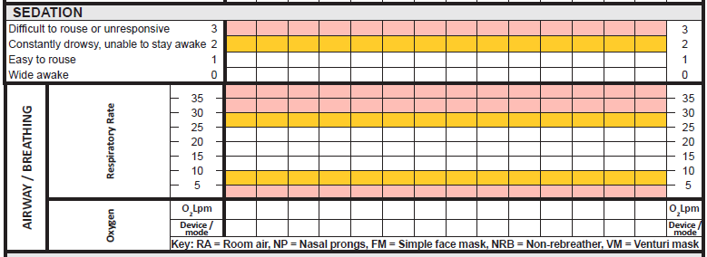
Neuraxial Opioid Single Dose Observation pages
A sedation score or a respiratory rate in the ‘Yellow Zone’ require a Clinical Review by the Acute Pain Service
(or equivalent medical officer)





A sedation score OR a respiratory rate in the ‘Red Zone’ require a Rapid Response to be initiated
AND
contact the Acute Pain Service
(or equivalent medical officer)
2L
2L
2L



NP
NP
NP





2L 6L
RA RA RA
NP FM
Oxygen therapy and
Oxygen device/mode

Slide 14
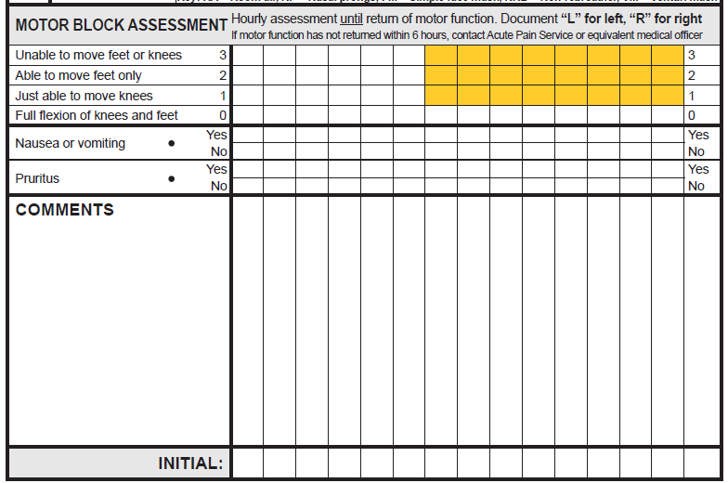
Neuraxial Opioid Single Dose Observation Pages
Motor block assessment
If motor function has not returned within 6 hours, contact the Acute Pain Service or equivalent medical officer
LR LR
LR LR
LR LR







Nausea or vomiting assessment.
Pruritus assessment.





Comments for free text
Ondansetron given PRN
Naloxone given PRN
Assessor’s initial
NH AT AT AT HC HC

Slide 15
The standardisation of this form promotes best practice in pain assessment and management of adverse effects in adult patients who have received morphine via the neuraxial route.
Information related to the NSW Pain Forms can be found on the ACI website:
http://www.aci.health.nsw.gov.au/networks/pain-management/acute-pain-forms
Comments or questions can be forwarded to:
Susan Rogers
Manager Pain Management Network
Agency for Clinical Innovation (ACI)
Phone: 0436611400
Email: ACI-PainManagement@health.nsw.gov.au
Emily Edmonds
Pain Nurses Australia: Director Corporate Governance
CNC Acute Pain Service Blacktown Hospital
Phone: 0427074007
Email: emily.edmonds@health.nsw.gov.au
OR

Slide 16
This presentation was first prepared in 2013-2014 and reviewed in 2017 by the former NSW Pain Interest Group Nursing Issues in association with the ACI Pain Management Network.
A review was undertaken in 2023 by NSW members of Pain Nurses Australia.

Slide 17
Published Jun 2023. Next review 2028. SHPN: (ACI) 230324 ISBN: 978-1-76023-526-0 ACI/D23/817 [ACI_8121] © State of NSW (Agency for Clinical Innovation) CC-ND-BY

