Slide 1
Module 2: Learning and memory
Alcohol and drug Cognitive Enhancement (ACE) Program

Slide 2
Revision
What range of behaviour does a reptile brain allow in response to environmental triggers?
What part of the human brain allows us to think about our behaviour before we act?
What part of the brain is being used during a purely emotional response?
Notes:
What range of behaviour does a reptile brain allow in response to environmental triggers?
[Answer: move towards good and away from bad things.]
What part of the human brain allows us to think about our behaviour before we act?
[Answer: the cortex or frontal lobes.]
What part of the brain is being used during a purely emotional response?
[Answer: limbic system.]

Slide 3
Brainwork
How many of you got your notebook?
If you didn’t, raise your hand so we can give you one.
Notes:
How many of you got your notebook?
If you didn’t, raise your hand so we can give you one.
Today’s module is about learning and memory and there is a lot of valuable information.
Feel free to write things down if you think it will help you to learn them.

Slide 4
Brainwork outcome
Page 37 in workbook
Getting a notebook
Description | Actual outcome | Predicted outcome | Actual minus Predicted
Got the notebook | 3 | 3 | 1
Took an action towards the goal of getting the notebook but did not get it | 2 | 2
Thought about getting the notebook | 1 | 1
Did nothing towards the goal of getting the notebook | 0 | 0
MINUS
The closer to zero, the more accurate your predictions.
Negative number: you overestimated your performance.
Positive number: you underestimated your performance.
Notes:
Circle the number that matches your actual outcome then subtract the predicted outcome from the actual outcome and write down your score where it says ‘Actual minus Predicted’.
[click to animate slide – 3 times]
Would anyone like to share their score and what they think this says about their skill in predicting their own behaviour?

Slide 5
Group agreement
Module 2
Alcohol and Drug Cognitive Enhancement (ACE) Program
Notes:
This is an opportunity to revisit the group agreement (ground rules) that supports learning together.

Slide 6
Session overview
The three types of memory
Automatic
Episodic
Prospective
Learning through practical examples
Notes:
In this session you will learn about the three types of memory (Automatic, Episodic and Prospective).
We will use some practical examples using games. The games are designed to be fun, though some people in the group may find them more challenging than others.

Slide 7
Counting game
Page 4 in workbook
Count the words with the letter ‘A’ in them. Ready?
Notes:
[Ask participants to turn to the counting game worksheet (page 4 of the Workbook)]
We are going to play a game where your job is to count how many times you see a certain thing on the screen.
[click to animate slide]
To help you count, you can make marks on a page, like a tick or line, every time you see the thing I’m going to ask you to count. Record your answers in Game 1.
Any questions?
[click to animate slide]
OK, count the words with the letter ‘A’ in them. Ready?
[The next 20 slides will progress at a rate of one per second, and stop on a blank slide.]

Slide 8
RED

Slide 9
ANGER

Slide 10
FIRE

Slide 11
LIPS

Slide 12
FERRARI

Slide 13
RUBY

Slide 14
SUN

Slide 15
WINE

Slide 16
HOT

Slide 17
WESTPAC

Slide 18
BLUSH

Slide 19
READ

Slide 20
BLOOD

Slide 21
TAPE

Slide 22
CHINA

Slide 23
ROSE

Slide 24
CHILLI

Slide 25
MATCH

Slide 26
RADISH

Slide 27
COMMUNIST

Slide 29
Next counting game
Page 4 in workbook
Living things: count when you see a word for
an actual living thing
part of a living thing
Notes:
Now we’re going to play the same game, except I’m going to ask you to count something different.
[click to animate slide]
This time I’d like you to count how many words represent living things. They can be an actual living thing or part of a living thing.
Record your answers in Game 2.
Any questions? [Address questions.]
[The next 20 slides will progress at a rate of one per second, and stop on a blank slide.]

Slide 30
APPLE

Slide 31
CASTLE

Slide 32
CARROT

Slide 33
BOAT

Slide 34
LION

Slide 35
SINK

Slide 36
FLOWER

Slide 37
MOUTH

Slide 38
SHOE

Slide 39
FISH

Slide 40
AXE

Slide 41
DOG

Slide 42
HAND

Slide 43
BOWL

Slide 44
PAN

Slide 45
POSSUM

Slide 46
CAR

Slide 47
HAMMER

Slide 48
BIRD

Slide 49
JACKET

Slide 51
Scoring
Page 4 in workbook
Count how many marks you made for Game 1 and write this next to ‘Total’
Correct tally = 8 words
Count how many marks you made for Game 2 and write this next to ‘Total’
Correct tally = 10 words
We will return to this later.
Notes:
[click to animate slide] + [read text on slide]
[click to animate slide for answer] - 8 words containing ‘A’
[click to animate slide] + [read text on slide]
[click to animate slide for answer] - 10 are living things (or 5 living things and 5 objects that are part of living things)
[It’s OK to have a debate about this.]

Slide 52
Surprise!
Page 4 in workbook
In the left column of Game 3, write down as many words as you can remember from the first task
Write down all the words you can remember from that list, even the ones without the letter ‘A’.
You will have one minute to do this.
Notes:
Now, it is important that you do this next part by yourself, without speaking to anyone else.
[click to animate slide] - In the left column of Game 3, I want you to write down as many words as you can remember from the first task where you had to count the number of words that contain the letter ‘A’.
[click to animate slide] - Write down all the words you can remember from that list, even the ones that did not contain the letter ‘A’. You will have one minute to do this.
[click to animate slide] + [Start timer for 1 minute.]

Slide 53
Surprise 2!
Page 4 in workbook
In the right column of Game 3, write down as many words as you can remember from the second counting task
Write down all the words you can remember from that list, including words for both living and non-living things.
You will have one minute to do this.
Notes:
[click to animate slide] - Now I’d like you to write down as many words as you can remember from the second counting task, where you had to count the number of living things.
[click to animate slide] - In the right-hand column of Game 3, write down all the words you can remember from that list, including both living and non-living things.
[click to animate slide] - You will have one minute to do this.
[Start timer for one minute.]
[Explain that we will return to this a little later.]

Slide 54
Main types of memory
Automatic
Episodic
Prospective
Notes:
There are at three main types of memory: automatic, episodic and prospective.

Slide 55
Automatic memory
Implicit – you don’t remember the event(s) that created the memory
Because you never consciously processed them
The event may have influenced your preferences or strong dislikes (e.g. to foods)
Anyone have a food they can’t stand? (not an allergy)
Can you remember what made you hate it so much?
May be influenced by exposure without even realising it
Let’s test this!
Notes:
[Some participants may struggle with the introduction of new words and information. Remind participants that the information is included in their Workbooks if they need to read it later]
There are two types of memory that are automatic, in that they do not require conscious effort to create them. These are referred to as implicit and procedural memories.
[click to animate slide]
Implicit memory is when you remember something from a previous experience, even though you’re not necessarily aware that you have that memory.
For example, a two-year-old girl who watched the family pet German shepherd chase or terrorise one of the chickens in the backyard may develop a fear of dogs, even though she cannot actually recall that earlier memory.
[click to animate slide]
It is this type of memory that often leads us to develop particular preferences or strong dislikes of things like foods.
Does anyone have any particular food they cannot stomach? (Not an allergy)
Do you remember the event that caused you to hate this food? (Most will not because they didn’t consciously process the relationship between eating the food and then becoming sick.)
[click to animate slide]
Implicit memory might be influenced by our most recent exposures to those things. Let’s do a quick test of this.

Slide 56
First to mind
Page 4 in workbook
Turn to the Counting Game Worksheet
Write down the first thing that comes to your mind.
You will only have two seconds to write this thing down.
Are you ready?
Notes:
Turn to the Counting Game worksheet on Page 4 of the Participant Workbook and write your answers on the bottom of page 4.
Don’t put any thought into what you are about to write down.
I just want you to write down the first thing that comes to your mind.
You will only have two seconds to write this thing down.
Are you ready?
OK, as quickly as you can, write down the first food that comes to mind. [Wait 2 seconds]
We’ll discuss this in a moment. But before we do, we’re going to try another one.
This time I want you to write this thing down even quicker than the first time. OK, are you ready? I want you to write down the first colour that comes to mind.

Slide 57
First to mind
How many chose blue?
How many chose yellow?
How many chose green?
How many chose red?
Notes:
[Ask about each colour and ask participants to tally responses.]
[More participants should have chosen red.]
Why do you think more of you chose red?

Slide 58
Words from first counting game
Red
Anger
Fire
Lips
Ferrari
Ruby
Sun
Wine
Hot
Westpac
Blush
Read
Blood
Tape
China
Rose
Chilli
Match
Radish
Communist
Notes:
[Explain that it is because every single word from the first list was associated with the colour red in some way. They were probably not aware of this when they did the task.]
[If the majority of participants selected a colour other than red, this may be because there was a dominant colour in the room e.g. blue paint on the walls, blue being a dominant colour in this presentation, etc.]
In these types of memories, learning occurs by creating a connection in the mind between events or responses to events.
For example
If you crave dessert after dinner each night, it is probably because you have associated the end of dinner with the beginning of dessert.
You might have connected using or drinking to a bus route used to score, an area where you meet people in to drink, or a thought or feeling, etc., so you get cravings when on that bus, in that area or having that thought or feeling.
These are examples of implicit memory – remembering something that you encoded automatically without awareness.

Slide 59
Automatic memory
Procedural memory
Develops with practice
e.g. learning to draw or ride a bike
Sometimes referred to as ‘muscle memory’
Learning relies on ‘doing’, rather than ‘thinking’
A lot of effort at first but then becomes second nature
e.g. learning to drive
Notes:
Procedural memory refers to skill learning, like learning to draw or ride a bike.
This is sometimes referred to as ‘muscle memory’ because your memory of how to do those things doesn’t rely on you thinking about doing them, but more on just doing them. At first, forming this type of memory takes a lot of effort, but with more and more practice, it becomes second nature.

Slide 60
Episodic memory
Remembering episodes or events from your PAST
Involves 3 processes:
Encoding = creating a new memory
Storage = keeping a memory over time
Retrieval = finding the right memory at the right time
Notes:
[click to animate slide]
This is all about remembering episodes from your past (e.g. events, conversations, experiences, etc).
[click to animate slide – 3 times]
In order to do this, you need to create a memory (encoding), store it (storage), and then find it again (retrieval).
Encoding, Storage and Retrieval are the three different elements that make up Episodic memory.

Slide 61
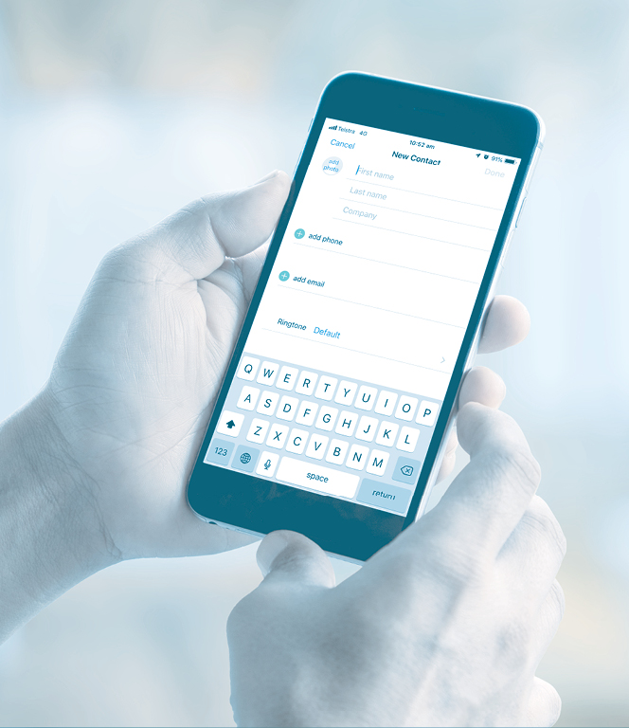
Encoding
Encoding
Notes:
Encoding is the process of creating (saving) a new memory. When you are learning something new, if you remember that thing for longer than a few minutes, then some encoding has occurred.
Encoding is one of the most important stages of memory, because, if you don’t encode information, there will be nothing there to ‘remember’ in the future.
Encoding is like putting money in the bank or putting a piece of paper in a filing cabinet. If you do either of those things properly, you will make sure that the money gets into your account at the bank or that the piece of paper is filed in the right order in the filing cabinet.
It is also like putting a new contact in your phone. If you enter the name with the right spelling, you will be able to find that contact easily in the future.
Encoding represents the ‘learning’ part of episodic memory. This type of learning requires attention and a lot of effort.

Slide 62
Storage
Encoding
Notes:
Storage refers to how well the information is kept over time. So, if it is a reputable bank that you put your money into, you would expect it to still be there after many years.
If your mobile phone is working properly, you would expect your contact list to remain unchanged
And if your filing cabinet is locked and no-one else has access to it, you would expect your papers to remain filed in the right order, just as you had filed them to start with.

Slide 63
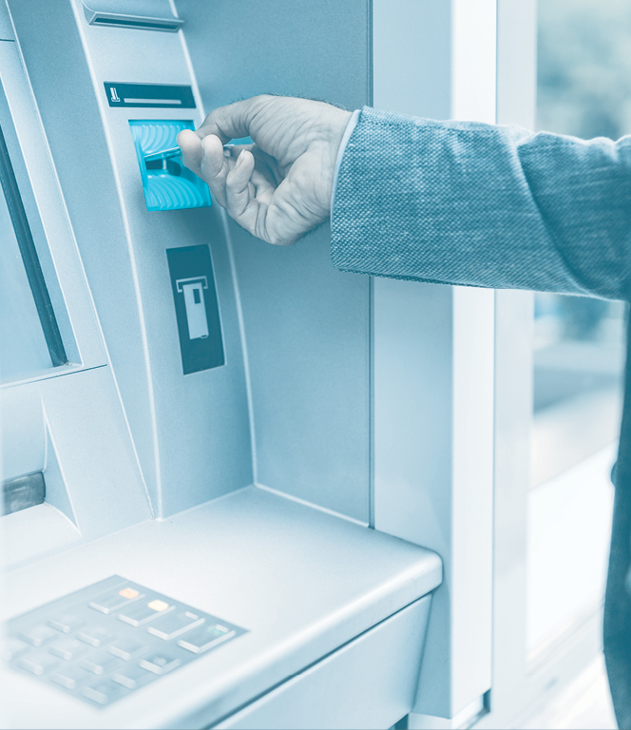
Retrieval
Encoding
Notes:
In many ways, retrieval is the most important part of memory, because encoding and storage are no good to you if you can’t find the right information at the right time. An example of when retrieval malfunctions is a tip-of-the-tongue moment.
Has anyone experienced that? Well, that is a classic retrieval failure.
Retrieval is like going to the ATM to withdraw money, looking up the person you want to talk to in your contacts list on your mobile phone or opening up your filing cabinet to get a document.
Even though the information might be in there, if you didn’t enter it correctly to start with (e.g. put money into the wrong account, misfiled the document, or spelt the name of the person incorrectly), it will be very difficult for you to find that information when you need it.

Slide 64
Prospective memory
All about remembering what you intend to do in the FUTURE
E.g. ‘I must remember to get milk on my way home’
‘I must pick up that notebook’
Notes:
The third type of memory is prospective memory.
Prospective memory is when you want to remember to do something in the future.
It is about the ‘prospect’ of doing something. Another way of thinking about it is it is remembering to remember. For example, remembering to buy milk on the way home, or remembering to pick up a notebook!

Slide 65
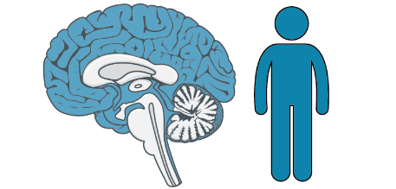
Past, present and future
Past
Present
Subconscious experiences
Skill practice
Subconscious responses
Skills
Automatic memory
Conscious experiences (Episodes)
Conscious memories
Episodic memory
Future
Conscious intentions
Future behaviour
Prospective memory
Notes:
[click to animate slide]
If you are having an subconscious response (for example, having a food aversion without remembering the experience that created that aversion) or using a skill in the present (like riding a bike), you likely do so because you automatically learned the skill through practice or had an subconscious experience in the past. You are using your automatic memory.
[click to animate slide]
If you are consciously recalling something from your past (for example, remembering what you did last weekend), you are using episodic memory.
[click to animate slide]
And if you are intending to do something in the future (for example, remembering to pick up a notebook!), you are using prospective memory.
[click to animate slide]
It is mainly the limbic system that is involved in automatic and episodic memory and the frontal lobe that is involved in prospective memory.

Slide 66
How did I remember that?
How many words did you recall from part 1 (to do with ‘A’ words) of the counting game?
How many words did you recall from part 2 (to do with living things) of the counting game?
Why this result?
Notes:
Turn back to the counting game worksheet on page 4 in your Participant Workbook.
Let’s now look at the results of the memory test you didn’t know was a memory test.
[click to animate slide]
[Ask if anyone remembered the same number of ‘A’ words and ‘living things’. Then ask how many people remembered more ‘A’ words than ‘living things’. Explain that on average, people will have remembered more words from the ‘living things’ list.]
[Ask participants why they think they achieved that result.]

Slide 67
Expansion strategies
It’s all about processing information at a deeper level
Link the information to what you already know
Think about how this information came about
Ask yourself as many questions as you can about the information
Simply spend time thinking about it
Explain it to someone else but in your own words
The best way to learn is to teach
Notes:
(TIP: Expansion strategies are types of strategies to improve memory, noting that Memory Strategies will also be addressed in Module 3)
The reason that as a group you remembered more words from that list is you processed the information at a deeper level.
This is why we always remember things that are meaningful to us. So, if you want to remember something that someone has told you or information you have come across, spend some time thinking about this at as deep a level as possible.
You can do this by:
linking the information to what you already know
thinking about how this information came about (e.g. ‘how do we know this?’)
asking yourself as many questions as you can about the information (what, who, why, where, when and how?)
simply spending time thinking about it. The more time you spend thinking about it, the stronger the memory will be.
explaining it to someone else in your own words (paraphrase), as they say: ‘The best way to learn is to teach’.
[Use this guided example if the group requires further information to understand the Expansion strategies]
Linking the information to what you already know
[EXAMPLE: Well, I know that driving is automatic. I don't have to think about driving and I can still do it. If episodic memory is about episodes from my past, then I can think about the episode of this year versus the episode of last year - that will help me remember what 'episodic' means. And prospective memory is about the future. This sounds to me like 'prospecting', which is when people look for gold or other valuable material - because they want to find it in the future.]
Thinking about how this information came about (e.g. ‘how do we know this?’)
[EXAMPLE: I'm not sure how we know about these different types of memory. I imagine people have researched it in the past. Maybe I can look it up when I have time.]
Asking yourself as many questions as you can about the information (what, who, why, where, when and how?)
[EXAMPLE: I wonder who did the research to discover these different types of memory? Why would we have these different types of memory? I suppose it's helpful to automatically remember some things. And it's important to remember to do things in the future. I wonder how the brain actually causes these types of memory to occur.]
Simply spending time thinking about it. The more time you spend thinking about it, the stronger the memory will be.
[EXAMPLE: I'm going to try to be more aware of when I'm using my automatic, episodic and prospective memory for the next week. When other use those types of memory, I'll point it out to them.]
Explaining it to someone else in your own words (paraphrase), as they say: ‘The best way to learn is to teach’.

Slide 68
Brainwork prediction
Pages 3 and 37 in workbook
Apply expansion strategies
Description | Actual outcome | Predicted outcome | Actual minus Predicted
Used four or more expansion strategies | 3 | 3
Used three expansion strategies | 2 | 2
Used two expansion strategies | 1 | 1
Used one or no expansion strategies | 0 | 0
The closer to zero, the more accurate your predictions.
Negative number: you overestimated your performance.
Positive number: you underestimated your performance.
Notes:
Record the date next to the assigned brainwork task.
Today’s brainwork task is ‘Apply expansion strategies’, so go ahead and put today’s date next to that task. Practice the expansion strategies (from page 3 of Participant Workbook) by applying them to the information learnt in today’s session.
Then circle 3, 2, 1, or 0 depending on how much of the brainwork you think you will complete.
In the next session, you will be asked to honestly then circle how much of your brainwork you actually completed. Then you are to simply subtract actual from predicted brainwork completion to obtain a score ranging between -3 and +3.
Predict how much of the brainwork you think you will complete and write this down now.

Slide 69
End of Module 2
July 2020

Slide 70
Copyright
This presentation is for use as part of the Alcohol and Drug Cognitive Enhancement (ACE) Program. No part may be copied or used for any other purpose without permission from the NSW Agency for Clinical Innovation. Contact via https://www.aci.health.nsw.gov.au/
The examples may be amended to suit local conditions.

Slide 71
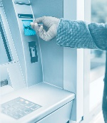
Image credits
Shutterstock.com
Published Mar 2018. Next Review 2028. © State of NSW (Agency for Clinical Innovation) and Advanced Neuropsychological Treatment Services

