Slide 1
Epidural Analgesia (non obstetric) form
ADULT
NSW Pain Form
June 2023
Emily Edmonds | Co-ordinator NSW Pain Forms, CNC Acute Pain Service Blacktown Hospital

Slide 4
Epidural Analgesia (non obstetric) form - adult
The Epidural Analgesia prescription and observation form for adult patients has been developed in NSW by a team of experts in the field of acute pain including clinical nurse consultants, anaesthetists and pharmacy representatives.
The Epidural Analgesia form is not suitable for use in paediatric patients.
Standardisation of this chart promotes best practice in prescribing, pain assessment and management of adverse effects in those patients receiving Epidural Analgesia via an infusion modality.

Slide 5
Aim of this presentation
This presentation aims to explain:
  how to use the form for prescribing an epidural infusion
  how to record the administration and discard of drugs used for an epidural infusion
  how to complete the clinical observations
  guidelines on the management of patients receiving an epidural infusion including the management of adverse effects.

Slide 6
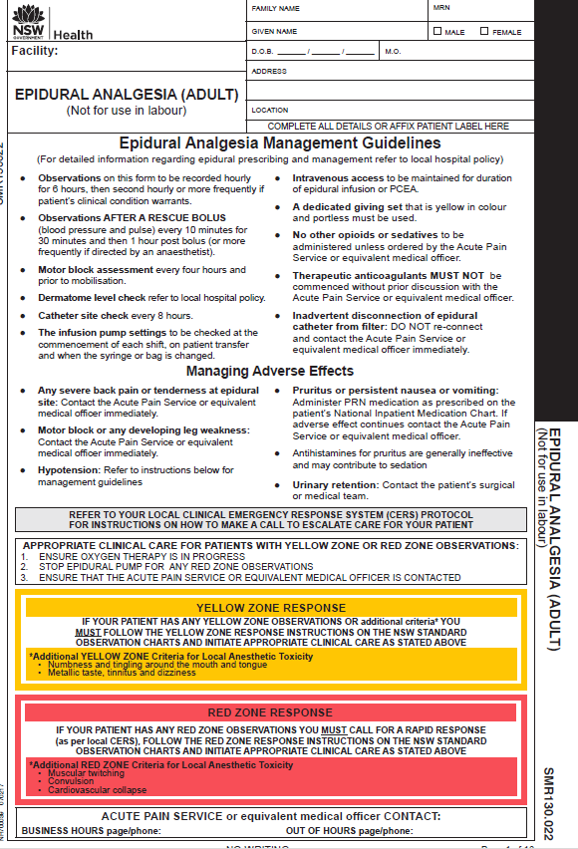
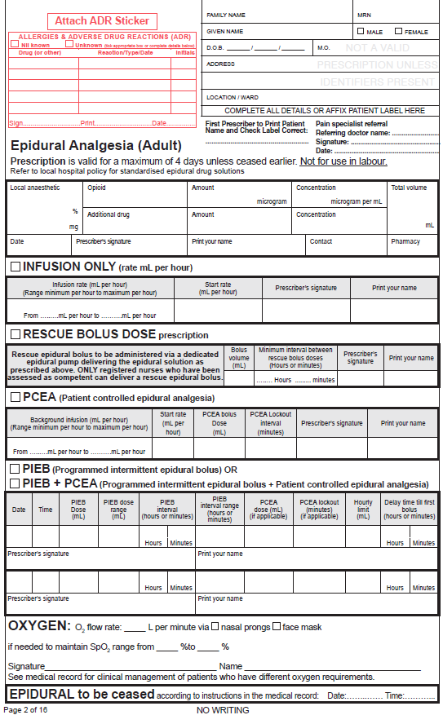
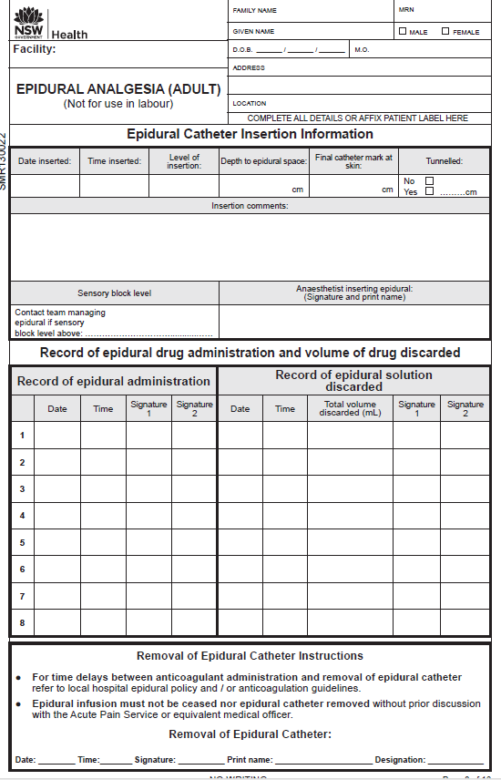
Booklet format
Prescription valid for 4 days | Observation pages for 4 days
Epidural Analgesia form – adult
Page 1
Page 2
Page 3
Page 1
Management guidelines
Yellow and Red Zone response instructions
Page 2
Epidural prescription,
programs, oxygen prescription, epidural ceased
Page 3
Epidural drug administration, drug discard, removal of epidural catheter

Slide 7
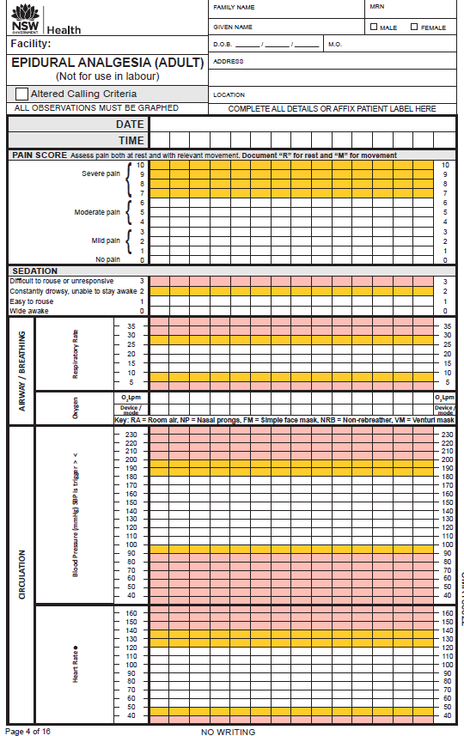
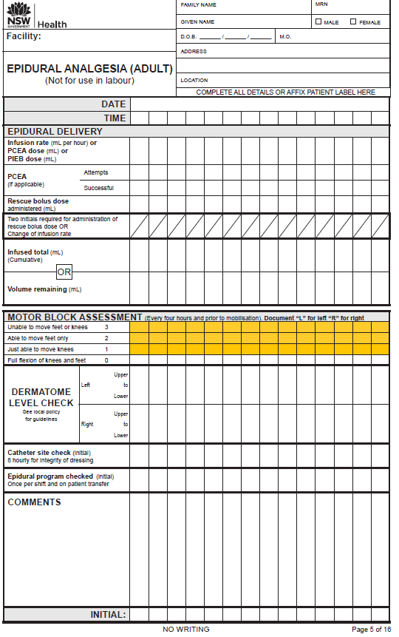
Epidural Analgesia
form – adult:
observation pages
for up to 4 days

Slide 8
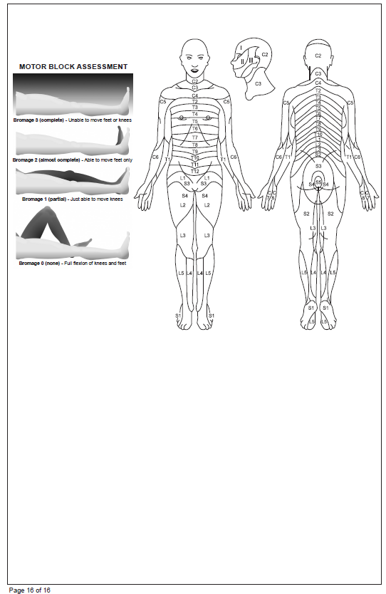
Epidural Analgesia
form – adult
Motor Block Assessment (Bromage score)
Dermatome diagram
Back page

Slide 9
Epidural Analgesia
form – adult
For detailed information regarding epidural prescribing and management refer to local hospital epidural policy or procedure
Managing adverse effects
Yellow and Red Zone
response instructions

Slide 10
Patient label and allergy
adverse reactions
Epidural Analgesia form – adult:
Prescription
Program prescription options:
infusion only
Rescue bolus dose
PCEA (patient controlled epidural bolus)
PIEB (programmed intermittent epidural bolus)
PIEB+PCEA.
Private patients:
pain specialist referral for Medicare billing purposes. referral from the referring doctor (name), signature and date
Page 2
Epidural prescription
Oxygen prescription
CEASE epidural

Slide 11
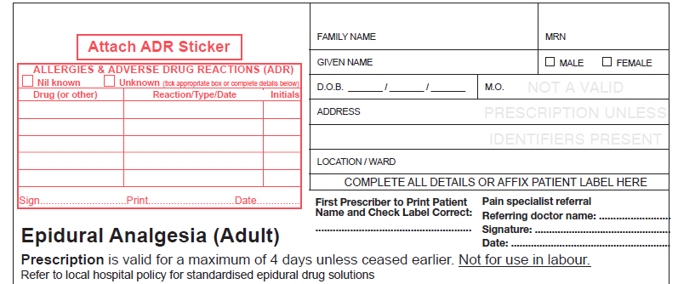
Epidural prescription
Handwrite patient details
OR affix patient label
(First prescriber to check
patient label is correct)
Prescriber to complete patient allergy and ADR section in full
Private patients:
For Medicare billing purposes a pain specialist referral from the referring doctor (name), signature and date
TSmith
SMITH
4/4/17

Slide 12
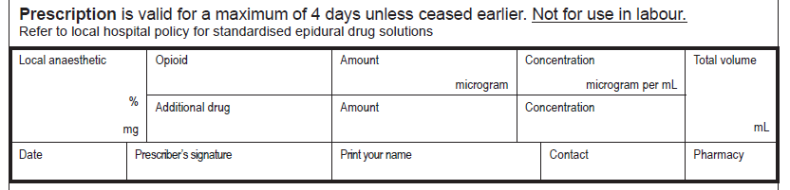
Epidural prescription to include: local anaesthetic, opioid, amount, concentration, total volume
Below is an EXAMPLE epidural prescription.
Refer to hospital epidural policy for local guidelines on epidural analgesia prescribing.
Epidural prescription
Fentanyl
2
400
Ropivacaine 0.2
200 mL
NIL
4/4/17
TSmith
SMITH
7511
Prescriber’s signature,
printed name and contact
Space is provided for an additional drug to be added if needed
Space provided for pharmacist reconciliation

Slide 13
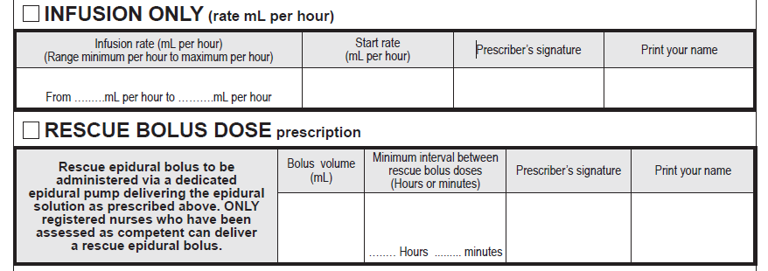
Below is an EXAMPLE for an INFUSION ONLY program and a RESCUE BOLUS DOSE for administration
by a registered nurse.
Refer to hospital epidural policy for local guidelines
on epidural program prescribing.
Epidural program options

5
10
5 mL
TSmith
SMITH

2
TSmith
SMITH
5 mL
✶

Slide 14
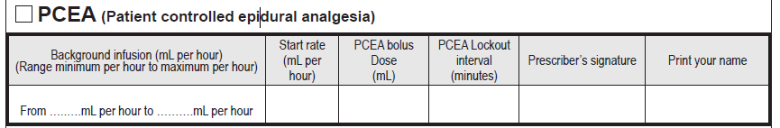
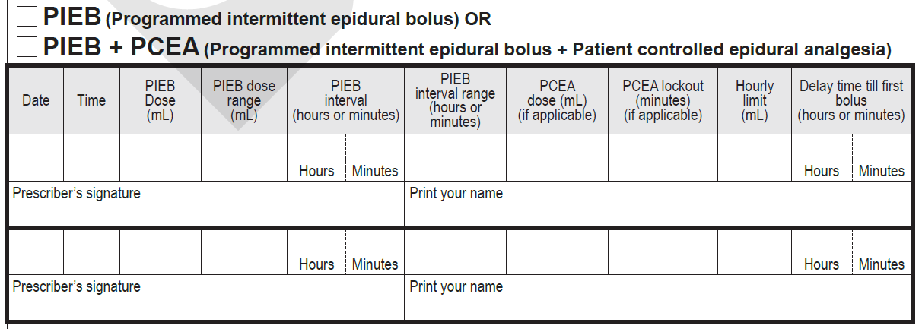
Below is an EXAMPLE for a PIEB program.
Refer to hospital epidural policy for local guidelines on epidural program prescribing.
Epidural program options

4/4/17 5 mL 5mL
5 – 7mL 1 -
- - 20mL - 30
20 minutes
to 1 hour
TSmith
SMITH

Slide 15
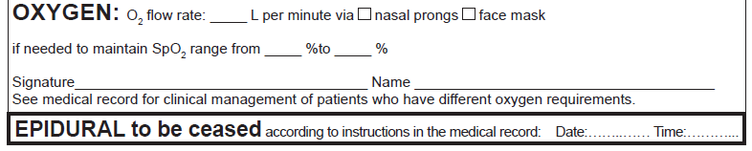
Oxygen order and cessation of epidural
Oxygen prescription flow rate via nasal prongs or face mask and Sp02 range
2

92 96
PSmith SMITH
CEASE EPIDURAL instruction

Slide 16
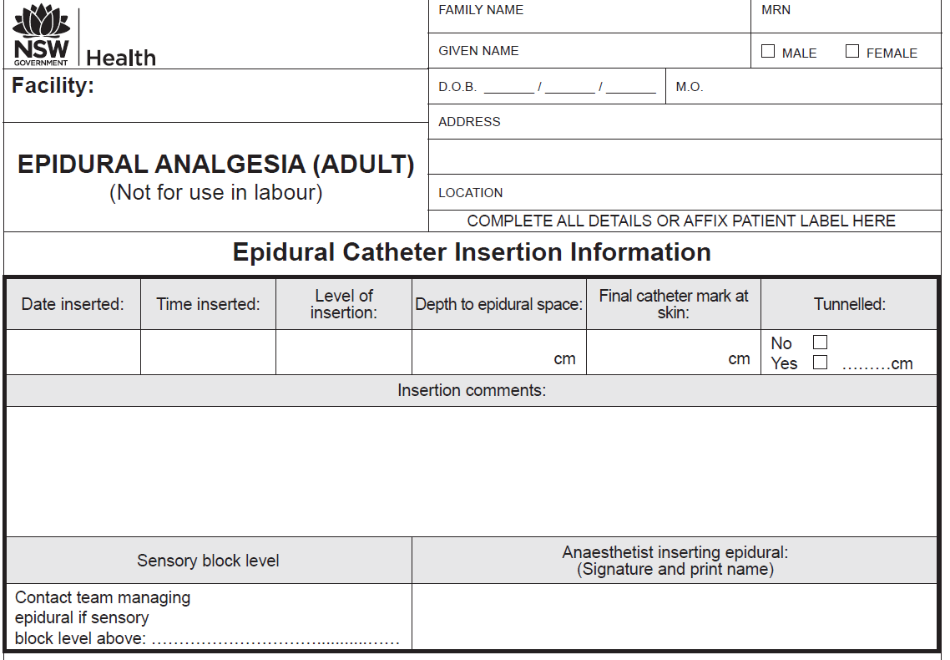
Insertion details
Where an epidural is placed during theatre, documentation of insertion details may be viewed on the anaesthetic chart

4/4/17 10:00 T6/7 3 7
Patient sitting, Asepsis throughout,
first pass. See anaesthetic chart for further details
Tsmith SMITH

Slide 17
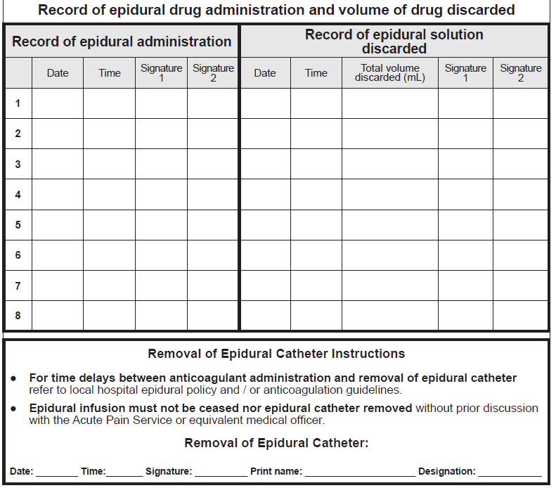
Administration and discard of epidural solution
4/4/17
10:00
THall
SRose
4/4/17
23:00
5
BLoh
JLucas
4/4/17
23:00
BLoh
JLucas
5/4/17
09:00
50 mL
Plamb
TBuck
Discard of any remaining epidural solution
Page 3
Epidural commenced
Removal of epidural catheter
5/4/17 11:00 PLamb LAMB RN

Slide 18
Observation pages
The Epidural chart provides observations for a maximum of 4 days.
If the epidural continues beyond 4 days, a new epidural chart must be started and a new prescription written.
Observation pages

Slide 19
Observation part 1
(left side of chart)
Pain score
Sedation score and
respiratory rate
Oxygen therapy and oxygen device mode
Blood pressure and
heart rate

Slide 20
Epidural delivery
(complete applicable sections only)
Infusion rate
PIEB
PCEA
Rescue bolus dose
Two initials for administration of rescue bolus dose
Infused total OR Volume remaining
Observations part 2
(right side of chart)
Motor block assessment
Dermatome level check (see local policy for guidelines)
Catheter site check
(8 hourly for integrity of dressing)
Epidural program check
(once per shift and on patient transfer)
Assessor’s initial

Slide 21
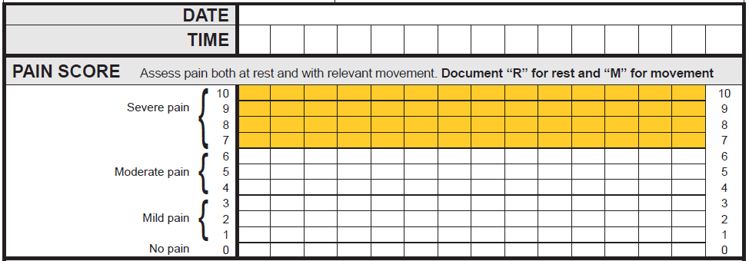
Documenting observations Pain Assessment
‘R’ for rest ‘M’ for movement
Where a patient scores their pain 7 or above (in the Yellow Zone), the nurse must assess the current clinical pain management plan for the patient.
For example:
Have pain scores previously been in the White Zone (0 to 6)?
Has the epidural been dislodged or fallen out?
Can the epidural infusion rate be altered?
Has the patient been reviewed by the Acute Pain Service or equivalent medical officer?
The assessing nurse may need to consult with the NURSE IN CHARGE to decide whether a CLINICAL REVIEW (or other CERS – Clinical Emergency Response) call should be made.
05/10/14
1100
1200
1300
1400
1500
M
M
M
M
M
R
R
R
R
R

Slide 22
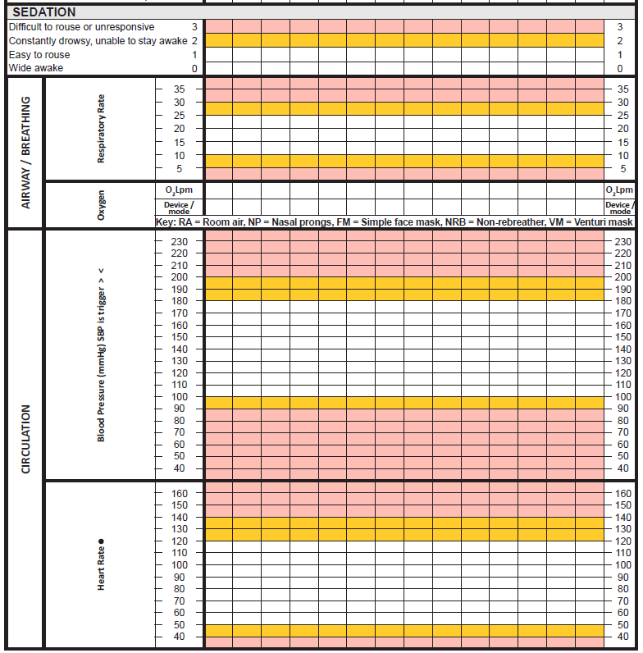
• • •
•
Observations in the ‘Yellow Zone’ require
a Clinical Review
by the
Acute Pain Service (or equivalent
medical officer)
•
• • •
2L 2L 2L 2L
Documenting observations:
Sedation,
respiratory rate, oxygen therapy,
blood pressure and heart rate
NP NP NP NP
Observations in the ‘Red Zone’ require
a Rapid Response
to be initiated
AND
contact the Acute Pain Service
(or equivalent
medical officer)








•
•
•
•

Slide 23
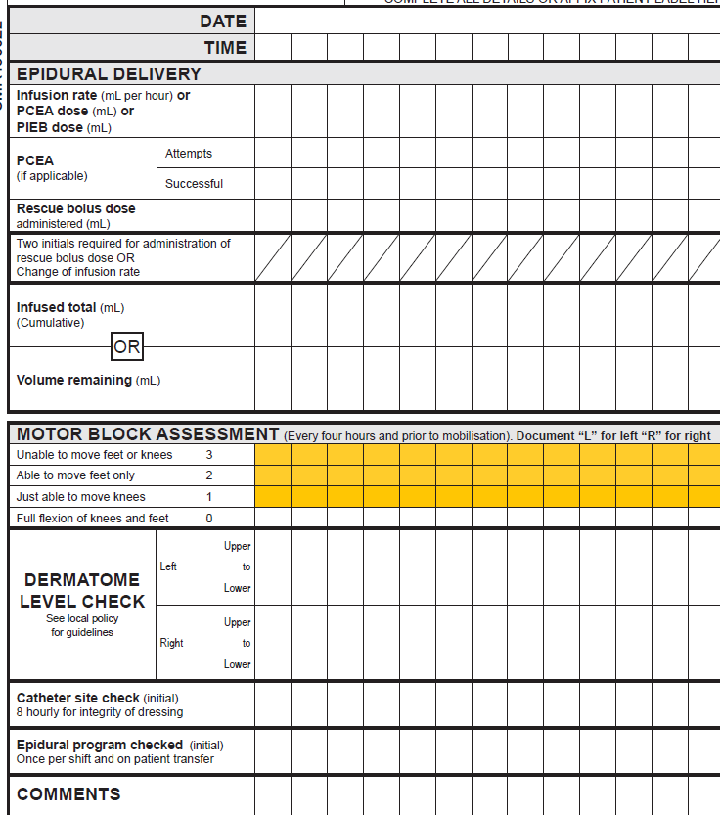

4/4/17
0900
1200
1400
1500
1000
1100
1300
Documenting observations
5 5 5 7 7 7 7
5
Epidural delivery
Infusion rate (mL/hr)
PCEA (if applicable)
Rescue bolus dose (if applicable)
Two initials for administration of rescue bolus dose
Infused total (cumulative) OR Volume remaining
ES
TG
10 20 27 34 41 48
L L
LR LR LR LR LR
Dermatome level check
Check hospital policy for assessment requirements of dermatome level check
R R
T9 – T12
T9 – T12
Catheter site check
Epidural program check
ES
ES
ES
BT
APS notified about leg weakness
ES
BT

Slide 24
The next four slides detail:
Epidural Analgesia Management Guidelines (on the front page)
Yellow and Red Zone instructions (on the back page)
Motor block assessment and dermatome diagram (on the back page)

Slide 25
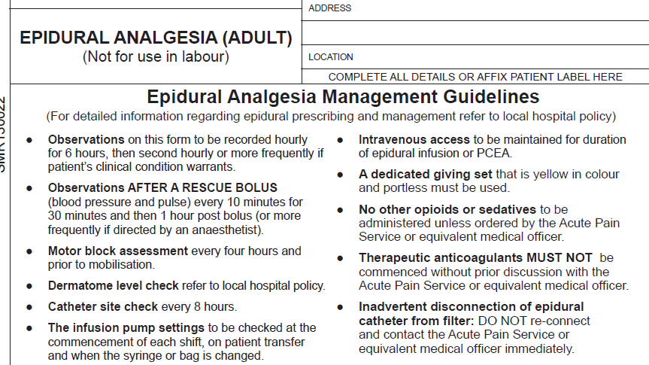

Slide 26
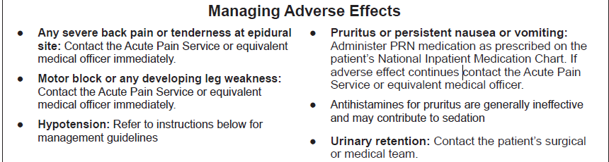

Slide 27
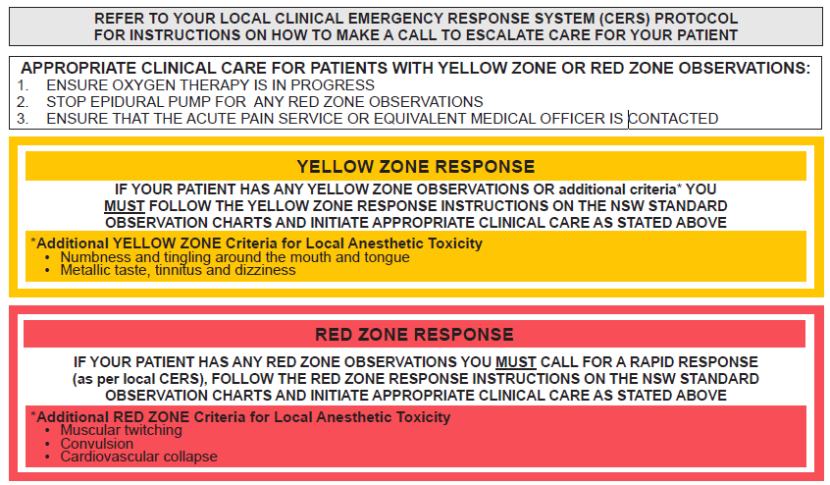

Slide 29
The standardisation of this form promotes best practice in prescribing, pain assessment and management of adverse effects in those patients receiving epidural analgesia via an infusion modality.
Information related to the NSW Pain Forms can be found on the ACI website:
http://www.aci.health.nsw.gov.au/networks/pain-management/acute-pain-forms
Comments or questions can be forwarded to:
Susan Rogers
Manager Pain Management Network
Agency for Clinical Innovation (ACI)
Phone: 0436611400
Email: ACI-PainManagement@health.nsw.gov.au
Emily Edmonds
Pain Nurses Australia: Director Corporate Governance
CNC Acute Pain Service Blacktown Hospital
Phone: 0427074007
Email: emily.edmonds@health.nsw.gov.au
OR

Slide 30


This presentation was first prepared in 2014 and reviewed in 2017 by the former NSW Pain Interest Group Nursing Issues in association with the ACI Pain Management Network.
A review was undertaken in 2023 by NSW members of Pain Nurses Australia.

Slide 31
Published Jun 2023. Next review 2028.
SHPN: (ACI) 230326 ISBN: 978-1-76023-528-4
ACI/D23/819 [ACI_8121]
© State of NSW (Agency for Clinical Innovation) CC-ND-BY

