Slide 1
Peripheral Nerve Infusion Form ADULT
NSW Pain Form
June 2023
Emily Edmonds | Co-ordinator NSW Pain Forms, CNC Acute Pain Service Blacktown Hospital

Slide 4
Peripheral Nerve Infusion NSW Form – adult
The Peripheral Nerve Infusion Prescription and Observation form for adult patients has been developed in NSW by a team of experts in the field of acute pain including clinical nurse consultants, anaesthetists and pharmacy representatives.
The Peripheral Nerve Infusion Form (adult) is not suitable for paediatric patients.
Standardisation of this form promotes best practice in prescribing, pain assessment and management of adverse effects in those patients who are receiving local anaesthetic via an infusion modality for pain management.

Slide 5
Aim of this presentation
This presentation aims to explain:
how to use the form for prescribing a peripheral nerve infusion
how to record the administration of local anaesthetic drugs used for a peripheral nerve infusion.
how to complete the clinical observations
guidelines on the management of patients who are receiving a continuous local anaesthetic infusion including the management of adverse effects.

Slide 6
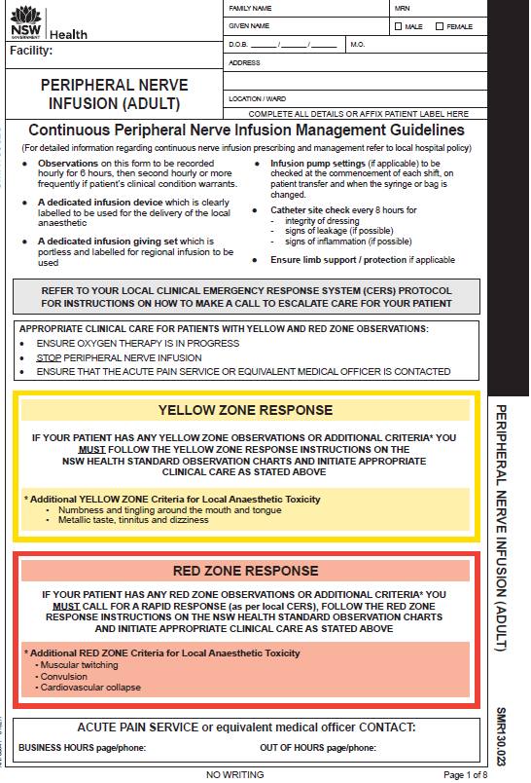
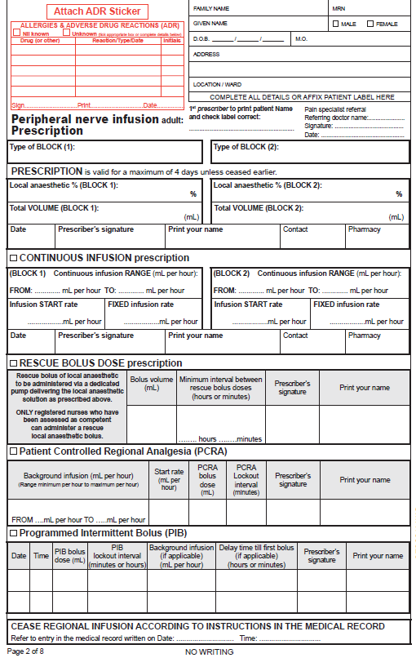
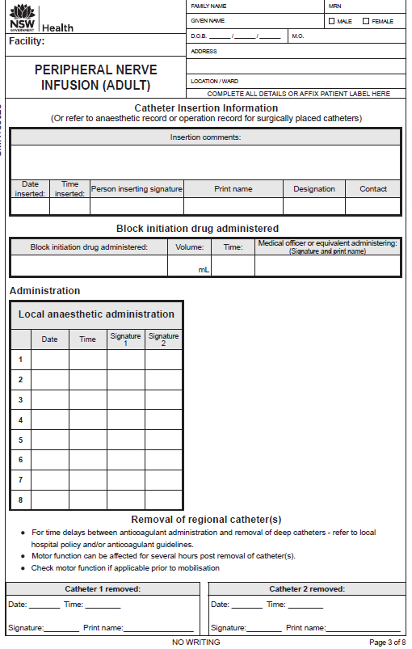
Peripheral Nerve Infusion for adults
Page 2
Page 3
Page 1
Page 1 Management guidelines Yellow and Red Zone response instructions
Page 2 Prescription, programs, cessation of regional infusion
Page 3 Catheter insertion details Local anaesthetic administration, removal of catheters

Slide 7
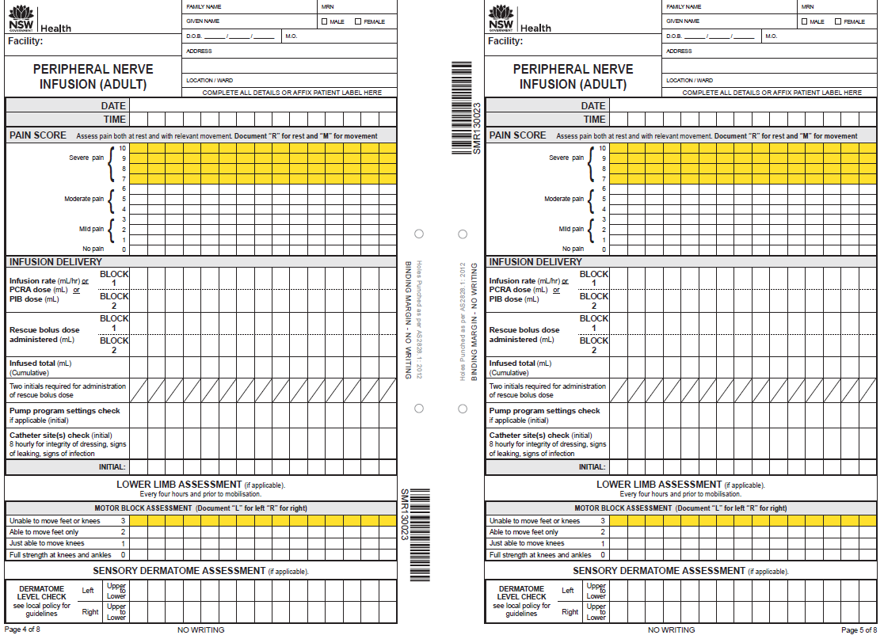
Peripheral Nerve Infusion form – adult
Observation pages:
for up to 4 days

Slide 8
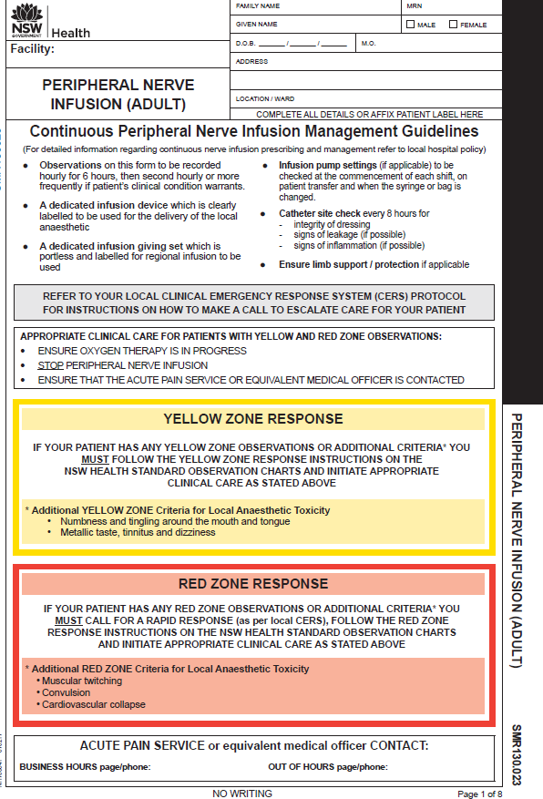
Front page
For detailed information regarding the management of Continuous Peripheral Nerve Infusions refer to local hospital policy or procedure
Instructions for managing patients whose observations are in the Yellow or Red Zone
including additional criteria related to local anaesthetic toxicity
Space provided for the contact details of your Acute Pain Service or equivalent medical officer

Slide 9
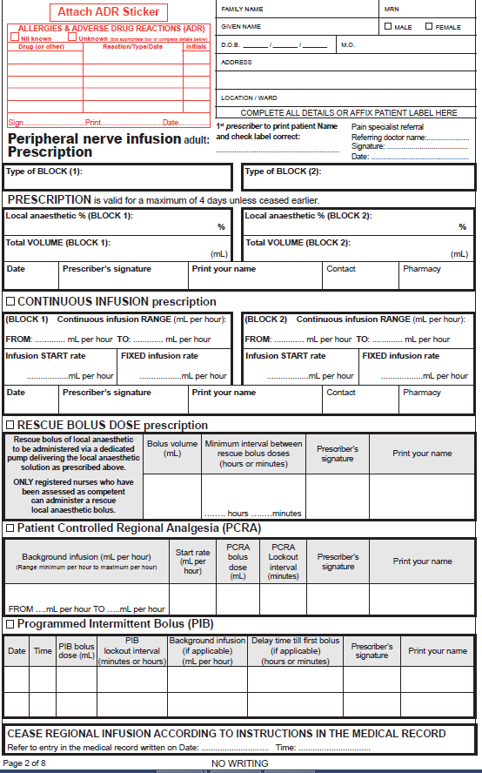
Patient label and allergy adverse reactions
Prescription page
Private patients: pain specialist referral, for Medicare billing purposes, referring doctor (name), signature and date
Program prescription options:
continuous infusion
rescue bolus dose
PCRA (patient controlled regional analgesia)
PIB (programmed intermittent bolus).
Type of block and local anaesthetic prescription
Page 2
Cease regional infusion instructions

Slide 10
Peripheral nerve infusion prescription
Handwrite patient details OR affix patient label
(First prescriber to check patient label is correct)
Prescriber to complete patient allergy and ADR section in full
Private patients:
For Medicare billing purposes a pain specialist referral from the referring doctor (name), signature and date
PSmith
SMITH
3/3/15
TSmith SMITH 4/4/17

Slide 11
Below is an EXAMPLE prescription.
Refer to hospital policy for local guidelines on prescribing local anaesthetic for peripheral nerve infusions.
Local anaesthetic prescription
Type of block
Fascia iliaca
Ropivacaine 0.2 %
200
4/4/17 TSmith SMITH 7511
Peripheral nerve infusion prescription to include:
local anaesthetic, total volume, date, prescriber’s signature and printed name, contact
Space provided for pharmacist reconciliation

Slide 12
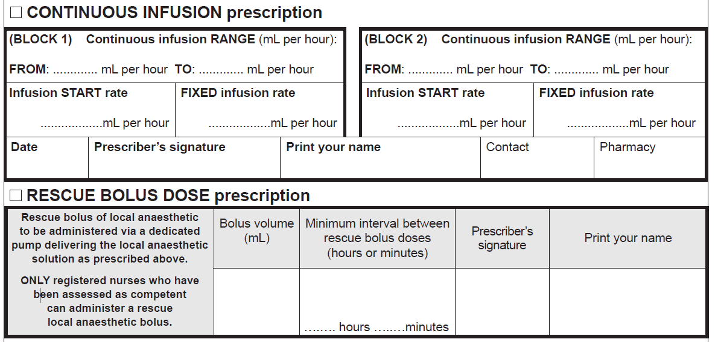
Below is an EXAMPLE for a CONTINUOUS INFUSION program and a RESCUE BOLUS DOSE for administration by a registered nurse.
Refer to hospital policy for local guidelines on peripheral nerve infusion program prescribing.
Program options

5
10
5
4/4/17 TSmith SMITH 7511

5 mL
5 mL
2 - Smith SMITH

Slide 13
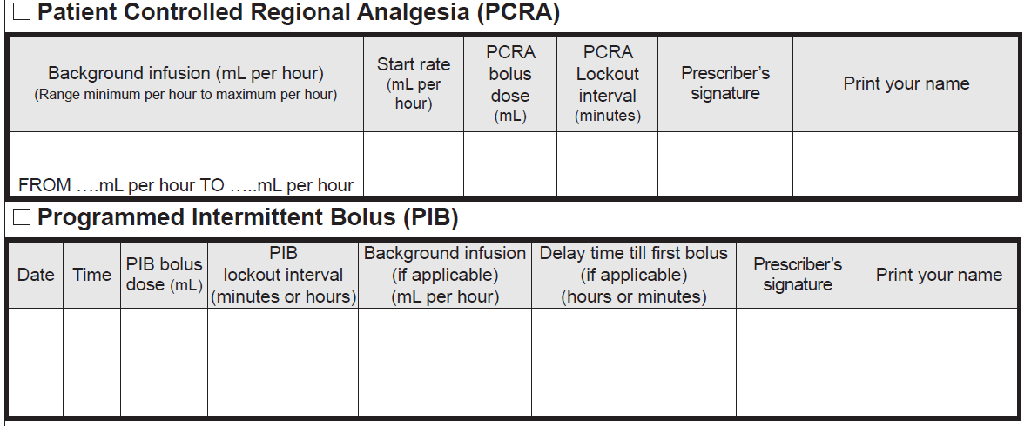
Below is an EXAMPLE for a PCRA (patient controlled regional analgesia program).
Refer to hospital policy for local guidelines on peripheral nerve infusion program prescribing.
Program options

5 8 5 mL 5mL 30 mins TSmith SMITH

Slide 14
Below is an EXAMPLE for a PIB (programmed intermittent bolus program).
Refer to hospital policy for local guidelines on peripheral nerve infusion program prescribing.
Program options

4/4/17 1000 5 4 hours nil 4 TSmith SMITH

Slide 15
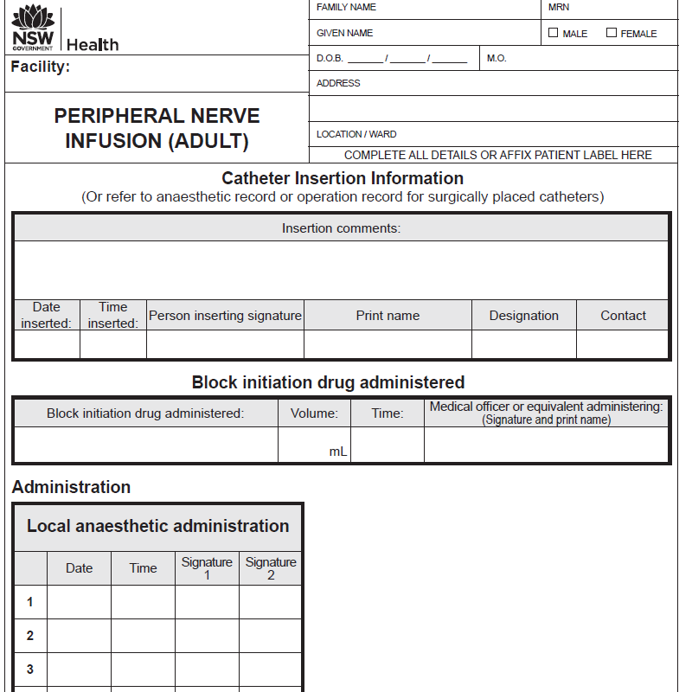
Catheter insertion details
Catheter insertion information:
If a catheter was placed during surgery, insertion details may be recorded on the operation or anaesthetic record
Fascia iliaca block. Asepsis throughout. Ultrasound guidance used. 5mL 1% lignocaine to skin. Planes identified, catheter passed easily
4/4/17 10:00 TSmith SMITH Anaesthetist 7511
Ropivacine 0.375% 40 10:00 TSmith (SMITH)
Local anaesthetic infusion commenced
Page 3
4/4/17 10:30 THall SRose

Slide 16
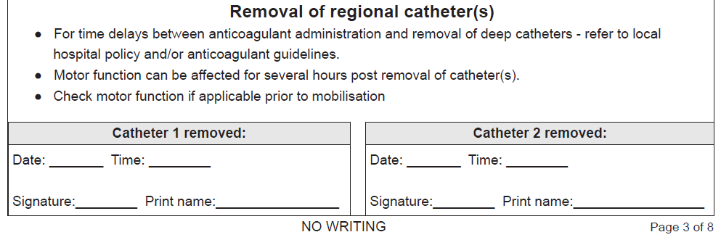
Removal of regional catheter(s)
5/4/17 10:00
SRose ROSE

Slide 17
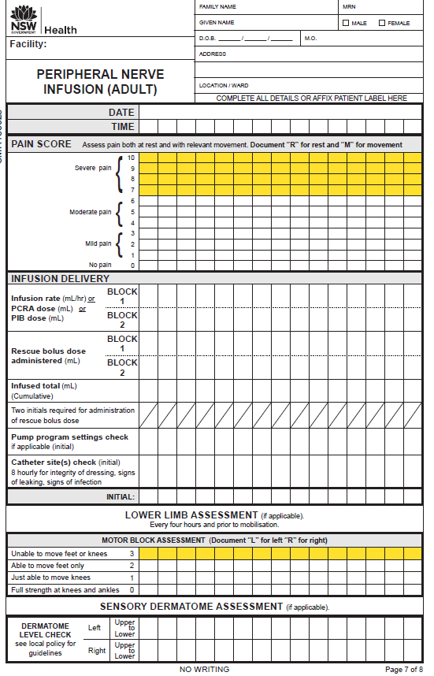
Observation pages
Pain score
The Peripheral Nerve Infusion form provides observations for a maximum of 4 days.
If the infusion continues beyond 4 days, a new chart must be started and a new prescription written.
Infusion delivery
Pump program settings check
catheter site(s) check
Motor block assessment (if applicable)
Sensory dermatome assessment (if applicable)

Slide 18
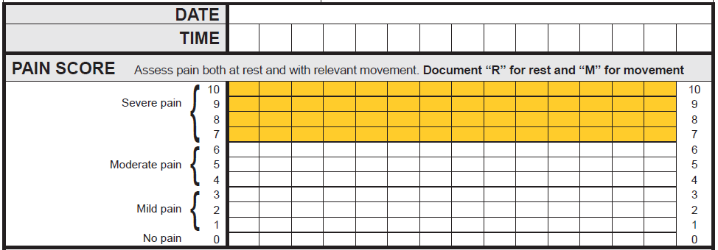
Documenting observations: Pain Assessment ‘R’ for rest ‘M’ for movement
Where a patient scores their pain 7 or above (in the Yellow Zone), the nurse must assess the current clinical pain management plan for the patient. For example:
Have pain scores previously been in the White Zone (0 to 6)?
Have additional prescribed analgesics been administered?
Has the patient been reviewed by the Acute Pain Service or equivalent medical officer?
The assessing nurse may need to consult with the NURSE IN CHARGE to decide whether a CLINICAL REVIEW (or other CERS – Clinical Emergency Response) call should be made.
04/4/17
1100
1200
1300
1400
1500
M
M
M
M
M
R
R
R
R
R

Slide 19
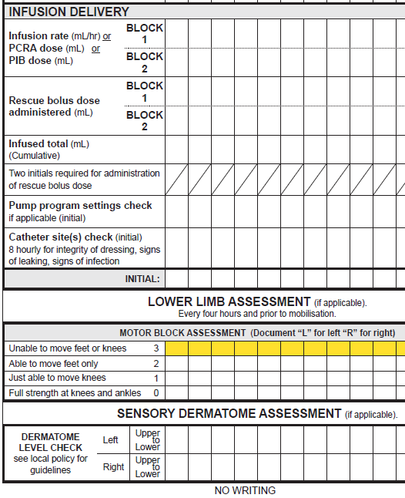
Infusion delivery
Infusion rate, PCRA or PIB dose
Rescue bolus dose
Infused total
Two initials for administration of bolus dose
Observations
5 5 5 7 7 7 7 7 7
5
ES
SH
ES
TS
Pump program settings check
Catheter site(s) check
ES
TS
ES
ES
TS
ES
ES
Lower limb assessment (if applicable)
LR LR LR LR LR
Dermatome assessment (if applicable)

Slide 20
The next slide details:
Peripheral Nerve Infusion Management Guidelines
Yellow and Red Zone response including additional criteria for local anaesthetic toxicity

Slide 21
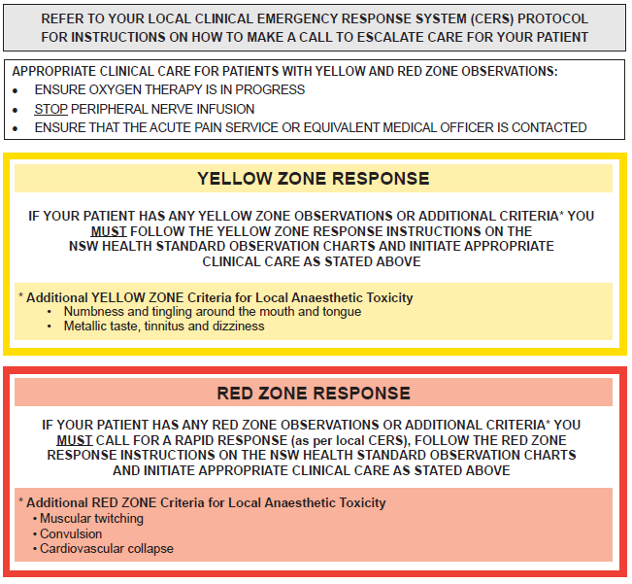

Slide 22
The standardisation of this form promotes best practice in pain assessment and management of adverse effects in adult patients receiving a peripheral nerve infusion.
Information related to the NSW Pain Forms can be found on the ACI website:
http://www.aci.health.nsw.gov.au/networks/pain-management/acute-pain-forms
Comments or questions can be forwarded to:
Susan Rogers
Manager Pain Management Network
Agency for Clinical Innovation (ACI)
Phone: 0436611400
Email: ACI-PainManagement@health.nsw.gov.au
Emily Edmonds
Pain Nurses Australia: Director Corporate Governance
CNC Acute Pain Service Blacktown Hospital
Phone: 0427074007
Email: emily.edmonds@health.nsw.gov.au
OR

Slide 23
This presentation was first prepared in 2015 and reviewed in 2017 by the former NSW Pain Interest Group Nursing Issues in association with the ACI Pain Management Network.
A review was undertaken in 2023 by NSW members of Pain Nurses Australia.

Slide 24
Published Jun 2023. Next review 2028.
SHPN: (ACI) 230322 ISBN: 978-1-76023-524-6
ACI/D23/821 [ACI_8121]
© State of NSW (Agency for Clinical Innovation) CC-ND-BY
​

