Slide 1
Module 10: The Emotion Regulator
Alcohol and drug Cognitive Enhancement (ACE) Program

Slide 2
Revision
Which part or parts of the brain are responsible for self-talk?
What kind of plan would the Self-talker create and repeat to help the Visualiser stay focused on a goal?
Give an example of how self-talk can influence behaviour
Notes:
Which part or parts of the brain are responsible for self-talk?
[Answer: Broca’s Area, Wernicke’s Area or left hemisphere.}
What kind of plan would the Self-talker create and repeat to help the Visualiser stay focused on a goal?
[Answer: an if-then plan.]
Give an example of how self-talk can influence behaviour.

Slide 3
Brainwork outcome
Page 39 in workbook
Positive self-statements and coping thoughts
Description | Actual outcome | Predicted outcome | Actual minus Predicted
Added 4 difficult situations and accompanying positive statements or coping thoughts | 3 | 3 | 1
Added 3 difficult situations and accompanying positive statements or coping thoughts | 2 | 2
Added 2 difficult situations and accompanying positive statements or coping thoughts | 1 | 1
Added 0-1 difficult situations and accompanying positive statements or coping thoughts | 0 | 0
MINUS
The closer to zero, the more accurate your predictions
Negative number: You overestimated your performance
Positive number: You underestimated your performance
Notes:
Circle on your Brainwork Prediction Form how much of your brainwork you completed.
How well did you predict your own behaviour?
[Provide assistance to anyone unclear on how to do this but do not spend too long on it.]

Slide 4
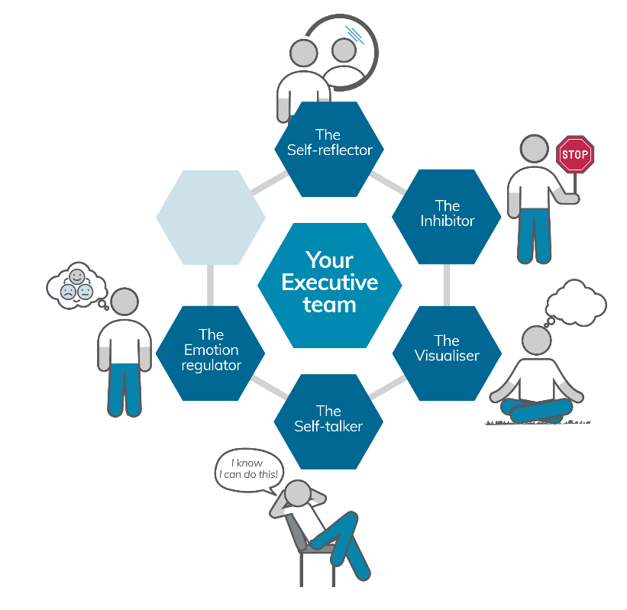
Your Executive team
Notes:
You have now met four members of your Executive Team and today you will meet the fifth one, The Emotion Regulator.

Slide 5
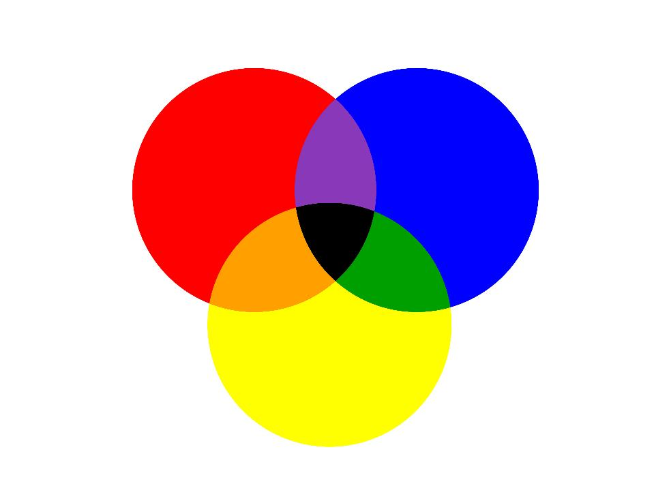
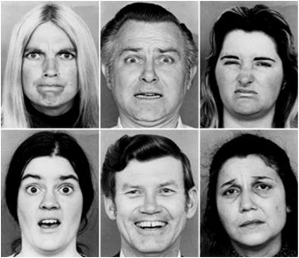
The primary emotions?
Notes:
If you think back to primary school, you will probably recall learning about the primary colours. Which are the primary colours?
[click to animate - Answer; red, yellow, blue].
These are called the primary colours because all other colours derive by mixing them together. For example you get green if you mix blue and yellow.
Similarly, there are primary emotions, which when combined can give rise to more complex emotions. There are six primary emotions. What do you think they are?
[Participants to brainstorm as you write their responses on the board or butchers paper. Write as the participants identify the following (these are in the correct order from left to right across each row):
Anger
Fear
Disgust
Surprise
Happiness
Sadness
If they mention other emotions such as “jealousy” or “empathy”, you still write them on the board but tell them that these are more complex emotions]
[Click to animate slide]
[point to the faces one at a time and ask the Participants to tell you which emotion is being expressed]

Slide 6
The functions of emotions
Basically, to move us closer to what is good for us and further away from what is bad for us (in the present moment)
Fear
Happiness
Anger
Disgust
Surprise
Sadness
− to move us away from immediate danger
− to draw us towards something rewarding
− to take action against injustice
− to move us away from toxic things
− to catch or hold our attention on an unexpected event
− to solve problems related to loss or failure
Let’s try some exercises that may bring about
an emotional change in you!
Notes:
[Click to animate slide]
Emotions all serve a function. Ultimately they function to bring us closer to what is good for us and further away from what is bad for us. However, they tend to do this in the present moment.
[Click to animate slide for each emotion]
At a glance, the function of:
Fear is to move us away from immediate danger
Happiness is to draw us to something rewarding
Anger is to take action against injustice
Disgust is to move us away from long-term danger or toxic things e.g. poison, ill health
Surprise is to catch and hold our attention on an unexpected event
Sadness is to help us solve problems related to loss or failure
[Say: … and now we are going to turn to an exercise that may bring about an emotional change in you, and I’d like you to pay attention to what that emotional change is”

Slide 7
Find-a-Word
Page 31 of workbook
You have one minute to get the highest score
3-5 letter words worth 1 point each
6-7 letter words worth 2 points each
8-9 letter words worth 10 points each
Notes:
[Ask everyone to turn to the Find a Word puzzle sheet, (page 31 of the workbook) but not to look before you say ‘Go’.]
[Tell the Participants that, when you say GO, to open the page and start the puzzle.]
[Say ‘GO’ and start the stopwatch; when it gets to one minute, say ‘STOP’, then Participants can score themselves. ]
[A proper debrief with participants may be necessary after this exercise to help them reflect on their scores. By prioritising finding the longest words, with 8 or 9 letters in length, participants can more easily achieve a higher score. The exercise is to help them become aware of how they prioritise and plan ahead.
How did you feel at the beginning of this exercise, as opposed to during, and after it?

Slide 8
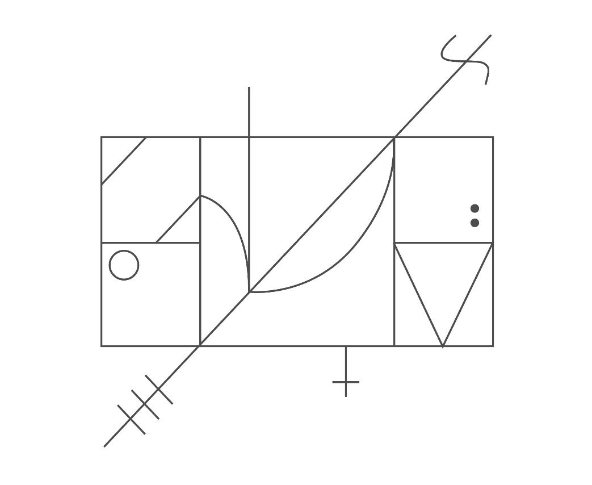
Page 32 of workbook
You have one minute to copy as much of this as you can
Notes:
[Ask the Participants to open page 32 in their workbook or a blank page in their notebooks]
[Say, ’You have one minute to copy as much of this as you can’]
[Click to animate slide] - to reveal the image, say ‘GO’ and start the stopwatch.
[When it gets to one minute, say ‘STOP’.]
[A proper debrief with participants may be needed to discuss their approach to this activity. The exercise is designed to build the participants awareness of how they prioritise i.e.: did they draw the complex parts or the easy parts first? Did they save completing the finer details to the end?]

Slide 9
Overload or overwhelm
A sense of overload can result in:
inaction
ignoring
denying
avoiding
or
impulsive (habitual) behaviour such as:
pathological gambling
pathological sexual behaviour
problematic substance use
Notes:
How did you feel at the beginning of this task?
Did anyone feel overloaded or overwhelmed by those tasks?
[click to animate slide]
A sense of overload can severely disrupt our ability to perform tasks and solve problems as we work towards our goals.
This can result in:
inaction
ignoring
denying
Avoiding
[click to animate slide]
or
impulsive (habitual) behaviour such as:
pathological gambling
pathological sexual behaviour
substance abuse
[Ensure a proper debrief with participants after this session, discussing how participants may have experienced ‘overload leading to inaction’. Mention that planning and organising can help to reduce overload.]

Slide 10
Manage your space and time
ORGANISE | PLAN
SPACE | TIME
Notes:
In order to reduce the chance of inaction or unhelpful impulsive behaviour when confronted by a sense of overload or being overwhelmed, it is important that we manage our space (i.e. our environment and the tools we need) and our time.
[Click to animate slide]
“Organise your Space and Plan your Time”

Slide 11
The POP technique
Prioritise
Organise
Plan
Notes:
A technique to help with this is P-O-P, which stands for: Prioritise, Organise, Plan. (Page 33 of Participant Workbook)
[Click to animate slide to introduce the P-O-P technique]
Prioritise
Make a list of everything you need to get done
Rank the items in order of priority (with more urgent or important items higher in the list)
Repeat this process daily or weekly
2. Organise
Make sure you have everything you need in order to complete your tasks.
For example, if you need to take your clothes to the laundromat, make sure you have all the clothes that are dirty, as well as coins and washing powder. It might also help you to put those items near the door the night before, to help you remember to take everything you need with you.
Have ‘a place for everything and everything in it’s place’
Plan
On your wall calendar, diary or smart phone, write down when you intend to achieve each of the tasks on your list
Each task should have a completion date
Remember the mantra: ‘It takes time to make time’
Can use an if-then plan, for example, ‘If I notice the dirty clothes near the door, then I will go to the laundromat and do my washing’.
This POP technique can be applied to everyday life, like organising your environment. How well do you organise your office or bedroom?

Slide 12
Practice POP-ing
Page 33 of workbook
Your car registration is due today
You have three unpaid gas and electricity bills you can’t find and they are due for payment next week
You bought a gift voucher for your nephew that you have misplaced. It is his birthday tomorrow and you don’t want to go empty-handed
What will you do to POP this situation?
Notes:
POP technique Worksheet (page 33 of Participant Workbook)
In pairs or small groups, discuss how you would apply the POP technique in the following scenario. [5 minutes]
[Click to animate the scenario] x4
Your car registration is due today
You have three unpaid gas and electricity bills you can’t find and they are due for payment next week
You bought a gift voucher for your nephew that you have misplaced. It is his birthday tomorrow and you don’t want to go empty-handed
What will you do to POP this situation?

Slide 13
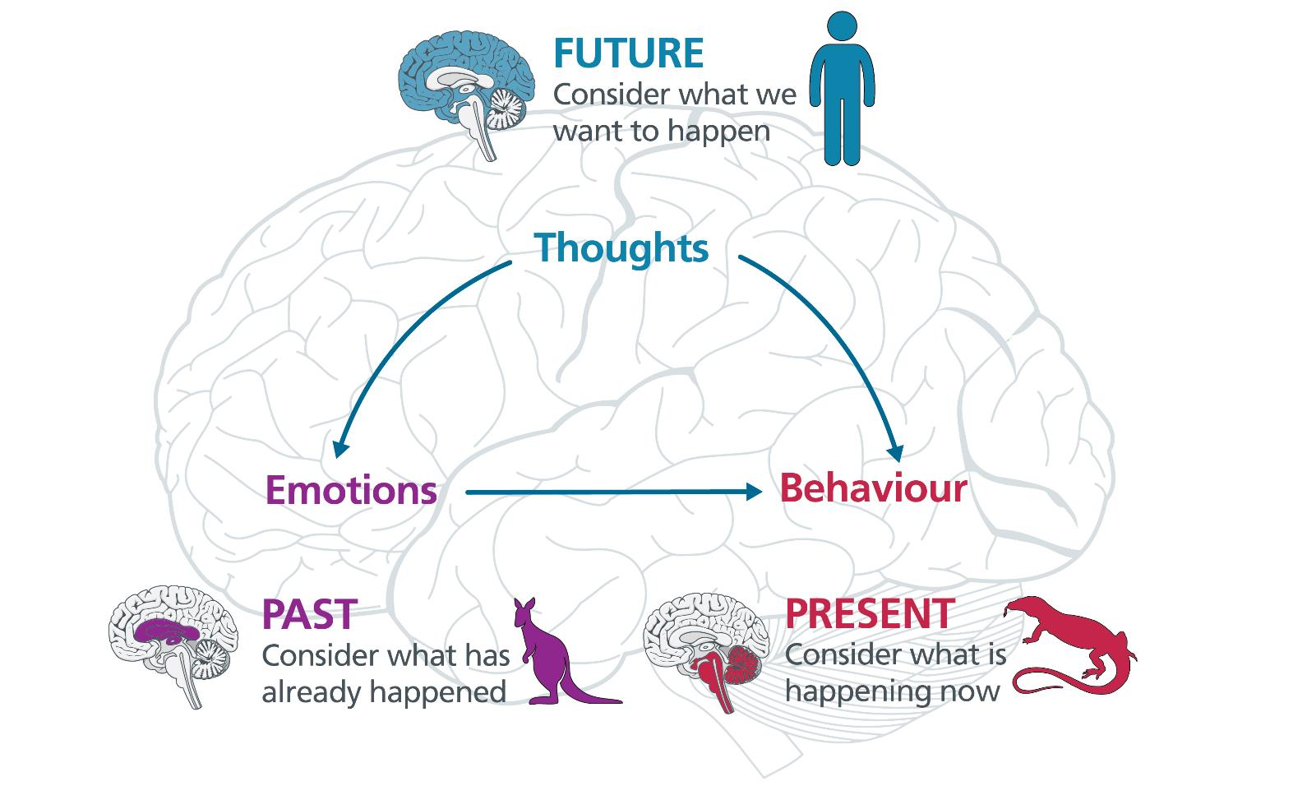
Notes:
[If you like, you can use your own words to summarise the script below. You don’t have to go into depth if you don’t want to.]
We have already learned that environmental triggers (like the availability of food or a mate) can cause our reptilian brain to respond to that present moment situation.
Emotions can be formed or strengthened based on past experiences, like the feeling of anxiety you might have in relation to being at the centre of attention in front of a group of people if you used to be teased at school. That emotion, embedded in your limbic (or mammalian) brain may cause the behaviour of avoidance. Suddenly you withdraw from the spotlight because the emotions are so strong.
However, if you are operating from your human brain (the neocortex or frontal lobes) your behaviour will be influenced by thoughts, and an important type of thought we have discussed in this program is your goals (these are our thoughts about what we want to happen in the future).
Our reptilian and mammalian behaviours can be shifted significantly by our future goals.
With strong goals, emotions towards things and people can change to move us closer to our goals, rather than away from them.

Slide 14
Make your emotions work for you (not against you)
Sally used to get excited and happy every time she went to the shopping centre because she would get her favourite treat –
a triple choc creamy Oreo shake!
Sally now feels disgusted at the thought of it.
Why?
Notes:
[Click to animate slide] – Sally used to get excited and happy every time she went to the shopping centre because she would get her favourite treat – a triple choc creamy Oreo shake.
[Click to animate slide] – Sally now feels disgusted at the thought of it.
[Ask participants - Why? ]
[Answers may include: Because she is on a diet, because she learnt that the shakes are unhealthy, because she decided she was going to be healthier]
[the target response should be something like:
When Sally used to get excited about the treat, she was responding with her reptilian brain (the trigger in the environment) or her mammalian brain (the good feeling one gets from taking in large amounts of fat and sugar – this feels good because our distant ancestors could survive for longer of they took in more fat and sugar). After she set the goal of becoming healthier (using her frontal lobes), she developed a disgust for those types of foods, as they were not in line with her health goals.]
[When framing Sally’s example, and when debriefing the participants, reinforce that this is just one example of how emotions can change depending on the goals you set. Not everyone will feel the same way that Sally did, and you don’t have the same emotional reaction as Sally did, as this is Sally’s individual example.]

Slide 15
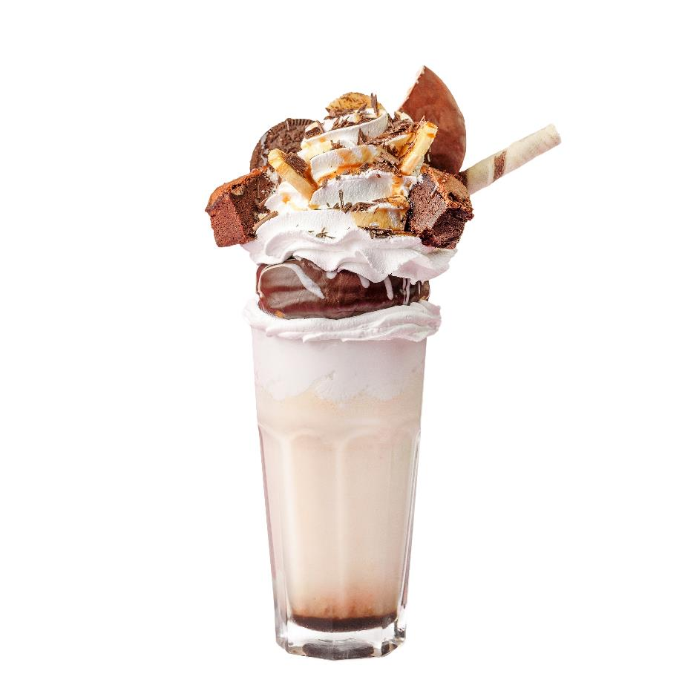
Sally’s emotion modification
No Goal
Goal
HAPPINESS
DISGUST
Notes:
[Click to animate slide]
When there is no goal, the emotion of happiness may dominate, which causes a person to approach that thing they are happy about. However, with a strong health goal, that emotion might change to disgust.

Slide 16
Make your emotions work for you (not against you)
Simon hated his new football coach because he was harsh and rude. He used to get upset every time the coach yelled at him.
He started to become very angry and resentful toward the coach.
Simon now has a sense of gratitude towards his coach
Why?
Notes:
[Click to animate slide] – Simon hated his new football coach because he was harsh and rude. He used to get upset every time the coach yelled at him. He started to become very angry and resentful toward the coach.
[Click to animate slide] – Simon now has a sense of gratitude towards his coach.
[Ask participants - Why?]
[The target response should be something like:
When Simon used to get upset when the coach yelled at him, he was just responding with his reptilian brain (the trigger in the environment) or his mammalian brain (he was perhaps reminded about how his older brother used to yell at him, which he hated). After he set the goal of achieving a football scholarship (using his frontal lobes), he developed a sense of gratitude for his coach, as his coach was helping him to achieve his goal.]

Slide 17
Simon’s emotion modification
No Goal
Goal
ANGER
GRATITUDE
Notes:
[Click to animate slide]
When there is no goal, the emotion of injustice (anger) may dominate when someone shouts at us, but with a strong fitness or athletic goal, that emotion might change to gratitude toward a coach.

Slide 18
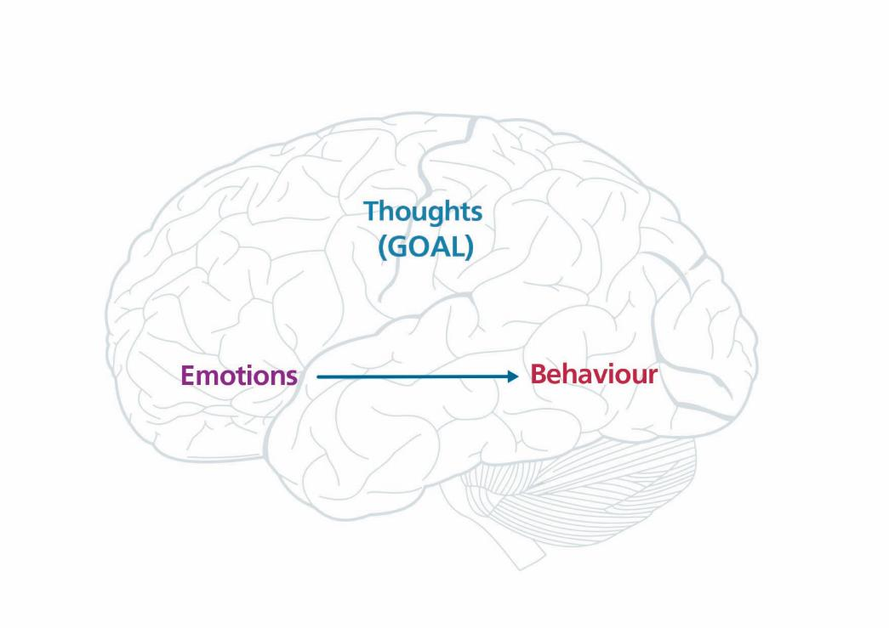
Visualise and feel what it would be like to achieve the goal
Use an If-Then plan
Make your emotions work for your future self (goals), not your present self
Behaviour will be more likely to be in line with your goals
Notes:
“To recap, we have now covered:
[Click to animate slide] – Using the Visualiser to feel the positive emotions associated with achieving our goals
[Click to animate slide] – Using the Self-Talker to generate an If-Then plan to deal with obstacles to achieving our goals
[Click to animate slide] – Making our emotions work for our future selves (our goals) rather than our present selves
[Click to animate slide] – Each of these techniques will make our behaviour more in line with our goals.”

Slide 19
Brainwork
Page 34 of workbook
Write down two situations in which your emotions changed in the past when you developed a strong goal.
Write down the original emotion and what it changed to
Write down two situations in which your emotions might change in the future when you develop or strengthen a goal.
Write down the original emotion and what it will change to
Complete your Posture Diary
Notes:
Emotion modification form (page 34 of Participant Workbook)
Write down two situations in which your emotions changed in the past when you developed a strong goal.
Write down the original emotion and what it changed to
Write down two situations in which your emotions might change in the future when you develop or strengthen a goal.
Write down the original emotion and what it will change to
Also:
Ensure your Posture Diary is completed ( page 21 of participant workbook)

Slide 20
Brainwork Prediction
Page 39 in workbook
Goals changing emotions
Description | Actual outcome | Predicted outcome | Actual minus Predicted
Wrote down and described emotion changes for 4 situations | 3 | 3
Wrote down and described emotion changes for 3 situations | 2 | 2
Wrote down and described emotion changes for 2 situations | 1 | 1
Wrote down and described emotion changes for 0-1 situations | 0 | 0
The closer to zero, the more accurate your predictions
Negative number: You overestimated your performance
Positive number: You underestimated your performance

Slide 21
End of Module 10
July 2020

Slide 22
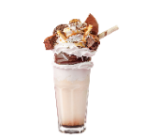
Copyright
This presentation is for use as part of the Alcohol and Drug Cognitive Enhancement (ACE) Program. No part may be copied or used for any other purpose without permission from the NSW Agency for Clinical Innovation. Contact via https://www.aci.health.nsw.gov.au/
The examples may be amended to suit local conditions.
Image credits
Shutterstock.com
Published Mar 2018. Next Review 2028. © State of NSW (Agency for Clinical Innovation) and Advanced Neuropsychological Treatment Services

