Slide 1
Module 6: The Self-reflector
Alcohol and drug Cognitive Enhancement (ACE) Program

Slide 2
Revision
What is a time horizon?
How does your time horizon affect your goals?
What are the executive functions?
Notes:
What is a time horizon?
[Answer: how far into the future a person thinks]
How does your time horizon affect your goals?
[Answer: can only set short-term goals with a short time horizon]
What are the executive functions?
[Answer: things we do to help us achieve our goals]

Slide 3
Brainwork outcome
Page 38 in workbook
Short and long term costs and benefits
Description | Actual outcome | Predicted outcome | Actual minus Predicted
Completed all 4 columns of the table and wrote down a simple plan to assist with completing the goal by then end of next week | 3 | 3 | 0
Completed all 4 columns of the table only | 2 | 2
Completed 2-3 columns of the table only | 1 | 1
Completed 0-1 columns of the table only | 0 | 0
MINUS
The closer to zero, the more accurate your predictions
Negative number: You overestimated your performance
Positive number: You underestimated your performance
Notes:
Circle on your Brainwork Prediction Form how much of your brainwork you completed.
How well did you predict your own behaviour?
[Provide help to anyone unsure of how to do this but do not spend too long on it.]
[FACILITATOR TIP:
It may be useful to recap what was set for brainwork in module 4 and module 5 to link the two tasks together, before reviewing how much of the brainwork each participant completed.
Participants should begin to see some improvement in their ability to predict their own behaviour.
Explain to participants that they will get more out of the program if they engage and do the brainwork and apply the strategies to help predict their behaviour better. Whilst the brainwork lasts only for the 12 modules, their long term outcomes will be better if they do the brainwork. Encourage them to ‘expand their time horizon’.

Slide 4
Your Executive team
Notes:
Today you will meet your first Executive team member, The Self-reflector.

Slide 5
How quick?
I want to see how quickly you can do some things with your dominant hand (the hand you write with).
Notes:
I want to see how quickly you can do some things with your dominant hand (the hand you write with).
When I say go, I want you to snap your fingers as fast as you can until I say stop, and to count how many times you snap your fingers. Ready? Go!
[Allow 10 seconds.]
[Ask participants to record number of snaps before moving on to the next task.]
With your index finger, as quickly as you can write a capital ‘E’ on your forehead.

Slide 6
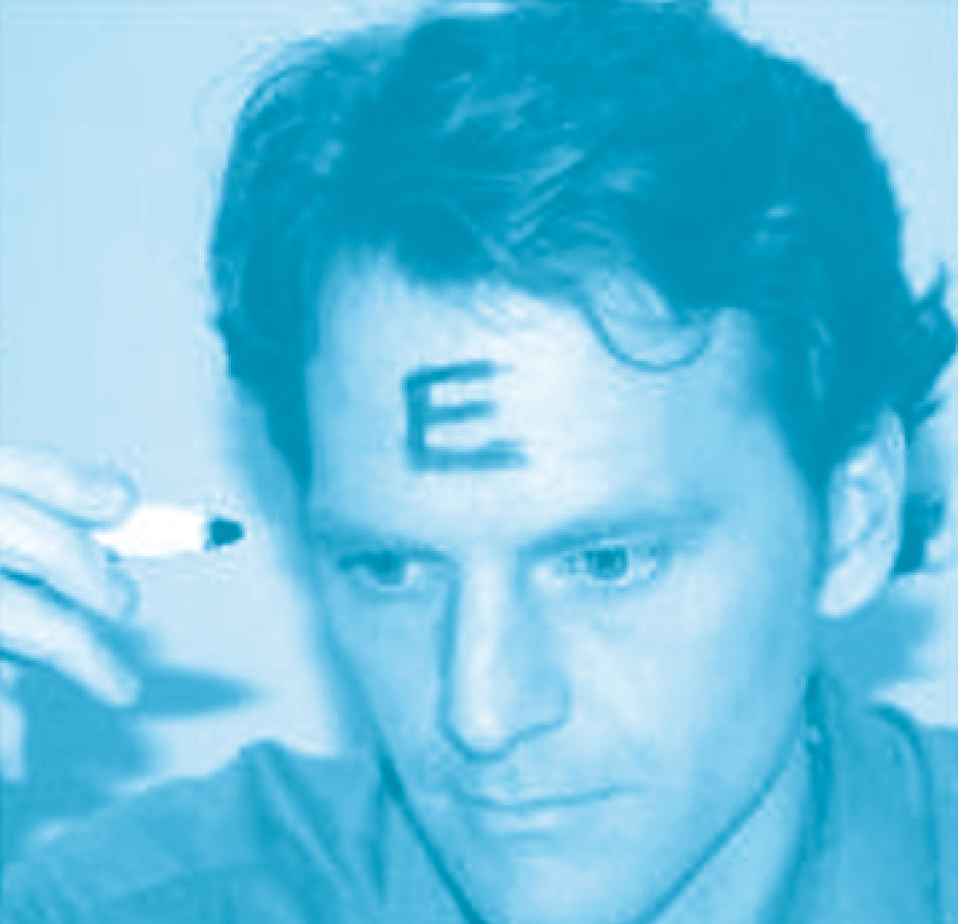
The ‘Selfie’ Scale
See the world from your perspective
See the world from other peoples’ perspective
Less sensitive to other peoples’ judgements
More sensitive to other peoples’ judgements
Notes:
So, did you write the E so that you could read it as an E, like the picture on the left?
Or did you write the E so that someone facing you sees it as an E, like the picture on the right?
[click to animate slide]
There is nothing wrong with either way. However, people who wrote the E the way other people could read it (like the picture on the right) place more value on what other people think, and those that printed it from their own perspective (like the picture on the left) put more value on what they think.
[click to animate slide]
This test can only give us two answers, but people can be a less sensitive or more sensitive to what other people think, making these two answers part of one long scale. Being at either extreme end of this scale could be problematic. It is not good to be too sensitive to other peoples’ judgements nor is it good to be too insensitive to what others might think.
[When debriefing people, ensure you let people know the way you answer this is not the ‘be all and end all’ and the answer may change, if you did this repeatedly at different times. You can also explain that someone can be an extreme ‘E’ at either end of the scale, but that most people sit closer towards the middle and can switch between each side depending on the situation.]

Slide 7
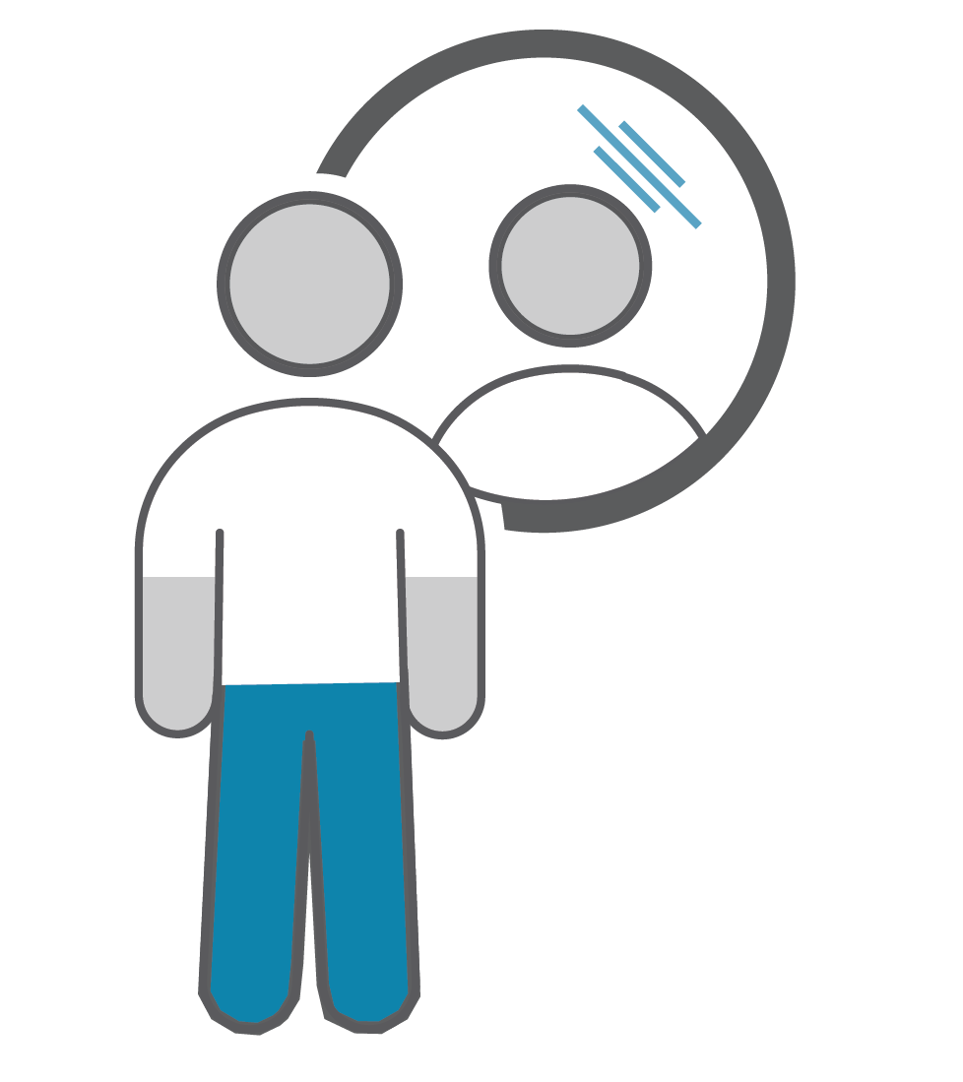
Self-reflector
The first executive skill to develop, between 8 and 18 months of age.
It helps us see ourselves as separate from other people.
It shows the beginnings of a sense of ‘self’
In doing so, we gradually become aware that we have goals that may be different to other people’s goals.
Notes:
[Facilitator Tip: Review the Facilitator Manual for in-depth description of how awareness of one’s self and perspectives is developed.]
The Self-reflector is the first executive skill to develop, between 8 and 18 months of age.
It helps us see ourselves as separate from other people.
It shows the beginnings of a sense of ‘self’
In doing so, we gradually become aware that we have goals that may be different to other people’s goals.

Slide 8
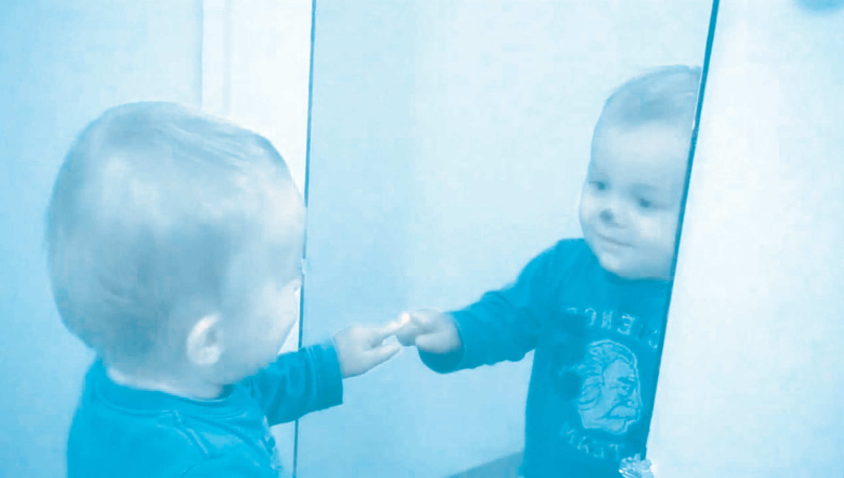
Self-awareness
Notes:
Self-awareness is tested with mirrors – if the child rubs their nose where the dot of make-up is, they have a sense of self-awareness.

Slide 9
Self-reflector
Monitors what’s happening inside us
Drives
Wants
Actions
Monitors what’s happening around us
Who is around?
Can they see me?
Does it matter?
Notes:
The self-reflector has a monitoring function - It:
monitors what's happening inside us (internal environment)
Drives (e.g. hunger)
Wants (e.g. shoes, gadgets, car)
Actions (i.e. our current behaviour)
monitors what's happening outside (external environment)
Who is around?
Can they see me?
Does it matter?

Slide 10
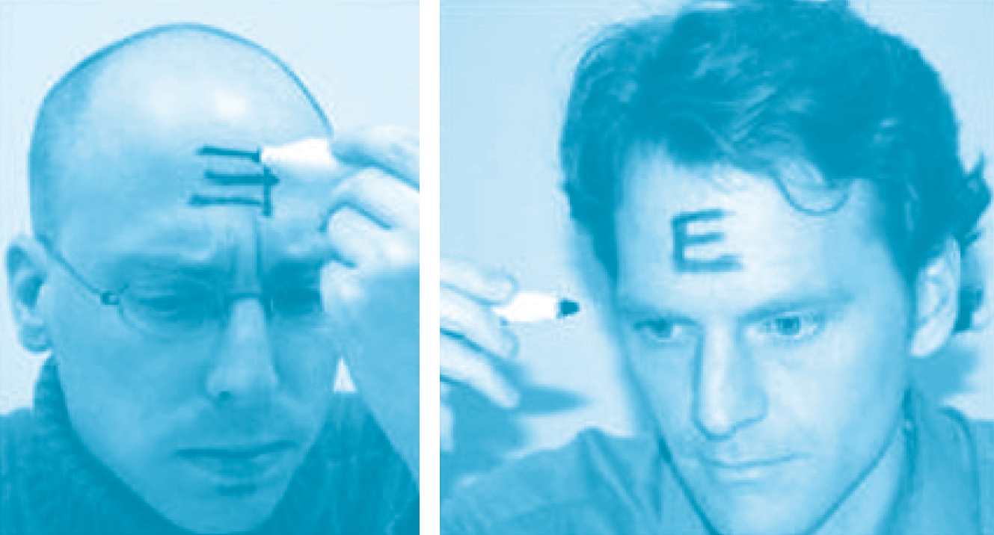
Self-reflector
Helps us be aware of any changes in our behaviour that might be needed at any time.
If we are sensitive to other people’s judgements, it is possible that we are better at monitoring what other people want at the expense of what we want.
When is this good?
When is this not so good?
Notes:
Helps us be aware of any changes in our behaviour that might be needed at any time.
If we are sensitive to other people's judgements, it is possible that we are better at monitoring what other people want at the expense of what we want.
When is this good?
[Target answer: When other people know something about the situation we are not yet aware of, such as in potentially embarrassing situations.]
When is this not so good?
[Target answer: when their goals clash with ours.]
Can anyone think of situation or example of when someone was more concerned with how other people see them rather than how they see themselves?
[Feel free to use the example/s below]
EXAMPLE - When you get ready in the morning, you (did your hair in a new or different way/decided to keep a moustache). When you saw it, you thought it looked (pretty/good), but after coming out this morning, a few people commented on the (hairstyle/moustache), and you thought they thought it looked funny. Even though you liked it, you decided then to (restyle your hair/shave the moustache off).

Slide 11
Self-reflector
Helps us be aware of whether or not we have the things we need to achieve our goals
And the thing we all need most of all is?
TIME
Notes:
Our Self-Reflector helps us be aware of whether or not we have the things we need to achieve our goals
And the thing we all need most of all is?
[click to animate slide] …TIME
By definition it will take time to achieve our goals, and how we perceive and use that time will make a big difference as to whether or not we achieve our goals

Slide 12
Brainstorm - time estimation failures
What are some time estimation failures you have experienced?
Notes:
What are some time estimation failures you have experienced?
[An example might be calling your work to say you’re running 10 minutes late, but you end up being a lot later than that!]
Because having enough time to do something is important, it is also important that we are able to estimate how much time has passed in a period, so we can better predict how long it might take us to get something done.

Slide 13
Time estimation activity
Estimate six time intervals
Clap once when you think that time interval has passed.
Notes:
Each of you will estimate six time intervals I will tell you.
I will randomly tell you one of six time intervals and start the stopwatch.
You are to indicate by clapping once when you think that time interval has passed. [Instruct participants not to use their watch, phone or other time keeping device]
I will count how many people clapped before the interval, at the interval, and after the interval.
[As an example: ask the participants to clap when they think that 6 seconds has passed….. Starting from NOW!]
[Mark the number of claps on the Time Interval Estimation form in your Facilitator Manual.]
[Write these results up on the board. The trend will show poorer estimation of time with longer intervals. Most people will underestimate the intervals. Highlight that if this trend continues to longer intervals, imagine how far off people will tend to be with their estimations of durations like 20 minutes or half an hour!]

Slide 14
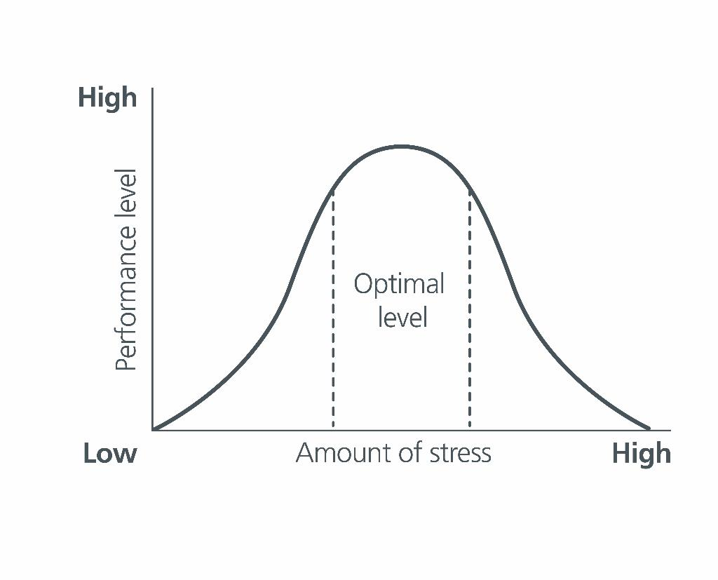
Stress-performance curve
Notes:
How well we perform on any task depends on how much stress we feel about the task. For example, if we feel no stress, we are unlikely to get started at all. So, we need some stress to perform at our best. If, however, we experience too much stress, then our performance suffers.
One of the things that causes stress is the amount of time available to us. This is why we sometimes procrastinate – so we can get some stress from time running out so we perform at our best.
Unfortunately, many people leave things so much to the last minute that they end up both running out of time and performing poorly.

Slide 15
Time pressure management
‘Let me give myself enough time to do the task’
Recognise
Prevent
Deal
Notes:
[Time Pressure Management and Task Orientation Tips] – Page 16 of Participant Workbook
It is possible to manage this sense of time pressure by using a simple technique called time pressure management. It comprises reminding yourself to allow enough time to achieve all that you want to achieve in a set period of time.
You do this by repeating the mantra:
“Let me give myself enough time to do the task”
And then follow these three steps:
1. Recognise: Is there limited time to get the task done? If so, go to 2. Be AWARE of how much time you have and need.
2. Prevent: What can I do to reduce time pressure before I begin the task (how do I prepare)? The mantra “It takes time to make time” might help. Remember: “It takes time to make time”.
3. Deal: What do I do if there is still time pressure despite preparing as much as possible in advance?
Make a plan of what you will do if you run out of time.

Slide 16
Time slipping away
Have you ever tried to do a ‘spring clean’ or a big tidy-up, only to end up getting side-tracked by an item you forgot that you even owned?
Or something similar?
The following strategy can help…
Notes:
If you haven’t managed your time it may feel like time is slipping away. When we get distracted we can easily lose track of time, and not finish things within the timeframes we set for ourselves.
Have you ever tried to do a 'spring clean' or a big tidy-up, only to end up getting side-tracked by an item you forgot that you even owned?
Or something similar?
The following strategy can help…

Slide 17
Task orientation
PRESENT
What am I doing NOW?
What was I doing BEFORE THIS?
What am I supposed to do NEXT?
PAST
FUTURE
Notes:
Task Orientation is a strategy that helps us make sure that we are paying attention to the right task at the right time. This also follows a very simple three step process of asking yourself:
[click to animate slide for each of the below]
What am I doing NOW?
What was I doing BEFORE THIS?
What am I supposed to do NEXT?
Use Time Pressure Management and Task Orientation to become better aware of time and to take better take control of how you spend it.

Slide 18
Brainwork
Page 17 of workbook
Self-reflect on whether you are standing or sitting up straight over the next two days.
Every time you become aware that you are not sitting or standing up straight, make a note of:
the situation (e.g. reading a magazine)
what you did (e.g. changed my seating position).
Predict your performance on your brainwork prediction form as soon as you are able.
Notes:
Posture Awareness Form (page 17 of the participant workbook)
Researchers have shown that improving self–control in one area (such as correcting your posture) can then generalise to better self-control in other areas (such as budgeting skills, study habits, healthy lifestyle choices).
Self-reflect on whether you are standing or sitting up straight over the next two days.
Every time you become aware that you are not sitting or standing up straight, make a note of the situation (e.g., reading a magazine) and what you then did (e.g., changed my seating position) and note this down as soon as you are able or at the end of the day.

Slide 19
Brainwork prediction
Page 38 in workbook
Posture awareness
Description | Actual outcome | Predicted outcome | Actual minus Predicted
Completed 4 or more rows of the table | 3 | 3
Completed 3 rows of the table | 2 | 2
Completed 2 rows of the table only | 1 | 1
Completed 0 - 1 row of the table only | 0 | 0
The closer to zero, the more accurate your predictions
Negative number: You overestimated your performance
Positive number: You underestimated your performance
Notes:
Predict how much of the brainwork you think you will complete and write this down now.

Slide 20
End of Module 6
July 2020

Slide 21
Copyright
This presentation is for use as part of the Alcohol and Drug Cognitive Enhancement (ACE) Program. No part may be copied or used for any other purpose without permission from the NSW Agency for Clinical Innovation. Contact via https://www.aci.health.nsw.gov.au/
The examples may be amended to suit local conditions.
Published Mar 2018. Next Review 2028. © State of NSW (Agency for Clinical Innovation) and Advanced Neuropsychological Treatment Services

