Slide 1
Module 1: Introduction and brain basics
Alcohol and drug Cognitive Enhancement (ACE) Program

Slide 2
Program overview
Designed for improvement of ‘executive’ brain functions, which are often weakened in people who access drug and alcohol treatment.
12 sessions in total.
Each session will go for one hour.
The sessions will be made up of learning, discussion, group work, games and other activities.
Notes:
This program has been designed specifically to improve executive or frontal lobe functioning, which is often weakened in people who access drug and alcohol treatment.
This program is comprised of 12 sessions in total.
Each session will go for one hour.
The sessions will include learning, discussion, group work, games and other activities.

Slide 3
Program overview
This program is designed to:
help you learn more about how your brain works
give you tools to boost your brain functioning!
Notes:
[Read slide text]
Research has shown that, by learning how the brain works and by practicing thinking skills and strategies, people can improve their brain functioning.

Slide 4
Program overview
Introduction and Brain Basics
Learning and Memory
Attention
Goals and Plans
Time Horizons and the Executive Team
The Self-Reflector
The Inhibitor
The Visualiser
The Self-Talker
The Emotion Regulator
The Player
Revision
Notes:
These are the twelve (12) sessions that the group will cover.
The first two sessions will introduce a lot of new information and will contain a lot of content. Do your best to follow along and ask questions if you need to.
The later sessions introduce more games and activities.
This is also where you will meet your Executive team. 'Executive' brain functions are like the management team of your brain. They process and manage information, help us plan and make decisions, and also help keep everything under control (or try to).

Slide 5
Group agreement
How can we learn together?
Notes:
Every person in the group has a chance to learn something from this program.
The program is designed to be interactive and it is important that everyone feels that they can be involved in the discussions, games and activities.
[Facilitate a discussion to establish a group agreement that supports learning together]
Each facility can set its own House rules, however examples that could be included in the Group Agreement are:
Be respectful and remain courteous
Advise a staff member before leaving the group
Be punctual
One voice at a time (hands up before speaking)
What is said in the group remains in the room

Slide 6
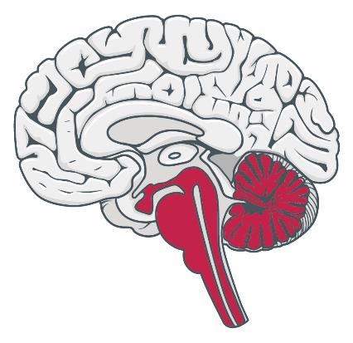
Reptilian brain
Image credit: Brain human sagittal section, Patrick J. Lynch, 2006.
Notes:
As the brain evolved, it built new layers on top of old ones.
One of the oldest layers of the brain, which directs and guides movement, is the reptilian brain.

Slide 7
Reptilian brain
Moves the animal
towards good things
and
away from bad things
What might be good and bad things for a lizard in the outback?
Notes:
[click to animate slide]
A reptile’s brain is pre-programmed. It processes instincts and very primitive emotions; it takes the animal closer to what is good for it and away from what is bad for it in terms of meeting it’s basic needs.
[Use with discretion]: It is basically responsible for the four Fs – feeding, fighting, fleeing and fornicating (mating)!
[click to animate slide]
What might be good for a lizard in the outback?
[Responses can include sunlight, food, water, a mate.]
What might be bad for a lizard in the outback?
[Responses can include a person about to step on it, being attacked by an eagle, and other threats of physical harm.]

Slide 8
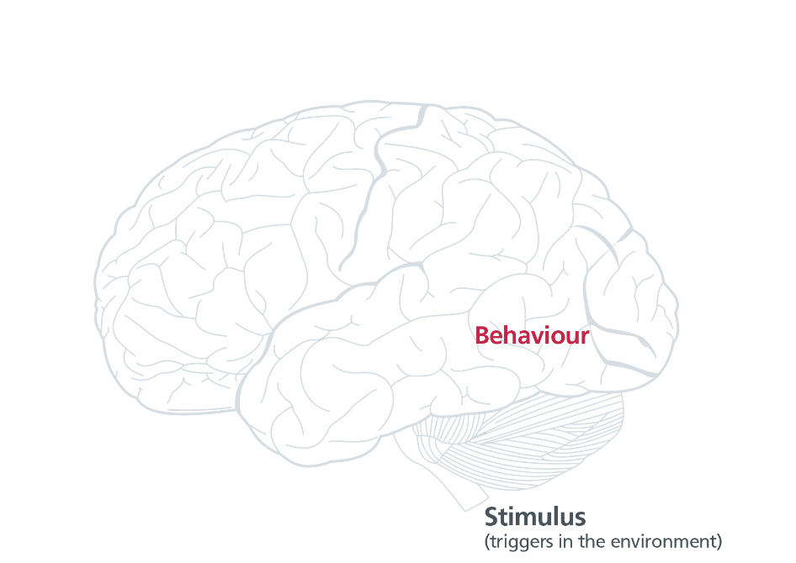
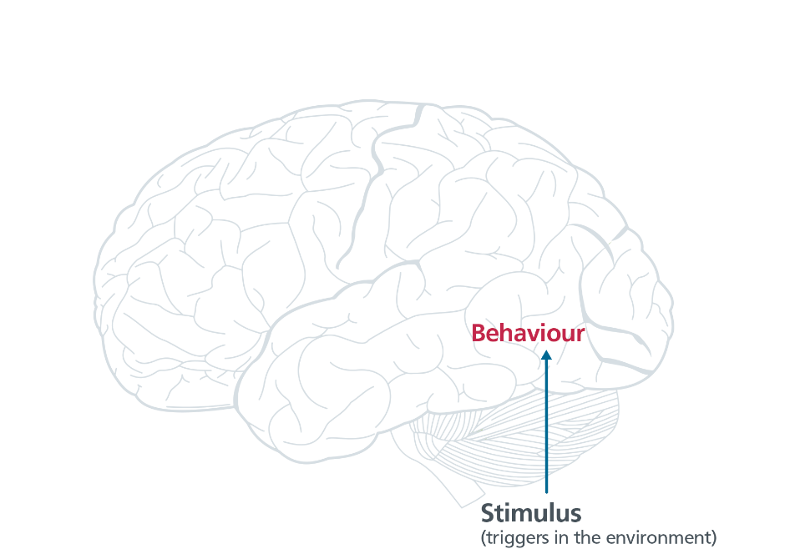
Reptilian brain
Notes:
A reptile has set programs of behaviour based on certain stimuli from the environment. The environment includes internal triggers (like hunger) and external triggers (like a predator).
[click to animate slide]
Those environmental stimuli are wholly responsible for the reptiles’ behaviour.

Slide 9
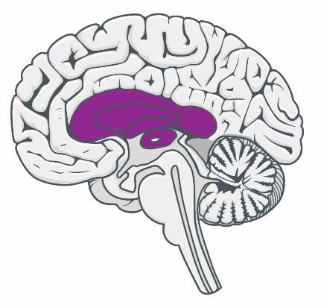
Limbic system
Found in all mammals
How are mammals different to reptiles?
Notes:
How are mammals different to reptiles?
(Answers may include that they give birth to live young, they have body hair, they are warm-blooded, they feed and nurture their young, they tend to live in groups, they are more social.)
Because of their need to develop mother-infant and other bonds, mammals developed another layer of brain, which processes more complex emotions. These emotions help navigate group and social behaviour.
This part of the brain is called the limbic system. The limbic system is connected to our reptilian brain and so it is the part of the brain that processes most of our emotions and is supposed to move us toward what is good and away from what is bad for us, especially socially.

Slide 10
Emotion
Positive emotions like joy or pleasure
Approach behaviour (move towards)
Negative emotions like fear
Avoidance behaviour (move away)
In what direction do these complex emotions move us (approach or avoidance)?
empathy
shame
disgust
Notes:
[click to animate slide]
So emotion, as the word suggests, is about motion – moving an animal closer to what is good for it (things causing positive emotions like pleasure) and away from what is bad for it (things causing negative emotions like fear).
[click to animate slide]
In which directions do the complex emotions of empathy, shame and disgust move us?
[Answer: Empathy usually creates approach behaviour]
[Answer: Shame and disgust usually create avoidance behaviours]

Slide 11
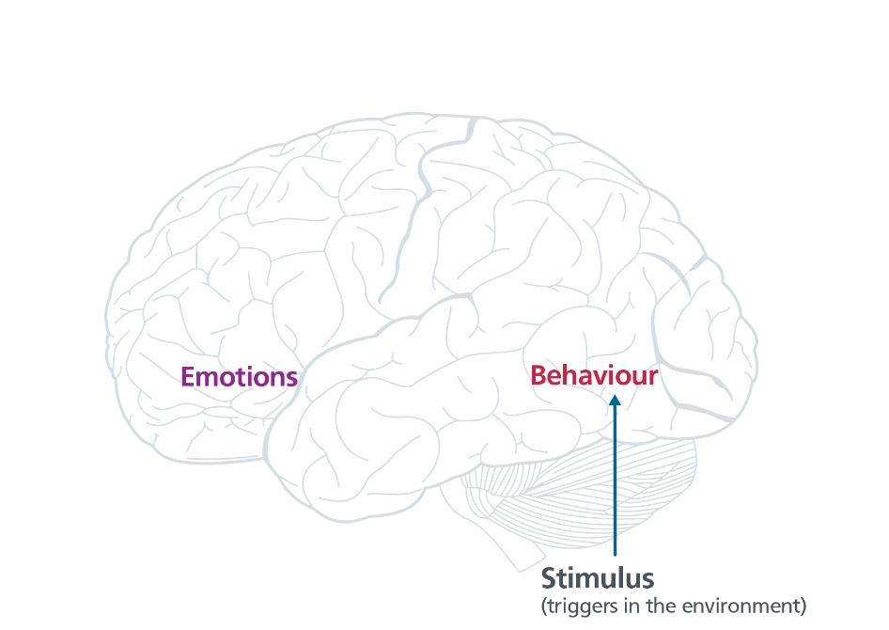
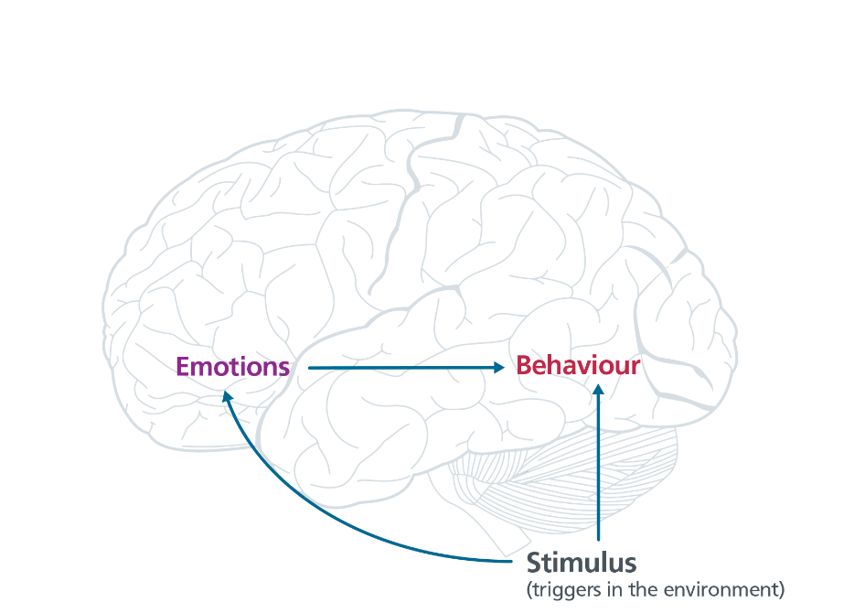
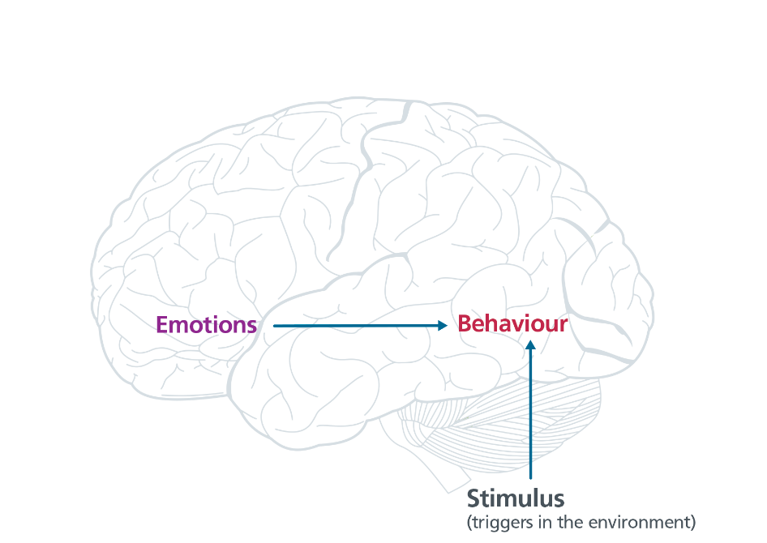
Limbic system
Notes:
So, through the limbic system, an animal may act either on the basis of a stimulus, such as an environmental trigger,
[click to animate slide] - or based on what emotion that trigger creates.

Slide 12
Brainstorm
When have emotions moved you:
towards something good
OR
away from something bad?
Notes:
[Ask question on slide] and allow for group discussion

Slide 13
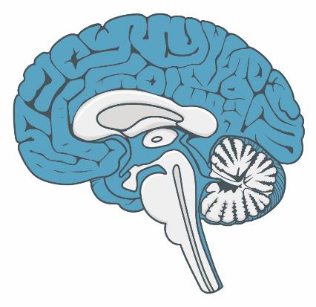
Neocortex
Neo = New
90% of our brain
Notes:
The cortex, or more specifically the neo-cortex, is called the ’new brain’, neo meaning ‘new’ in Latin. And ‘cortex’ meaning ‘covering’.
Humans have the largest neocortex of all animals, accounting for 90% of our brain size.

Slide 14
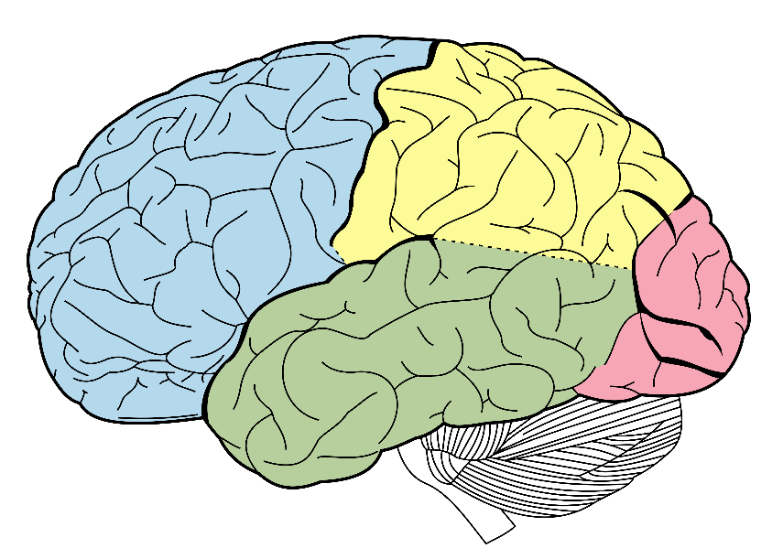
The cortex
Parietal lobe
Frontal lobe
What is happening right now?
What should I do next?
What has happened in the past?
Occipital lobe
Temporal lobe
Notes:
[Facilitator tip: An option is to introduce this slide by describing what each lobe does, as outlined in the Facilitator Manual]
If we divide the brain into the front and back parts like this [click to animate slide], we can say that the back parts ask the questions, [click to animate slide] “What is happening right now?” and [click to animate slide] “What has happened in the past?”
They then relay that information to the frontal lobes to answer the question, [click to animate slide] “What should I do next?”

Slide 15
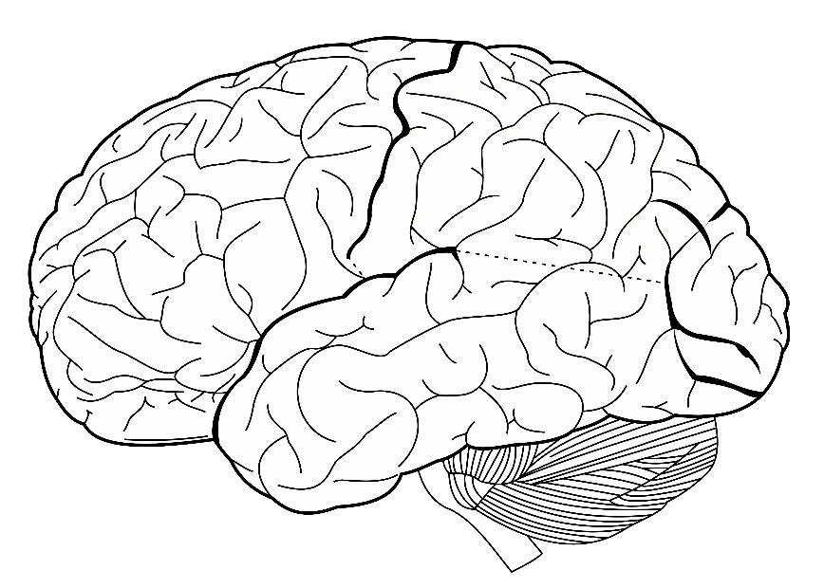
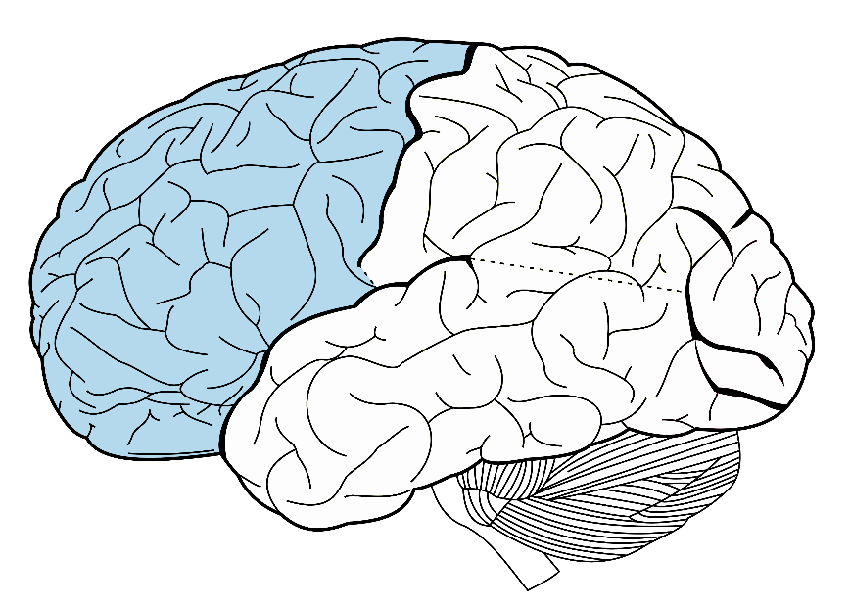
Frontal Lobe
Future
Notes:
[click to animate slide] - (highlights the frontal lobes)
So, the main job of the frontal lobe is to help us to decide and take action on what we need to do in the future.
[click to animate slide]
So, we could think of it as being the “Future Lobe”

Slide 16
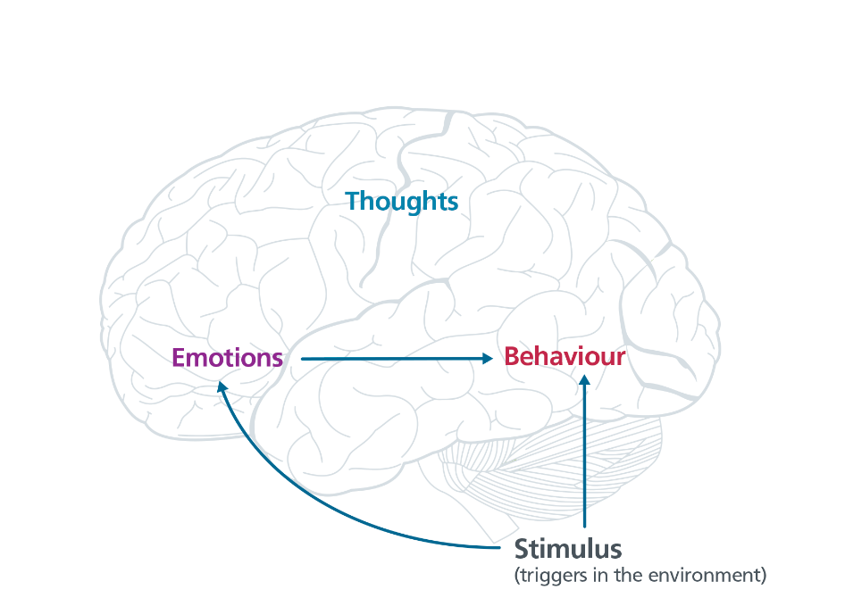
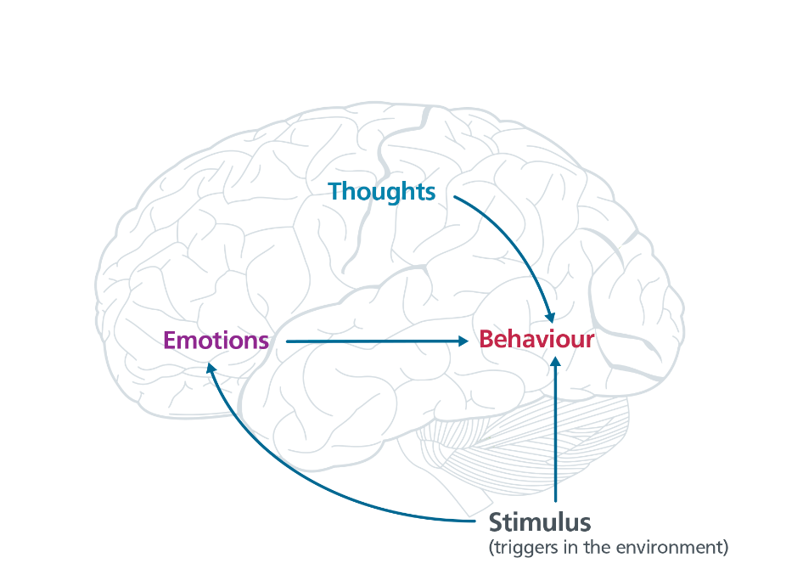
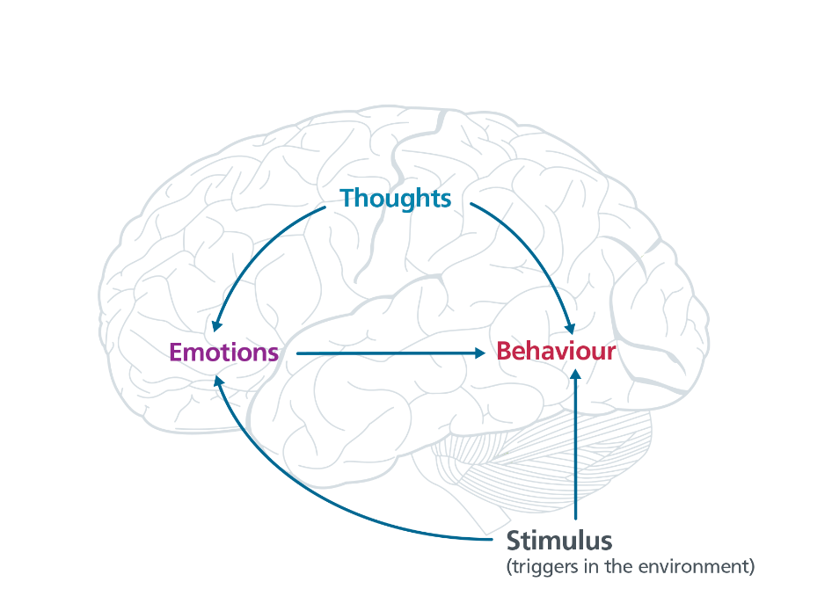
Neocortex
Notes:
So, humans can alter their behaviour based on thoughts, particularly thoughts about the future they want.
[click to animate slide twice]
This can be achieved directly by over-riding or changing the environment…
[click to animate slide]
…or indirectly by altering emotions that might otherwise drive certain behaviours.

Slide 17
What determines your behaviour?
Notes:
So, are you the type of person who is driven by whatever is happening in the environment you happen to be in?
[click to animate slide]
Or do you tend to be driven by how you are feeling at the time?
Or, do your thoughts determine how you act?
[Invite a short group discussion if people would like to reflect on the material.]

Slide 18
Brainstorm
When have emotions moved you towards something bad or away from something good?
What were the environmental triggers?
How were you feeling?
What were your thought processes?
How could your thoughts have helped manage your emotions or over-ridden the environmental triggers?
Notes:
Lead a brief discussion on each question.
[Refer to page 2 in workbook and encourage participants to write down their thoughts]
[Click to introduce next question after each discussion.]

Slide 19
The three brains
Reptilian Brain - Present
Limbic System - Past
Neocortex - Future
What should I do based on what is happening right now?
What should I do based
on what is happening right now and on what happened in the past?
What should I do based on
what is happening right now,
what happened in the past and what I want in the future?
Notes:
So let’s review the main differences between the three levels of brain that we all possess.
[click to animate slide]
A reptile’s behaviour is based on what is happening right now. A reptile does not think, it just moves to what is good for it and away from what is bad for it. It has no sense of time. So, whatever is immediately seen as good or bad is what drives its behaviour. It is aware of the present moment only.
[click to animate slide]
A small mammal’s behaviour is based on what is happening right now and what has happened in the past. Mammals have more complex emotions and are able to remember past experiences. For example, a dog will remember that its new owner has given it food before, causing positive emotions, so will be more likely to approach that owner in the future. So, these emotions, as well as what is happening in the environment may drive a small mammal’s behaviour. Its behaviour is based on the present moment as well as what it has learned in the past, based on good and bad outcomes from previous experiences.
[click to animate slide]
Humans have the option of acting based on what is happening right now, what has happened in the past and what is desirable in the future. We can override any environmental triggers or behaviour patterns based on emotional responses, especially if we establish clear and strong goals.

Slide 20
Brainwork
There are brainwork tasks for this program
Your first brainwork task is to:
Get a notebook
You will be asked to predict how close you will get to completing the brainwork.
Notes:
There are brainwork tasks for this program and your first brainwork task is to get a notebook.
[Provide instructions about where and when participants should pick up the notebook. There needs to be a pre-agreement with the relevant service staff from whom the notebooks are to be picked up.]

Slide 21
Brainwork prediction
Getting a notebook
Description | Actual outcome | Predicted outcome | Actual minus Predicted
Got the notebook | 3 | 3 | 1
Took an action towards the goal of getting the notebook but did not get it | 2 | 2
Thought about getting the notebook | 1 | 1
Did nothing towards the goal of getting the notebook | 0 | 0
The closer to zero, the more accurate your predictions.
Negative number: you overestimated your performance.
Positive number: you underestimated your performance.
Notes:
Turn to page 37 in your workbook to where it says “Brainwork Prediction Form”.
Each Brainwork task has a name, like “Getting a Notebook”.
[click to animate slide]
Firstly, record the date next to the brainwork task. So go ahead and put today’s date next to the Getting a Notebook Brainwork Task.
[click to animate slide]
Where it says Predicted outcome, circle 3, 2, 1, or 0 depending on how much of the brainwork task you think you will do.
For example, if you think you will take some action towards getting the notebook but won’t actually get it, circle 2 under Predicted outcome.
[click to animate slide]
In the next session, you will be asked to (honestly) circle the number for how much of the brainwork you actually did.
For example, if you ended up completing the task and got the notebook, you would circle 3 under Actual outcome.
[click to animate slide]
Then you simply subtract the predicted outcome from the actual outcome to get a score between -3 and +3.
So, 3 (the actual outcome) minus 2 (the predicted outcome) equals 1, so you would write 1 in the Actual minus Predicted column for that task.
[click to animate slide]
The closer your score is to zero, the better you are at predicting future events.
If your score is negative (towards the -3 end), you overestimated your ability to do the task and if your score is positive (towards the +3 end), you underestimated your ability to do the task. You will realise in future sessions why your ability to predict your own behaviour is an important skill.
Always complete your brainwork prediction form at the end of every module before leaving the room

Slide 22
End of Module 1
July 2020

Slide 23
Copyright
This presentation is for use as part of the Alcohol and Drug Cognitive Enhancement (ACE) Program. No part may be copied or used for any other purpose without permission from the NSW Agency for Clinical Innovation.
The examples may be amended to suit local conditions.
Published Mar 2018. Next Review 2028. © State of NSW (Agency for Clinical Innovation)
And Advanced Neuropsychological Treatment Services

