Slide 1
Module 9: The Self-talker
Alcohol and drug Cognitive Enhancement (ACE) Program

Slide 2
Revision
Which part of the brain is mostly responsible for visualisation (you can point to it if you don’t know the name)?
How might visualisation help elite sports men and women?
How can the visualiser make our goals seem stronger?
Notes:
Which part of the brain is mostly responsible for visualisation (you can point to your own head if you don’t know the name)?
[Answer: occipital or parietal lobes.]
How does visualisation help an elite sports person?
[Answer: it is a form of practice and/or it helps them clarify the goal they want to achieve.]
How can the visualiser make our goals seem stronger?
[Answer: to make them feel more real and closer to us.]

Slide 3
Brainwork outcome
Page 38 in workbook
Visualisation practice
Description | Actual outcome | Predicted outcome | Actual minus Predicted
Did 5 minutes of deep visualisation 4 times | 3 | 3 | 1
Did 5 minutes of deep visualisation 3 times | 2 | 2
Did 5 minutes of deep visualisation 2 times | 1 | 1
Did 5 minutes of deep visualisation 0 - 1 time | 0 | 0
MINUS
The closer to zero, the more accurate your predictions
Negative number: You overestimated your performance
Positive number: You underestimated your performance
Notes:
Circle on your Brainwork Prediction Form how much of your brainwork you completed.
How well did you predict your own behaviour?
[Provide assistance to anyone unclear on how to do this but do not spend too long on it.]

Slide 4
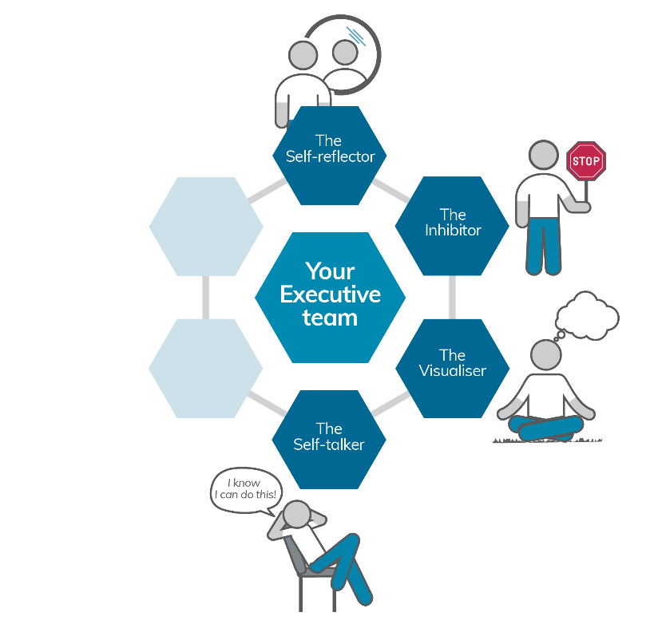
Your Executive team
Notes:
You have now met three members of your Executive Team and today you will meet the fourth one, The Self-Talker.

Slide 5
The Self-talker
The Self-talker is like a sound-based version of the Visualiser.
If the Visualiser is the mind’s eye, then the Self-talker is the mind’s voice.
Notes:
The Self-talker is like a sound-based version of the Visualiser. If the Visualiser is the mind’s eye, then the Self-talker is the mind’s voice.
Some people prefer to use self-talk instead of visualisation in some situations. For example when given a phone number, some people may try to remember the position of the numbers on a dial pad (using the Visualiser) whereas others will repeat the numbers to themselves as they hear or read them (using the Self-talker).

Slide 6
Self-talker
Our present self talks to our past and future selves
Self questioning
Self instruction
Self regulation
Self organisation
Problem-solving
Ever noticed yourself talking out loud whilst solving a problem?
Notes:
Our self-talker allows our present self to talk to our past or future selves. This can be in the form of:
self-questioning
self-instruction
self-regulation
self-organisation
problem-solving.
[Click to animate slide]
Ever noticed yourself talking out loud whilst solving a problem?

Slide 7
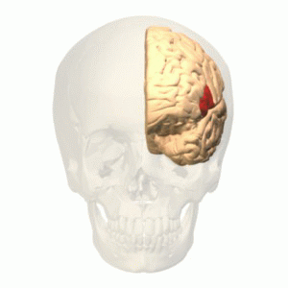
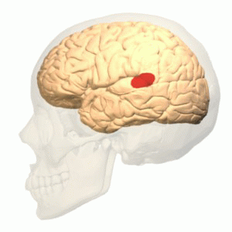
Broca’s Area
Wernicke's area
Image credits: Broca's area animation from BodyParts 3D. 2008. Database Center for Life Science [CC-BY-SA-2.1-Japan] via Wikimedia Commons Wernicke's area animation from BodyParts 3D. 2008. Database Center for Life Science [CC-BY-SA-2.1-Japan] via Wikimedia Commons
Modified from Brain Surface Gyri, by James.mcd.nz [CC BY-SA 4.0], via Wikimedia Commons
Module 9
7
Notes:
There are two main areas in the brain responsible for self-talk: Broca’s Area (in the frontal lobes) and Wernicke’s Area (in the parietal lobes). The connection between these regions is also necessary for self-talk.
We all carry out self-talk, almost all of the time. Our self-talk sometimes comes to the surface (when the Inhibitor is not doing its job) and our self-talk becomes actual talk. These are the ‘did I just say that out loud?’ moments we might have experienced.
Sometimes it is helpful to talk to yourself out loud.

Slide 8
Talk yourself out of it!
Page 26 of workbook
You will hear a string of numbers
When I say ‘GO’, write them down on the page in front of you
DO NOT write the numbers until you hear me say ‘GO’
You are not allowed to say anything out loud
Notes:
Condition 1
We are going to practice self-talking with an exercise.
[Click to animate slide for each instruction]
I will read a string of numbers.
2. After I say ‘Go’, write them down on the page in front of you (page 26 of the workbook). DO NOT write the numbers until I say ‘Go’. [You can suggest that participants practice using their ‘inhibitor’ for this exercise.]
3. You are not allowed to say anything out loud.
[Read the following numbers at the rate of one per second:
1st sequence: 8 3 6 2 [say ‘Go’ after 5 seconds]
2nd sequence: 1 9 4 3 7 [say ‘Go’ after 5 seconds]
3rd sequence: 4 6 1 9 7 5 [say ‘Go’ after 6 seconds]
4th sequence: 2 8 1 3 6 2 5 [say ‘Go’ after 7 seconds]
5th sequence: 5 8 9 4 6 1 7 3 [say ‘Go’ after 8 seconds]]
Repeat for condition 2:
Condition 2
[Play radio or podcast with talking (not music), or the co-facilitator can read an article from a magazine or newspaper, at the same or slightly higher volume than the facilitator’s voice throughout, even while participants are writing down the numbers].
[Read the following numbers at the rate of one per second:
1st sequence: 3 1 4 8 [say ‘Go’ after 5 seconds]
2nd sequence: 7 6 9 5 2 [say ‘Go’ after 5 seconds]
3rd sequence: 5 3 2 9 8 4 [say ‘Go’ after 6 seconds]
4th sequence: 4 1 2 9 5 7 6 [say ‘Go’ after 7 seconds]
5th sequence: 3 5 2 6 1 8 7 4 [say ‘Go’ after 8 seconds]]

Slide 9
Talk yourself out of it!
Condition 1
8 3 6 2
1 9 4 3 7
4 6 1 9 7 5
2 8 1 3 6 2 5
5 8 9 4 6 1 7 3
Condition 2
3 1 4 8
7 6 9 5 2
5 3 2 9 8 4
4 1 2 9 5 7 6
3 5 2 6 1 8 7 4
Which condition was harder? Why?
What strategies did you use in the task?
Notes:
Score up how many number strings you had correct for conditions 1 and 2.
(Participants do this by checking what they wrote down with the number strings on the screen)
Which condition was harder? Why?
What strategies did you use in the task? [Discuss scoring.]
Condition 2 was harder because of the distraction.
A good strategy is to repeat the numbers to yourself as they are read out.
Mental rehearsal of the numbers keeps them fresh in one’s mind between hearing them and writing them down.
[Some participants might have had to stop themselves saying the numbers out loud to override the distraction by using their inhibitor.]

Slide 10
Content of Self-talk
The content of our self-talk can affect both
how we feel (our emotions) and
what we do (our behaviour).
So, it is important that our self-talk helps us by creating the emotions and behaviours that will help us achieve our goals.
Notes:
[Click to animate slide]
Even though we are not always aware of it, we are almost always engaged in self-talk. The content of our self-talk can affect both how we feel (our emotions) and what we do (our behaviour).
[Click to animate slide]
So, it is important that our self-talk helps us by creating the emotions and behaviours that will help us achieve our goals.

Slide 11
Content of self-talk – Sue’s story
Module 9
Alcohol and Drug Cognitive Enhancement (ACE) Program
Notes:
For example:
Sue is at Luna Park with her 9 year old son, Timothy, who really wants to go on the rollercoaster as he now meets the height requirements.
Sue is terrified of rollercoaster rides but does not want to let Timothy know this. So, she gathers some courage and in her mind’s voice says to herself, “OK, I can do this, what’s the worst thing that can happen?”
Just as they are about to board the rollercoaster, she freezes in the queue and refuses to go, saying out loud to Timothy and the ride attendant, “I can’t do it, I just can’t do it”!

Slide 12
Sue’s self-talk
Page 27 of workbook
What happened to Sue’s self-talk?
To help with ensuring our self-talk leads to useful emotions and behaviours, we might rehearse in our mind’s voice (using the Self-talker) statements that are helpful to us.
Sometimes these are referred to as positive self-statements.
Notes:
Sue’s self-talk was conflicting. On the one hand she was telling herself that she could do it and on the other, her self-talk led her to consider the worst possible outcome. In the end, her vocalised self-talk of ‘I can’t do it’ likely led her to not go on the ride. The consideration of the worst possible outcome probably generated the emotion of fear and that emotion likely led to her behavioural avoidance.
[Click to animate slide]
To help make sure our self-talk leads to useful emotions and behaviours, we might rehearse in our mind’s voice (using the Self-talker) statements that are helpful to us. Sometimes these are called positive self-statements.
Sometimes these are referred to as positive self-statements
[Facilitator Tip: You may wish to show a short video clip on positive self-talk and coping thoughts, or link the discussion to other programs delivered by your service.]
Turn to page 27 in your Participant Workbooks for the Positive Self-Talk and Coping Thoughts Worksheet
[Go through a few examples of positive self-statements from the worksheet.]

Slide 13
Mental contrasting
It is important to note the differences between the future goal with the current reality.
This technique is called mental contrasting.
It involves identifying the most important obstacle to goal attainment and making a plan to get around the obstacle.
Notes:
Remember the visualisation exercise from the last session, which was also your brainwork?
It is important to also note the differences between the future goal and the current reality.
This technique is called mental contrasting.
It helps with working out the most important obstacle to goal attainment and making a plan to get around the obstacle.

Slide 14
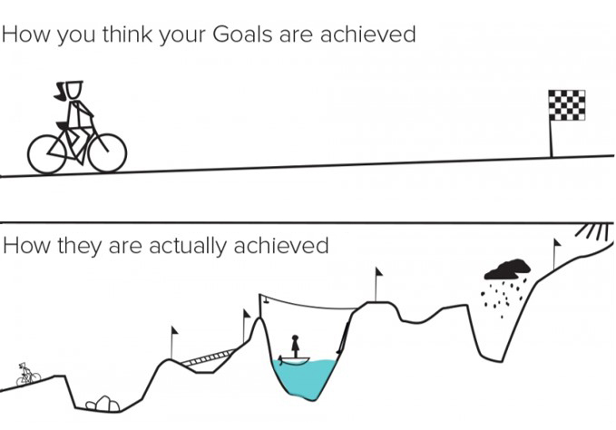
Plan for the obstacles to your goals
Image modified from: Plans. Doghouse Diaries. 2013.
Notes:
As you would have experienced in life, you might think there is a straight and clear path towards your goals, but in reality, there are many obstacles you can encounter along the way!

Slide 15
Mental contrasting
Page 28 of workbook
Think about the goal you visualised at the last session.
What situations could make it difficult for you to achieve your goal?
Think about the main obstacle that would stop you from achieving the goal from last session and write this down in one key word.
Elaborate on this obstacle in your own thoughts.
Why would this make it hard to achieve your goal?
When and where would this occur?
Notes:
[Ask participants to turn to page 28 of the Participant Workbook]
Think about the goal you visualised in the Visualisation Exercise last session and for your brainwork. What situations could make it difficult for you to achieve your goal?
Think about the main obstacle that you personally believe would stop you from achieving your goal and write this down in one word.
Go into more detail about this obstacle in your own thoughts. What would this be like?
Visualise experiences or events that this obstacle may cause or currently causes in your life.
Why would this make it hard to achieve your goal?
When and where would this happen?
[EXAMPLE: Here are some mental contrasting examples for the goal of completing a TAFE course within 6 months:
Obstacle: Attendance to class may be impacted by being called into work, the bus being late or childcare arrangements falling through. The key word may be ATTENDANCE.
Why: Being unable to attend class may mean that you do not meet the minimum attendance requirements, or that you miss out on learning important information that is needed to pass an assignment or exam.

Slide 16
If-then plans
Now that you have a clear vision for your goal and you know the major obstacle, you are able to form an if-then plan to help you get around the obstacle.
Make a plan
Notes:
Now that you have a clear vision for your goal and you know the major obstacle, you are able to form an if-then plan to help you get around the obstacle.
For the obstacle you have specified, you are now going to make a plan to be followed whenever you run into the obstacle over the coming days or weeks. Although achieving your goal may be challenging, this plan should be something that you believe will be realistic and possible to follow in your daily life.

Slide 17
Examples of if-then plans
For the goal of brushing one’s teeth before going to bed:
Obstacle: I am too tired just before going to bed
Plan: If I have finished dinner, then I will brush my teeth right away
For the goal of eating healthy food:
Obstacle: There’s too much junk food at home
Plan: If I go shopping, then I will only buy healthy food
Notes:
Let’s run through some examples:
For the goal of brushing one’s teeth before going to bed:
The obstacle might be “ I am too tired just before going to bed.”
And then the plan to overcome this obstacle could be “If I have finished dinner, then I will brush my teeth right away.”
For the goal of eating healthy food:
The obstacle might be “There’s too much junk food at home.”
And then the plan to overcome this obstacle could be “If I go shopping, then I will only buy healthy food.”

Slide 18
Examples of if-then plans
For the goal of controlling one’s anger:
Obstacle: My partner dismisses me
Plan: If my partner is dismissive towards me, then I will assertively speak to him/her about it
For the goal of getting up on time:
Obstacle: I feel too tired and press snooze on the alarm
Plan: If the alarm goes off, then I will get out of bed straight away
Notes:
For the goal of controlling one’s anger:
The obstacle might be: “My partner dismisses me”
And the plan to overcome this obstacle could be: “If my partner is dismissive towards me, I will assertively speak to him/her about it”
For the goal of being punctual:
The obstacle might be: “I feel too tired and press snooze on the alarm”
And the plan to overcome this obstacle could be: “If the alarm goes off, then I will get out of bed straight away”

Slide 19
If-Then Plans
Page 29 of workbook
Think of the goal you visualised in Module 8.
Complete this sentence on your worksheet in relation to overcoming the major obstacle to achieving your goal:
If I ________________________________,
then I will __________________________.
Notes:
[Direct the participants to the if-then plan worksheet on page 29 of their workbooks. Ask them to complete an if-then plan to over come an obstacle to achieving the goal they visualised in the in module 8.]

Slide 20
If-Then Plans
Page 29 of workbook
Repeat what you have written down in your head a few times (using your self-talker!)
Close your eyes and imagine yourself acting out this plan in a real life situation.
How does this make you feel?
Give your thoughts and imagination free rein and write or draw them in your workbook.
Notes:
[Click to animate slide]
After you have written this down, repeat what you have written down in your head a few times (using your self-talker!). Remember this is entirely personal; there are no right or wrong statements.
[Click to animate slide]
Close your eyes and imagine yourself acting out this plan in a real life situation. Visualise yourself achieving your goal by putting this plan in action and overcoming this obstacle. Can you imagine the positive outcome connected with achieving your goals? How does this make you feel? Give your thoughts and imagination free rein and write or draw them on the page in front of you.

Slide 21
If-Then Plans
Page 29 of workbook
Continue to visualise the positive outcomes associated with your goal and follow the if-then plan you have developed, in order to achieve your goal.
Notes:
Over the next few days, I would like you to continue to visualise the positive outcomes that could come with achieving your goal and follow the if-then plan you have created in order to achieve your goal.

Slide 22
Brainwork
Page 27 of workbook
Add at least four difficult situations and accompanying positive statements you could use for them on your Positive Self-Talk and Coping Thoughts Worksheet.
Complete your Posture Diary
Notes:
Positive Self-Talk and Coping Thoughts Worksheet
Add at least four difficult situations and accompanying positive statements you could use for them on your Positive Self-Talk and Coping Thoughts Worksheet (page 27 of participant workbook).
Also:
Ensure your Posture Diary is completed (Page 21 of participant workbook).

Slide 23
Brainwork prediction
Page 39 in workbook
Positive self-statements and coping thoughts
Description | Actual outcome | Predicted outcome | Actual minus Predicted
Added 4 difficult situations and accompanying positive statements or coping thoughts | 3 | 3
Added 3 difficult situations and accompanying positive statements or coping thoughts | 2 | 2
Added 2 difficult situations and accompanying positive statements or coping thoughts | 1 | 1
Added 0-1 difficult situations and accompanying positive statements or coping thoughts | 0 | 0
The closer to zero, the more accurate your predictions
Negative number: You overestimated your performance
Positive number: You underestimated your performance
Notes:
The brainwork task is:
Add at least four difficult situations and accompanying positive statements you could use for them on your Positive Self-Talk / Coping Thoughts Worksheet (page 27 of participant Workbook).”
Predict how much of the brainwork you think you will complete and write this down now.

Slide 24
End of Module 9
July 2020

Slide 25
Copyright
This presentation is for use as part of the Alcohol and Drug Cognitive Enhancement (ACE) Program. No part may be copied or used for any other purpose without permission from the NSW Agency for Clinical Innovation. Contact via https://www.aci.health.nsw.gov.au/
The examples may be amended to suit local conditions.
Image credits
Shutterstock.com
Published Mar 2018. Next Review 2028. © State of NSW (Agency for Clinical Innovation) and Advanced Neuropsychological Treatment Services

