Slide 1
Module 7: The Inhibitor
Alcohol and drug Cognitive Enhancement (ACE) Program

Slide 2
Revision
What does the Self-reflector monitor?
What level of stress helps us do something well?
What is the best way to manage time pressure?
Notes:
What does the Self-reflector monitor?
[Answer: The internal and external environments and/or time]
What level of stress helps us do something well?
[Answer: not too much and not too little]
What is the best way to manage time pressure?
[Answer: Give yourself enough time to do the task (Recognise, Prevent and Deal)]

Slide 3
Brainwork outcome
Page 38 in workbook
Posture awareness
Description | Actual outcome | Predicted outcome | Actual minus Predicted
Completed 4 or more rows of the table | 3 | 3 | 1
Completed 3 rows of the table only | 2 | 2
Completed 2 rows of the table only | 1 | 1
Completed 0 - 1 row of the table only | 0 | 0
MINUS
The closer to zero, the more accurate your predictions
Negative number: You overestimated your performance
Positive number: You underestimated your performance
Notes:
Circle on your Brainwork Prediction Form how much of your brainwork you completed.
How well did you predict your own behaviour?
[Help anyone still not sure how to do this, but do not spend too long on it.]

Slide 4
Posture awareness
So, what happened when you became aware that you were not sitting or standing up straight?
Have you ever had someone else correct your posture?
If so, in a way, you have ‘internalized’ what was once a prompt from someone else, and this is how we develop a lot of our executive skills
Notes:
So, what happened when you became aware that you were not sitting or standing up straight?
[Most will say that they changed their posture.]
Have you ever had someone else correct your posture?
If so, in a way, you have ‘internalized’ what was once a prompt from someone else, and this is how we develop a lot of our executive skills.

Slide 5
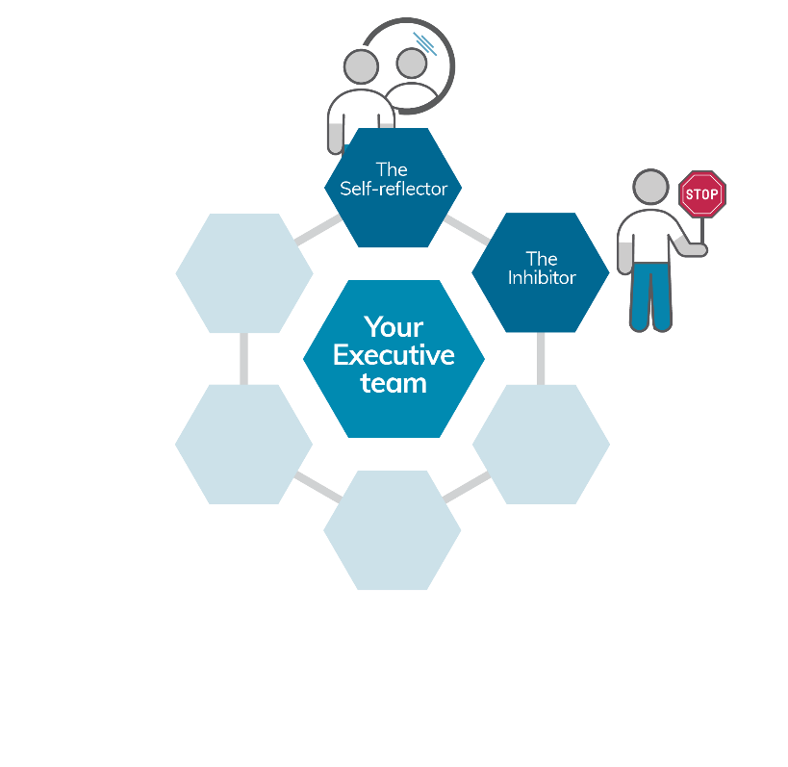
Your Executive team
Notes:
You have now met one member of your Executive Team and today you will meet the second one, The Inhibitor.

Slide 6
Yummy marshmallows
Children aged 4 to 6 years old alone in an empty and uninteresting room.
Researcher said they’d be back in 15 minutes.
On the desk, a single marshmallow on a plate.
If the child avoids eating that marshmallow for the 15 minutes, the child could have two marshmallows.
Notes:
[Read text aloud word for word]
[click to animate slide] - In 1972, children aged 4 to 6 years old were interviewed one at a time by a researcher in an empty and uninteresting room.
[click to animate slide] - During the interview, the researcher said to the child that they needed to leave the room and that they would be back in 15 minutes.
[click to animate slide] - On the desk, there was a single marshmallow sitting in a plate.
[click to animate slide] - The researcher said that if the child avoids eating that marshmallow for the 15 minutes that they are gone, the child could have two marshmallows when they get back.

Slide 7
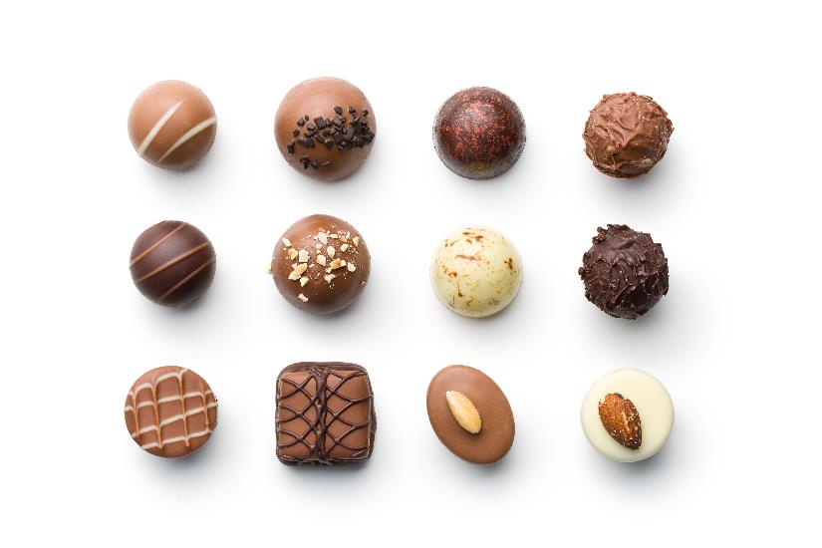
mmm… Delicious!
We are going to do the same experiment using treats
Avoid eating the treat that is in front of you and you will get
two treats!
Notes:
[Co-facilitator to distribute one treat per participant.]
[click to animate slide] - We are going to do the same experiment.. Instead of marshmallows, we will be using [say which ever treat you have chosen]
[click to animate slide] - So, if you avoid eating the treat that is in front of you for the next 15-20 minutes, you will get….
[click to animate slide] - two treats!

Slide 8
Temptation tempering tactics (TTT)
Looking around the room
Turning away from the marshmallow
If looking at the marshmallow, keeping glances brief, rather than focusing on it for a long period of time
Singing songs
Telling stories
Other self distraction techniques
Notes:
Ask participants to turn to the Temptation tempering tactics worksheet on page 19 of the participant workbook.
But I’m going to help you by sharing some of the strategies that the successful marshmallow-avoiding children employed. The ones who were able to resist the temptation of taking that single marshmallow managed their attention by doing the following.
Looking around the room
Turning away from the marshmallow
If looking at the marshmallow, keeping glances brief, rather than fixating on it for a long period of time
Singing songs
Telling stories
Other self-distraction techniques
So, I would like you to use these or any other techniques you think might be effective at helping you resist the temptation to eat that treat [say which ever treat you have chosen] that is in front of you.

Slide 9
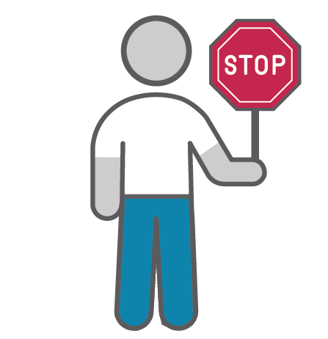
The Inhibitor
We realise that we can’t always have what we want when we want it.
So, we learn to inhibit (put the brakes on) our urges and impulses.
We learn to do this as young children
Notes:
Once The Self-reflector develops (at 8-9 months of age) and we realise that we are individual beings in a social world, we also realise that we can’t always have what we want when we want it.
So, we learn to inhibit (put the brakes on) our urges and impulses.
We learn to do this as young children, mainly from our parents teaching us social ‘rules’.

Slide 10
Brainstorm - I want it now!
What are some things infants/toddlers might want straight away?
What are some standard parental responses to these toddlers’ demands?
And what about teenagers?
Notes:
[click to animate slide] – What are some things infants/toddlers might want straight away?
[click to animate slide] – What are some standard parental responses to these toddlers’ demands?
[click to animate slide] – And what about teenagers?
No amount of teaching rules or social boundaries from our parents can prepare us for the strong need for inhibition we develop as teenagers.

Slide 11
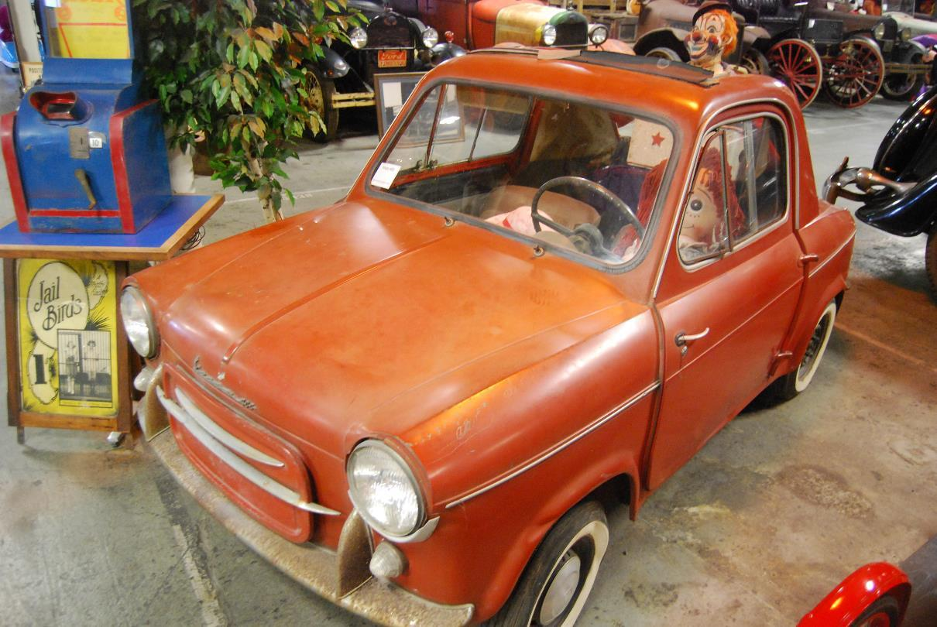
The Inhibitor in childhood
Image credit: Vespa 400. Rhbrakman. 2015 [CC BY-SA 4.0]
Notes:
So, the child who can inhibit (or put the brakes on) their behaviour due to their parents teaching them social rules might be represented by this Vespa 400 car.

Slide 12
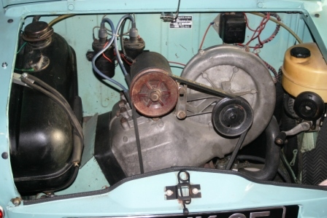
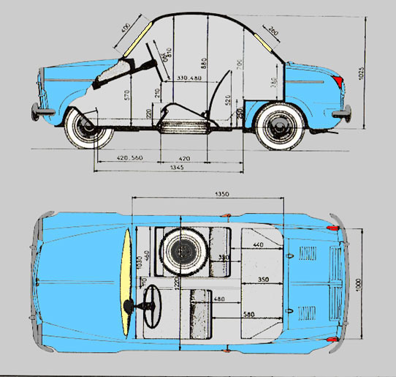
The Inhibitor in childhood
Notes:
It’s quite a small car, with a small engine but very well proportioned and designed.

Slide 13
The Inhibitor in childhood
Notes:
And quite capable of getting people from A to B.

Slide 14
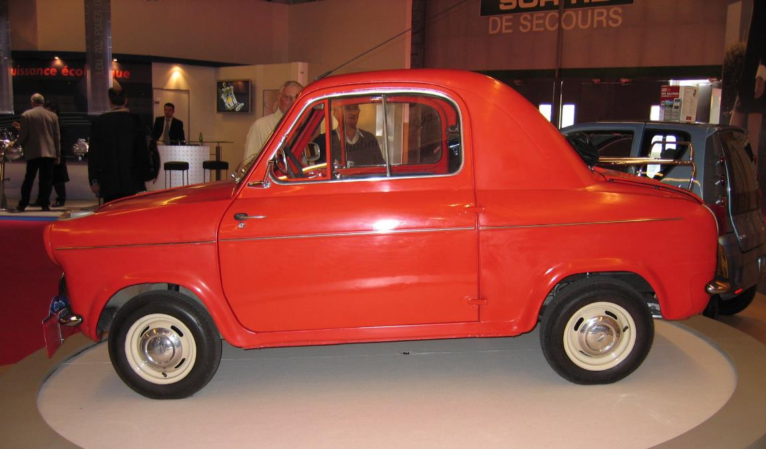
The Inhibitor in adolescence
Image credit: Vespa 400 1. Cars en travel. 2005. [CC BY-SA 3.0]
Notes:
However, during adolescence, our body and brain prepare us for adulthood.
This involves a rapid change in the nature and amount of various chemicals in the brain and body.

Slide 15
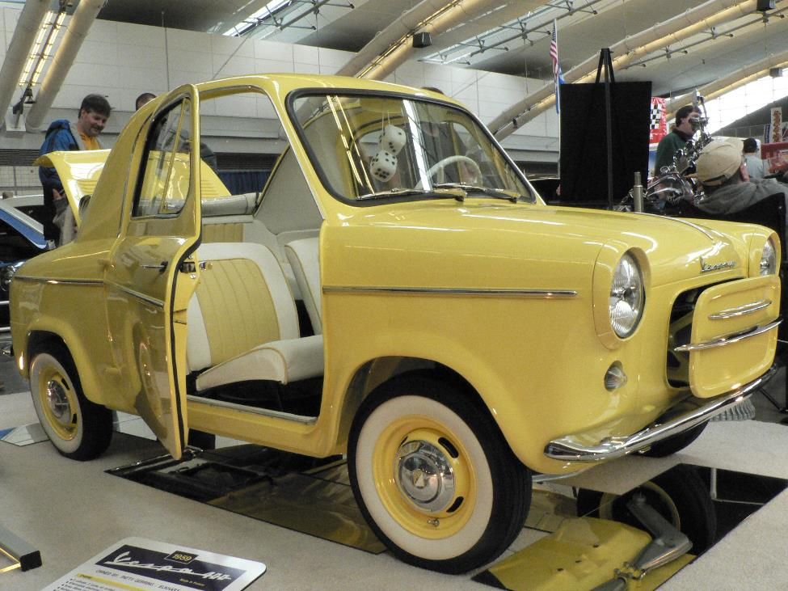
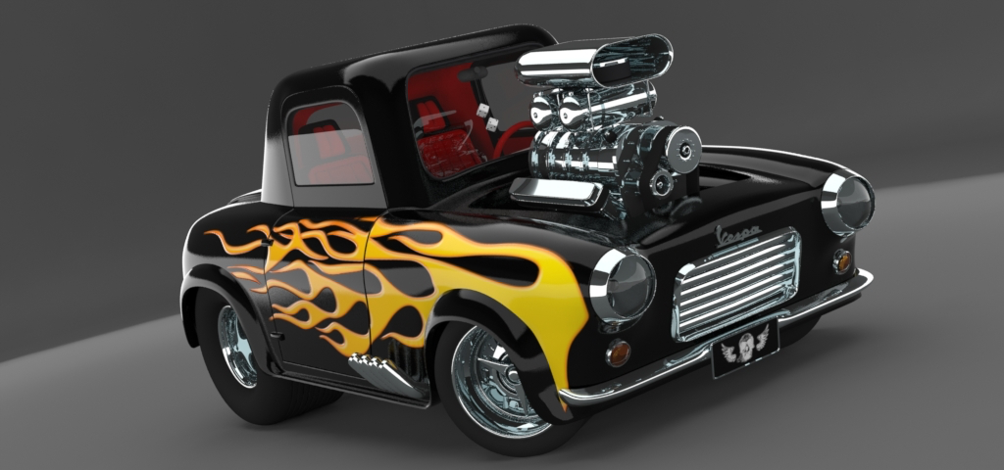
The Inhibitor in adolescence
Image credit: Vespa 400 2. Kev. 2008. [CC BY-SA 2.0]
Notes:
[Click to show transition to hotted up version.]

Slide 16
Brainstorm - uneven transition
How well equipped is the hotted up Vespa in terms of:
Suspension?
Steering?
Braking?
Notes:
How well equipped is the hotted up Vespa in terms of:
Suspension?
Steering?
Braking?
The Vespa has brakes that are good enough to stop it when it is just a Vespa (its childhood form). However, with the V8 engine and power, it needs much better brakes.
Adolescence is a time when the engine power is far too great for the brakes to always be able to stop the vehicle.

Slide 17
Uneven transition
The capacity for putting the brakes on (inhibition) is slow to develop.
This comes through practicing things such as:
biting your tongue
removing yourself from certain situations
distracting yourself
Notes:
The capacity for putting the brakes on (inhibition) is slow to develop.
For most people the braking capacity catches up with the engine power, sometimes by the late 20s or early 30s.
This comes through practice.
So, developing appropriate inhibition comes about by practicing things such as:
biting your tongue
removing yourself from certain situations
distracting yourself

Slide 18
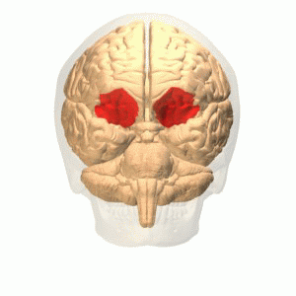
Visualise
Image credit: Orbital gyrus animation 2 from BodyParts 3 D. 2008. Database Center Life Science. [CC BY-SA 2.1 jp] via Wikimedia Commons
Notes:
The inhibitor lives in the floor of the frontal lobes. So, it is like the brakes in a car, they are also on the floor. It might help you to visualise pressing the floor of your frontal lobes when you need to inhibit something.

Slide 19
Notes:
[Distribute additional treats to those that still have one on their table. Participants are welcome to now eat their treats if appropriate.]

Slide 20
Temptation Tempering Tactics
Page 19 of workbook
What were your
Temptation Tempering Tactics?
Children who used these kinds of strategies had better:
educational attainment
higher SAT (like HSC) scores
ability to cope with stress or frustration
body mass index
Notes:
What were the strategies you used to help you manage the temptation of the treat?
[List on board and encourage participants to write the ones most useful to them on their TTT form.]
[click to animate slide]
When children in the original experiment were followed up as adults, they found that children who used these kinds of strategies had better:
educational attainment
higher SAT (like HSC) scores
ability to cope with stress/frustration, and
body mass index.

Slide 21
What do we need to inhibit?
In order to achieve our goals, we sometimes need to inhibit:
Emotional reactions
Which force us into the past or present and away from a future focus
Behavioural responses
to distractions or triggers in the environment
learned through habit
e.g. bad posture
Notes:
In order to achieve our goals, we sometimes need to inhibit:
Emotional reactions
Which force you into the past or present and away from a future focus
For example, if you are feeling the emotion of fear, all of your mind, energy and focus point towards that thing you are fearful of, leaving you no mental space or energy to consider thinking about the future.
Behavioural responses
to distractions or triggers in the environment
learned through habit
e.g. bad posture
For example, you might be in the middle of completing a very important task with an imminent deadline. Your ability to inhibit your want to check that facebook alert that just came through will make it more likely that you will get that deadline completed in time.

Slide 22
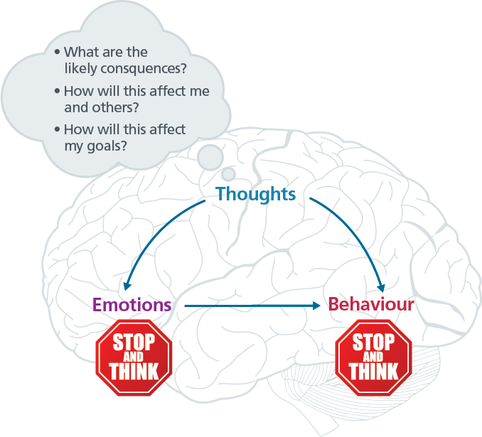
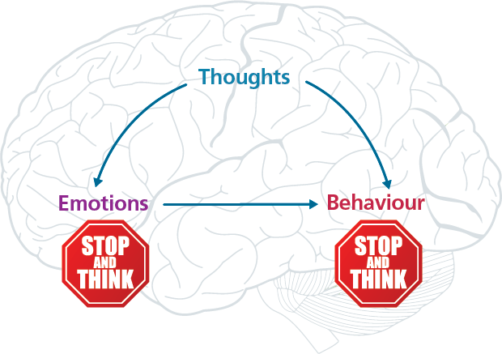
Notes:
So, thoughts can inhibit our emotions and behavioural responses to triggers.
Inhibiting our emotions
[click to animate slide] – …allows us to stop and think about how acting on our emotions might lead to a future state that is away from our goals.
Similarly, inhibiting our behaviours
[click to animate slide] – …allows us to stop and think about how acting out that behaviour might not be in line with our goals.
[click to animate slide] – There are different thoughts that could help you stay goal focused

Slide 23
Stop and Think Technique
Page 20 of workbook
What are the likely consequences?
How will this
affect me and others?
How will this
affect my goals?
Notes:
[click to animate slide]
The Stop and Think technique encourages us to STOP and ask a few basic questions very quickly (THINK) that might then help us change our behaviour so it is more consistent with our goals, such as:
What are the likely consequences?
How will this affect me and others?
How will this affect my goals?
For example, if you are queueing up to get into a live music venue or sporting event and someone nudges you from behind, causing you to spill your drink, stopping and thinking before acting on your anger may prevent you from yelling at or striking someone who may have themselves accidentally tripped and meant you no harm. They may even offer to buy you a new drink after apologising to you, if you provide the space and time for it.
[Ask the participants to complete the Stop and Think Strategy Worksheet at page 20 of the Participant Workbook while thinking of the goal they have set. When completing each of the three questions, they should first ask themselves “If I do what I feel the urge to do right now…”
Alternatively, select a goal from the Goal Menu on page 10 of the Participant Workbook and facilitate a group discussion to complete the Stop and Think Strategy Worksheet]

Slide 24
Brainwork
Page 21 in workbook
Practicing one form of habit inhibition improves inhibition more generally.
Inhibiting the habit of poor posture (over as little as a two week period) can help with inhibiting other things.
Your brainwork is to fill in your Posture Diary worksheet over the next two weeks.
Make a prediction of how much of this you will complete.
Notes:
Research shows that practicing one form of habit inhibition improves inhibition more generally.
Specifically, inhibiting the habit of poor posture (over as little as a two week period) can help with inhibiting other things.
So, your brainwork is to fill in your Posture Diary over the next two weeks.
Make a prediction of how much of this you will complete.

Slide 25
The closer to zero, the more accurate your predictions
Negative number: You overestimated your performance
Positive number: You underestimated your performance
Brainwork prediction
Page 38 in workbook
Posture diary
Description | Actual outcome | Predicted outcome | Actual minus Predicted
Completed 12-14 out of 14 days of the table | 3 | 3
Completed 8-11 out of 14 days of the table | 2 | 2
Completed 4-7 out of 14 days of the table only | 1 | 1
Completed 0-3 out of 14 days of the table only | 0 | 0
Notes:
Predict how much of the brainwork you think you will complete and write this down now.

Slide 26
End of Module 7
July 2020

Slide 27
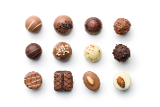
Copyright
This presentation is for use as part of the Alcohol and Drug Cognitive Enhancement (ACE) Program. No part may be copied or used for any other purpose without permission from the NSW Agency for Clinical Innovation. Contact via https://www.aci.health.nsw.gov.au/
The examples may be amended to suit local conditions.
Image credits
Shutterstock.com
Published Mar 2018. Next Review 2028. © State of NSW (Agency for Clinical Innovation) and Advanced Neuropsychological Treatment Services

