Slide 1
Module 5: Time horizons and the Executive team
Alcohol and drug Cognitive Enhancement (ACE) Program

Slide 2
Revision
Which part of the brain is responsible for setting goals and making plans?
A plan is simply a recipe for achieving a ______?
Do the frontal lobes have more to do with the past, present or future?
Notes:
Which part of the brain is responsible for setting goals and making plans?
[Answer: frontal lobes]
A plan is simply a recipe for achieving a ______?
[Answer: goal]
Do the frontal lobes have more to do with the past, present or future?
[Answer: future]

Slide 3
Brainwork outcome
Page 37 in workbook
What is the GAP?
Description | Actual outcome | Predicted outcome | Actual minus Predicted
Selected a goal, wrote it out in more detail, how often you do the goal behaviour per day/week, and the most you could realistically do this | 3 | 3 | 0
Selected a goal, wrote it out in more detail, and how often you do the goal behaviour per day or week | 2 | 2
Selected a goal and wrote out the goal in more detail | 1 | 1
Did nothing or selected a goal only | 0 | 0
MINUS
The closer to zero, the more accurate your predictions
Negative number: You overestimated your performance
Positive number: You underestimated your performance
Notes:
Circle on your brainwork prediction form how much of your brainwork you completed.
How well did you predict your own behaviour?
[Provide assistance to anyone unclear on how to do this but do not spend too long on it.]
[The goal of the brainwork exercise is to help participants develop insight on their ability to complete a task (i.e. overestimating or underestimating their ability to carry out a future action) and help them set realistic goals. This may present a good opportunity to unpack participants’ brainwork results, and promote self-reflection through asking them what the barriers might be to completing the task they set for themselves. Explore what comes up in discussion.]
Suggest asking:
‘What might this mean for other areas of your life?’
Overestimating and under delivering can have negative consequences socially and can negatively impact one’s self esteem and sense of self-efficacy, if they repeatedly fail to achieve set goals.

Slide 4
Complete the story…
Page 11 of workbook
Finish the story so that it has a beginning, middle and end.
You can write a sentence or two, just a few words as a prompt, or you can even draw pictures if you like.
You will have 90 seconds to complete the short story.
You don’t have to tell your story to anyone else.
Be as creative as you want!
Notes:
[Facilitator tips:
To encourage participants to engage in the activity, say: “This is an exercise similar to the ones we have done in previous modules and some will find it more or less challenging. It’s important that you give it a go even if you might have some reservations. There are no right or wrong answers”.
Engage in the activities with clients, especially if clients are disengaged or uninterested.
Consider completing stories 1 and 2, then introducing the time horizon and time horizon expansion exercises before completing stories 3 and 4 to give participants an opportunity to practice expanding their time horizon.]
[SAY]:
I am going to read you the first few words of a story.
I would like you to finish it off so it tells a story, with a beginning, middle and end.
You don’t have to write a whole story.
You can write a sentence or two, just a few words as a prompt, or you can even draw pictures if you like.
The main thing is that you have a story with a beginning, middle and end.
You will have only 90 seconds to complete the short story.
You don’t have to tell your story to anyone else.
Be as creative as you want!
So, please open to page 11 of your workbook.
I’ll start a story for you, and then let you finish it any way you wish. You will have 90 seconds to write your very short story.
I’ll start it now.”
[All stories and reflective task instructions must be read aloud as they appear i.e. word for word.]

Slide 5
Complete the story…
Page 11 of workbook
Story 1
“At three o’clock one bright sunny afternoon in November, two people were walking near the edge of town…”
Notes:
Story 1
[Read aloud word for word.]
“At three o’clock one bright sunny afternoon in November, two people were walking near the edge of town…”
Now, you start there and finish the story for me.

Slide 6
Complete the story…
Page 11 of workbook
Story 2
“Ten o’clock one morning Alice met her friend Jerry near the centre of town…”
Notes:
Story 2
[Read aloud word for word]
“Ten o’clock one morning Alice met her friend Jerry near the centre of town…”
Now you start there and finish it for me.

Slide 7
Complete the story…
Page 11 of workbook
Story 3
“Joe is having a cup of coffee in a restaurant and thinking of the time to come when…”
Notes:
Here is the start of another story that you may again finish any way you wish:
Story 3
[Read aloud word for word]
“Joe is having a cup of coffee in a restaurant and thinking of the time to come when…”
Now you finish it for me.

Slide 8
Complete the story…
Page 11 of workbook
Story 4
“After waking, Belinda began to think about her future.
In general she expected to…”
Notes:
Here the last story that I’ll give you. I want you to finish it any way you wish, just like you did on the other stories. Here it is:
Story 4
[Read aloud word for word]
“After waking, Belinda began to think about her future. In general she expected to…”
Now you start there and finish it for me.

Slide 9
Complete the story…
How long a time was involved in your stories – not in telling them but in the actions described?
Let’s start with Story 1. How much time went by between the beginning and end of the story?
And in Story 2, how much time went by from the beginning to the end of the story?
In Story 3, how much further ahead is Joe thinking?
And in Story 4, how much further ahead was Belinda thinking?
Notes:
Now I want you to determine how long a time was involved in your stories – not in telling them but in the actions described.
[Click to animate slide] - Let’s start with Story 1. How much time went by between the beginning and end of the story?
[Click to animate slide] - And in Story 2, how much time went by from the beginning to the end of the story?
[Click to animate slide] - In Story 3, how much further ahead is Joe thinking?
[Click to animate slide] - And in story 4, how much further ahead was Belinda thinking?

Slide 10
Horizons
SPACE
TIME
Notes:
Ask the participants - What is a horizon?
[Answer will be something like: when you look out as far as you can see, you see the horizon.]
What can you see in the horizon in this picture?
[Answer: an island.]
[Click to animate slide]
Yes, that can be considered a ‘space horizon’, because it represents how far you can see in space (in terms of area around you, not outer space). A similar concept is a ‘time horizon’, which represents how far you can see into the future.

Slide 11
Time horizons
Story | No condition (mid 30s) | A person with a mental illness | A person with substance dependence
1 | 2 hours | 1 hour | 1.3 hours
2 | 2-3 hours | 1.5 hours | 1.7 hours
3 | 7-10 days | 1 hour | 1 hour
4 | 4-5 years | 9 months | 9 days
Notes:
And what you have just done is 'measured' your time horizon using a few test items from a proper psychological test. Because we are just looking at only a few items, the results may not be exactly the same as if you did the whole test. However, this will give you a bit of an idea of what your time horizon is compared to other groups of people.
[click to animate slide]
[Describe table results with each animation (e.g. In a study that looked at time horizons across groups, for individuals with no brain conditions, the average time horizon for story 1 was two hours. For similarly aged people dealing with a mental illness, it was one hour and for individuals with a substance dependence, it was 1.3 hours).]
“So, different types of brain disorders, like severe mental illness or substance dependence, can significantly affect one’s time horizons. Generally speaking, as frontal lobe functioning decreases, the shorter one’s time horizon will be.”
[Facilitator Tip: Before moving onto the next slide, reinforce the message that your result is changeable, adding a motivational statement along the lines of: “whatever the result don’t worry too much about it. We can improve this, and stretch your time horizon by practicing some simple strategies which we will cover next.”
Or frame it in way that links the statement to their recovery: “The horizon might seem far way and like a pipe dream, but once you get further into your recovery you will see that it is achievable, you will start to make plans into the future and the horizon won’t seem so far away.”]

Slide 12
Time horizons
Image modified from: Time horizons, Ed Batista. 2009.
Notes:
Our time horizons will significantly limit the types of goals we can set and plans we make. If our time horizons are too short, we will never be able to set long-term goals, and maybe not even medium-term goals.

Slide 13
Strrrreeeettttch
Notes:
So, whatever our time horizons are, it would be of benefit to stretch them out a little, and it is possible to do this.

Slide 14
Stretch your time horizon
Page 13 of workbook
Think of a time in the distant future (at least 15 years away) and ask yourself:
How old will you be?
Who will you be?
What will you be doing?
Answer the following questions:
How old will you be when…
1. Your first grandchild is born? _______
2. You die? _______
Complete the rest of the questions
Notes:
We will now take some time to complete a time horizon stretching exercise. Turn to page 13 of your workbook.
[Click to animate slide]
Think of a time in the distant future (at least 15 years away) and ask yourself:
How old will you be?
Who will you be?
What will you be doing?
Complete rest of the questions.
[Click to animate slide]
Answer the following questions (ignore any that are irrelevant):
How old will you be when…
1. Your first grandchild is born? _______
2. You die? _______
Complete rest of the questions.

Slide 15
Short and long term costs and benefits
Page 12 of workbook
Think about the immediate (short-term) costs and benefits of something you want to do and compare that with the long-term costs and benefits.
Let’s practice on a common goal:
increasing the amount of physical exercise we do.
Notes:
Another way of increasing your time horizon is to think about the immediate (short-term) costs and benefits of an activity (or behaviour you want to change) and compare that with the long-term costs and benefits.
Whiteboard or butchers paper activity
So, let’s do this as a group for a common goal that we have all probably had from time to time: increasing the amount of physical exercise we do.
You can copy the responses into your Participant Workbook (Page 12 of Participant Workbook)

Slide 16
Physical exercise
SHORT TERM (24 hours) Costs | SHORT TERM (24 hours) Benefits
LONG TERM (3 months) Costs | LONG TERM (3 months) Benefits
Notes:
[Brainstorm the short and long term costs and benefits of physical exercise as a group on a whiteboard. The results should show more short-term costs than benefits and more long-term benefits than costs.]
[Discuss how ‘living in the here and now’ (i.e. only considering short-term gain or pain) can make it very hard to engage in longer-term goals. However, if we think into the future (e.g. three months), the benefits of pushing through the short-term pain can feel more appealing to us.]

Slide 17
What are the executive functions?
What does an Executive team of a company do?
Notes:
What does an executive team of a company do?
[Write answers on whiteboard.]
[Answers could include:
Set goals or targets for the company to meet for the next quarter or financial year
Put together a strategic plan for how to compete with similar companies
Keep an eye on company finances (incomings and outgoings, growth)]

Slide 18
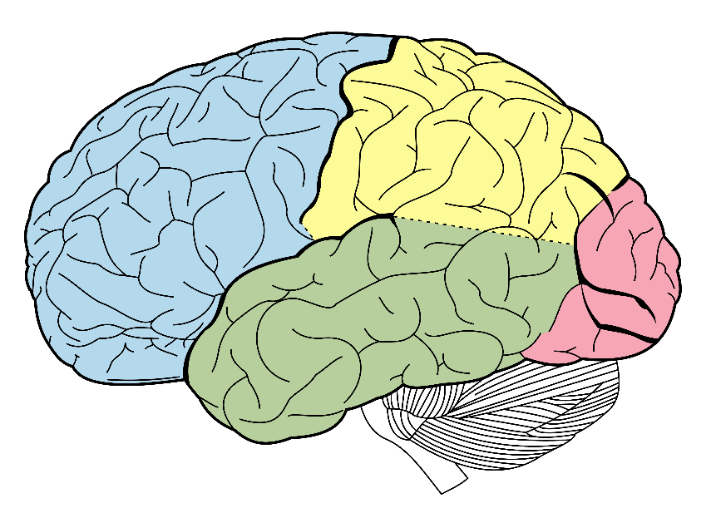
What are the executive functions?
Parietal lobe
Frontal lobe
Take in information
What do I want in the future?
What is happening right now?
What should I do next?
Occipital lobe
What has happened in the past?
Look into the future
Pay attention
Temporal lobe
Notes:
[click to animate slide]
This is the same kind of things that your frontal lobes do, thus the frontal lobes are linked to control of the executive functions.
[click to animate slide]
The frontal lobes take in all the information from the back of the brain (being sensory input and memories) to determine what the next action should be.
[click to animate slide]
However, the frontal lobes also give us the ability to look into the future and imagine a future we want.
[click to animate slide]
Once we know the future we want, the frontal lobes tell the parts at the back of the brain what to pay attention to in order to achieve those goals.
This is also the part of the brain that goes on holiday during addiction, so it's important that we get the executive team back up to speed by putting them to work (use it or lose it).

Slide 19
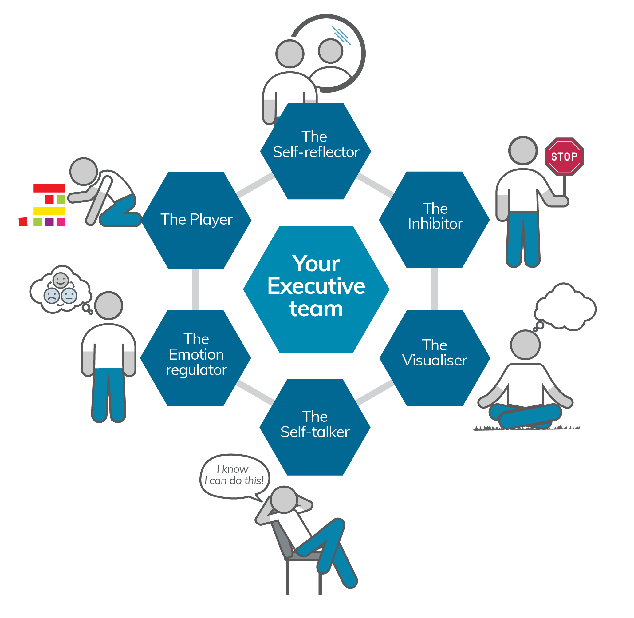
The Executive team
Self-reflector
Inhibitor
Visualiser
Self-talker
Emotion regulator
Player
Notes:
With that in mind, there are six members of our brain’s executive team. They are the:
Self-reflector
Inhibitor
Visualiser
Self-talker
Emotion regulator
Player

Slide 20
Notes:
These executive team members will help you set goals, make plans and solve problems along the way to achieving the goals that you create within your time horizons.
We will meet a new member of your team over each of the next six sessions and you will learn ways to help them to help you set and achieve your goals.

Slide 21
Brainwork
Page 15 of workbook
Brainwork prediction forms
For the goal you chose at the last session, complete the
exercise on the costs and benefits in the short-term and
long-term for that goal.
Then, write out a simple plan you can follow to help you achieve the goal by the end of next week
Notes:
[Click to animate slide]
[Review brainwork prediction forms.]
Short and Long Term Costs and Benefits (page 15 of your workbook)
For the goal you chose at the last session, complete the exercise in your workbook on the costs and benefits in the short-term and long-term for that goal.
Then, write out a simple plan you can follow to help you achieve the goal by the end of next week.
For example, if your goal is to floss your teeth 7 nights per fortnight, a plan might be to buy dental floss the next time you go shopping. If you already have dental floss, the plan could be to put it near your toothbrush so you remember (prospectively) to floss after (or before) you brush.

Slide 22
Brainwork prediction
Page 38 in workbook
Short and long term costs and benefits
Description | Actual outcome | Predicted outcome | Actual minus Predicted
Completed all 4 columns of the table and wrote down a simple plan to assist with completing the goal by then end of next week | 3 | 3
Completed all 4 columns of the table only | 2 | 2
Completed 2-3 columns of the table only | 1 | 1
Completed 0-1 columns of the table only | 0 | 0
The closer to zero, the more accurate your predictions
Negative number: You overestimated your performance
Positive number: You underestimated your performance
Notes:
Short and Long Term Costs and Benefits worksheet (page 15 of the Participant Workbook). Participants are to complete this worksheet for the goal they set themselves last session.
Complete your Brainwork Prediction Form for this session and write this down now.

Slide 23
End of Module 5
July 2020

Slide 24
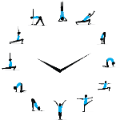
Copyright
This presentation is for use as part of the Alcohol and Drug Cognitive Enhancement (ACE) Program. No part may be copied or used for any other purpose without permission from the NSW Agency for Clinical Innovation. Contact via https://www.aci.health.nsw.gov.au/
The examples may be amended to suit local conditions.
Published Mar 2018. Next Review 2028. © State of NSW (Agency for Clinical Innovation) and
Advanced Neuropsychological Treatment Services
Image credits
Shutterstock.com

