Slide 1
Continuous Opioid Infusion ADULT
NSW Pain Form
June 2023
Emily Edmonds | Co-ordinator NSW Pain Forms, CNC Acute Pain Service Blacktown Hospital

Slide 4
Continuous Opioid Infusion form - adult
The Continuous Opioid Infusion prescription and observation form for adult patients has been developed in NSW by a team of experts in the field of acute pain including clinical nurse consultants, anaesthetists and pharmacy representatives.
This Continuous Opioid Infusion form is not suitable for use in paediatric patients and may not be suitable for palliative care or end of life patients.
Standardisation of this chart promotes best practice in prescribing, pain assessment and management of adverse effects in those patients receiving a continuous opioid infusion.

Slide 5
Aim of this presentation
This presentation aims to explain:
how to use the form for prescribing a continuous opioid infusion
how to record the administration and discard of drugs used for a continuous opioid infusion
how to complete the clinical observations
guidelines on the management of patients receiving a continuous opioid infusion including the management of adverse effects.

Slide 6
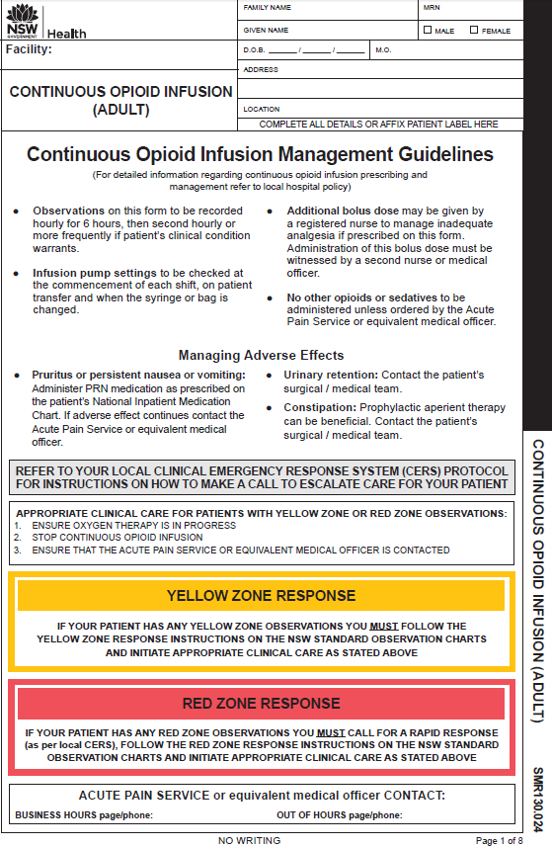
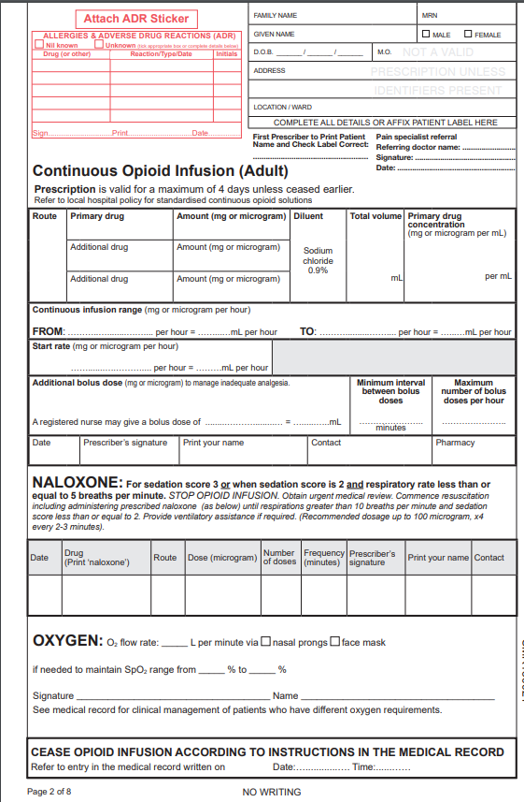
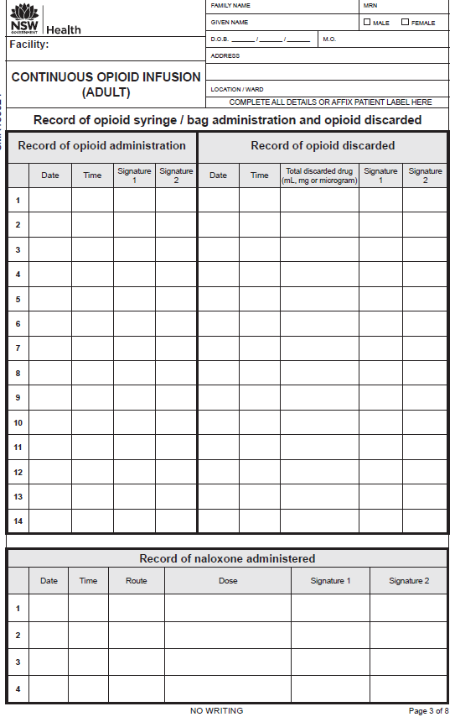
Booklet format
Prescription valid for 4 days | Observation pages for 4 days
Continuous Opioid Infusion form – adult
Page 1
Page 2
Page 3
Page 1 Management guidelines Yellow and Red Zone response instructions
Page 2 Continuous opioid prescription, naloxone and oxygen prescription, ceasing
Page 3 Administration and discard Opioid administration, drug discard, record of naloxone administration

Slide 7
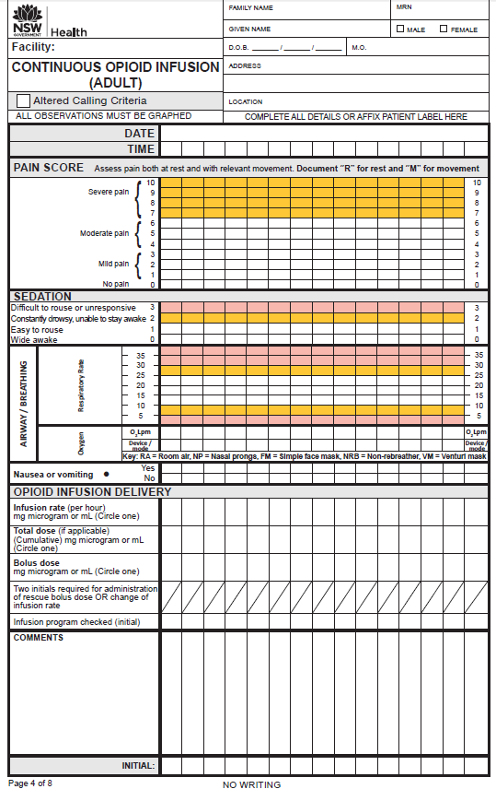
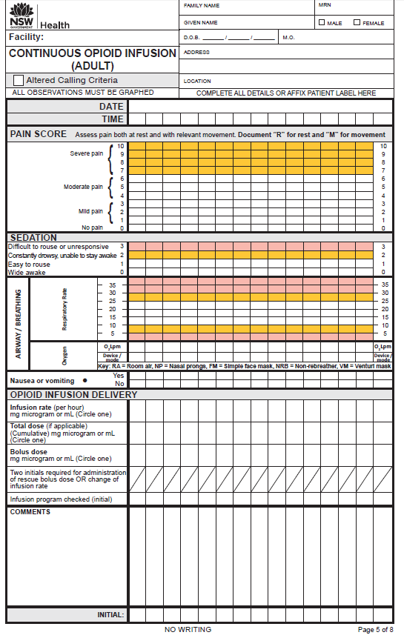
Continuous Opioid Infusion form – adult: observation pages for up to 4 days

Slide 8
For detailed information regarding continuous opioid infusion prescribing and management refer to local hospital continuous opioid infusion policy or procedure
Continuous Opioid Infusion form – adult
Managing adverse effects
Instructions for managing patients whose observations fall into the Yellow or Red Zone

Slide 9
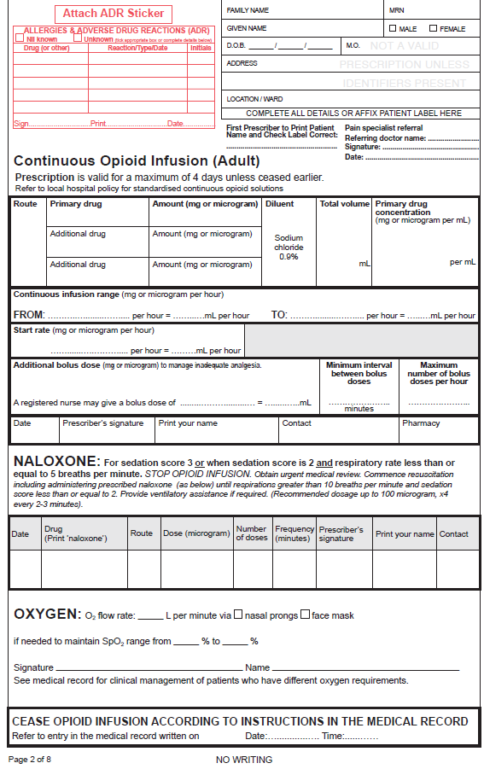
Patient label and allergy and adverse reactions
Continuous Opioid Infusion form – adult
Prescription (Page 2)
Opioid prescription:
primary opioid drug
option for additional drugs
continuous infusion range
start rate
additional bolus dose
Private patients: pain specialist referral from the referring doctor (name), signature and date
Naloxone prescription
Oxygen prescription
Ceasing instructions

Slide 10
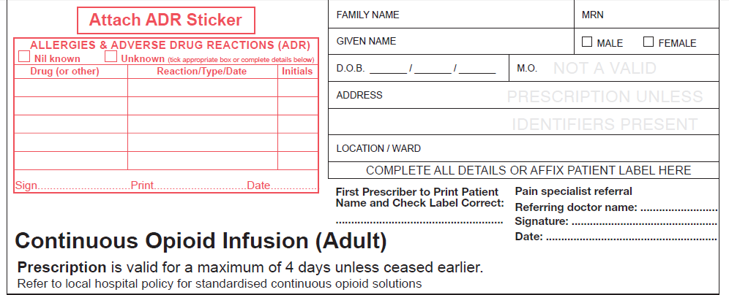
Continuous opioid infusion prescription
Handwrite patient details OR affix patient label
(First prescriber to check patient label is correct)
Prescriber to complete patient allergy and ADR section in full
TSmith
SMITH
5/4/17
PRIVATE PATIENTS:
For Medicare billing purposes
a pain specialist referral from the referring doctor (name), signature and date

Slide 11
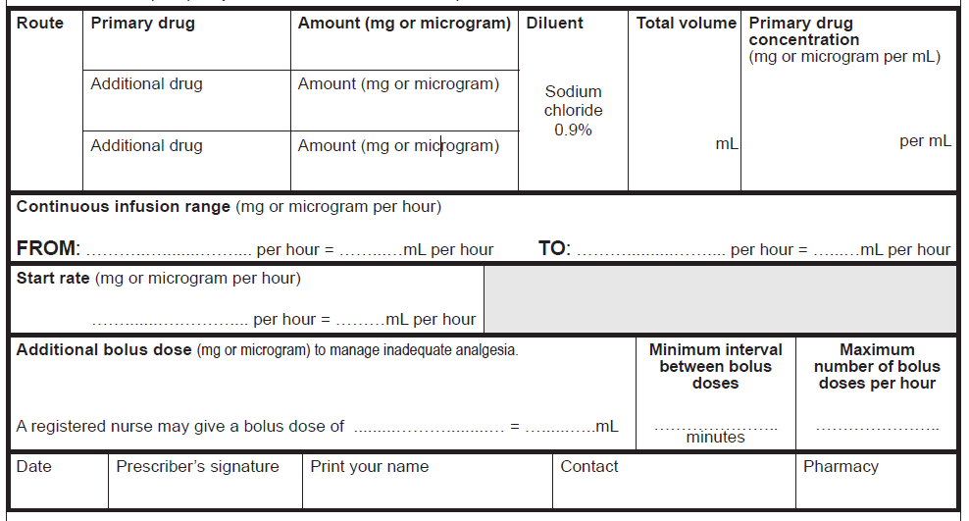
Below is an EXAMPLE prescription.
Refer to hospital policy for local guidelines on prescribing a continuous opioid infusion.
Continuous opioid prescription
Morphine
100 mg
IV
NIL
100
1 mg/mL
NIL
1 mg
3 mg
3
1
5
1 mg
1
3 mg
3
15
2
5/4/17
TSmith
SMITH
7511
Space provided for pharmacist reconciliation

Slide 12
Naloxone prescription
5/4/17 naloxone IV 100 x4 2 – 3 TSmith SMITH
microgram minutes

Slide 13
Oxygen order and cessation of opioid infusion
Oxygen prescription flow rate via nasal prongs or face mask and Sp02 range
2

92 96
PSmith SMITH
CEASE continuous opioid infusion as per Acute Pain Service or equivalent medical officer

Slide 14
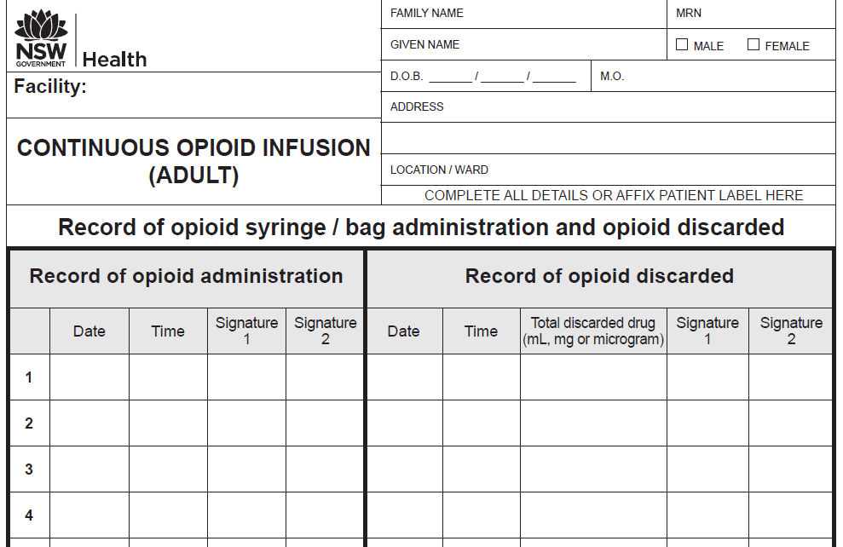
Administration and discard of opioid solution
5/4/17 10:00 Thall SRose 5/4/17 20:00 5mL ALoh JLucas
6/4/17 10:00 SLee SRose 6/4/17 21:00 10mL THall GLamb
Opioid infusion commenced
Page 3
Discard of any remaining opioid solution

Slide 15
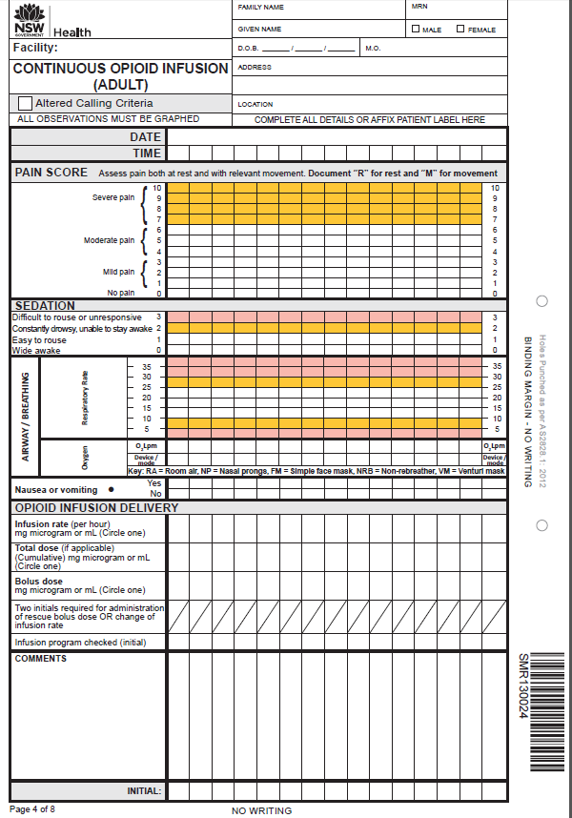
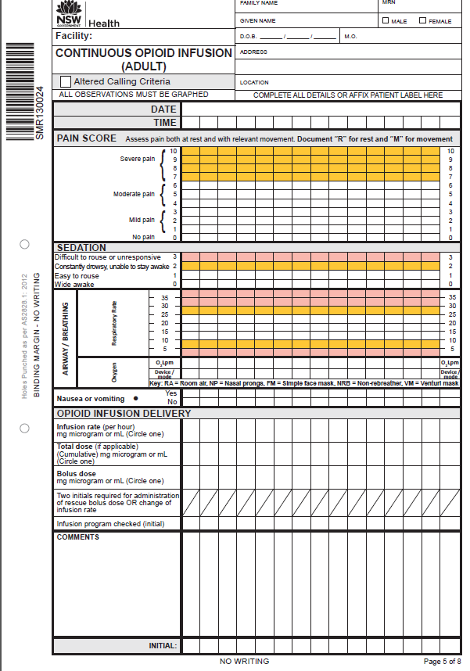
Observation pages
The Continuous Opioid Infusion form provides observations for a maximum of 4 days.
If the infusion continues beyond 4 days, a new form must be started and a new prescription written.
Observation pages

Slide 16
Observations
Pain score
Sedation score and
Respiratory rate
Oxygen therapy and oxygen device mode
Opioid infusion delivery
Infusion rate
Total dose
Bolus dose
Two initials for bolus dose
Program check

Slide 17
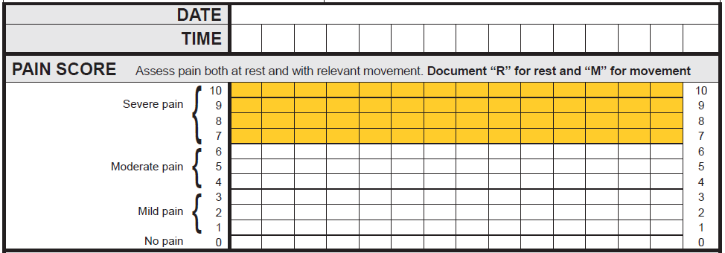
Documenting observations: Pain Assessment
‘R’ for rest ‘M’ for movement
Where a patient scores their pain 7 or above (in the Yellow Zone), the nurse must assess the current clinical pain management plan for the patient.
For example:
Have pain scores previously been in the White Zone (0 to 6)?
Is the infusion pump functioning correctly
Have additional prescribed analgesics been administered?
Has the patient been reviewed by the Acute Pain Service or equivalent medical officer?
The assessing nurse may need to consult with the NURSE IN CHARGE to decide whether a CLINICAL REVIEW (or other CERS – Clinical Emergency Response) call should be made.
05/4/17
1100
1200
1300
1400
1500
M
M
M
M
M
R
R
R
R
R

Slide 18
Documenting observations: sedation, respiratory rate, oxygen therapy and Infusion delivery
• • •
•
Observations in the ‘Yellow Zone’ require a Clinical Review by the Acute Pain Service (or equivalent medical officer)
•
• • •
2L 2L 2L 2L
NP NP NP NP
•
•
•
•
2 2 2 2
mg mg mg mg
Observations in the ‘Red Zone’ require a Rapid Response to be initiated
AND
contact the Acute Pain Service
(or equivalent medical officer)
3
mg
TS
TS
BJ
TS TS TS TS

Slide 19
The next two slides details:
Continuous opioid management guidelines
Yellow and Red Zone instructions

Slide 21
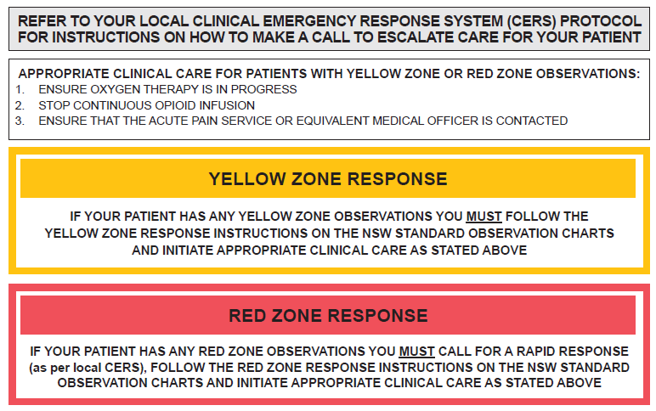

Slide 22
The standardisation of this form promotes best practice in prescribing, pain assessment and management of adverse effects in those patients receiving medications via a continuous opioid infusion modality.
Information related to the NSW Pain Forms can be found on the ACI website:
http://www.aci.health.nsw.gov.au/networks/pain-management/acute-pain-forms
Comments or questions can be forwarded to:
Susan Rogers
Manager Pain Management Network
Agency for Clinical Innovation (ACI)
Phone: 0436611400
Email: ACI-PainManagement@health.nsw.gov.au
Emily Edmonds
Pain Nurses Australia: Director Corporate Governance
CNC Acute Pain Service Blacktown Hospital
Phone: 0427074007
Email: emily.edmonds@health.nsw.gov.au
OR

Slide 23
This presentation was first prepared in 2015 and reviewed in 2017 by the former NSW Pain Interest Group Nursing Issues in association with the ACI Pain Management Network.
A review was undertaken in 2023 by NSW members of Pain Nurses Australia.

Slide 24
Published Jun 2023. Next review 2028. SHPN: (ACI) 230327 ISBN: 978-1-76023-529-1 ACI/D23/820 [ACI_8121] © State of NSW (Agency for Clinical Innovation) CC-ND-BY​

