Slide 1
Emergency Care Assessment and Treatment (ECAT)

Slide 2
Notes:
The Agency for Clinical Innovation (ACI) acknowledges that we operate and function on the lands of the Cammeraygal people and we pay tribute to the Traditional Custodians of the various lands that you are on today.
We pay our respect to these lands, sea and waterways that provide for us.
We acknowledge and pay respect to the ancestors who walked and managed these lands and waters for many generations.
We acknowledge and recognise all Aboriginal people who have come from their own Country and who have now come to call this Country home.
We acknowledge Elders who are the knowledge holders, teachers and pioneers.
We acknowledge the youth who are the hope for a brighter future and who will be future leaders.
We acknowledge and honour the stories, traditions and how culture is held, nurtured and shared.

Slide 4
ECAT
Emergency Care Assessment and Treatment
ECAT is a state-wide project that aims to standardise nurse-initiated emergency care
Notes:
Kylie

Slide 5
Divider slide

Slide 6
Background
In emergency settings, medical and nursing work closely as a team
Nurses are usually the first clinician to see patients - triage followed by initial assessment and management
Nurse initiated care is part of usual practice
Notes:
Frontline clinicians engaged

Slide 7
ECAT aims to reduce unwarranted variation
Variation in governance and sponsorship
Variation in nurse-initiated protocols
Variation in education delivery and standards
Leading to inequity of access to care
Leading to duplication of effort and career progression
Leading to duplication of processes, time and cost

Slide 8
ECAT expected benefits
Improved patient experience
decreased time to analgesia/ symptom relief, decreased waiting times
Improved patient outcomes
timely access to initial care, decreased LOS
Increased value
reduced duplication of development, approval and governance
Improved staff experience
transferability of skilled workforce across NSW, increased staff satisfaction

Slide 9
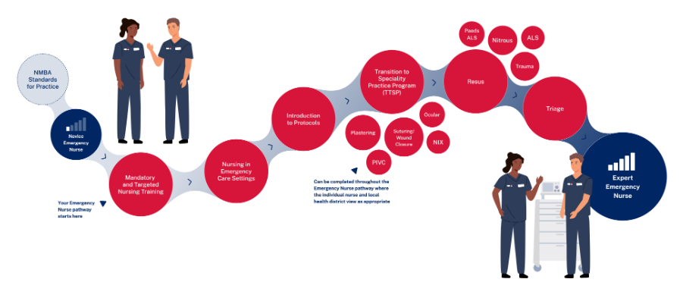
Standardised Education Pathway
Reproduced with permission from the NSW Health Education and Training Institute
Notes:
Image available at: https://www.heti.nsw.gov.au/education-and-training/our-focus-areas/nursing-and-midwifery/emergency-nursing

Slide 10
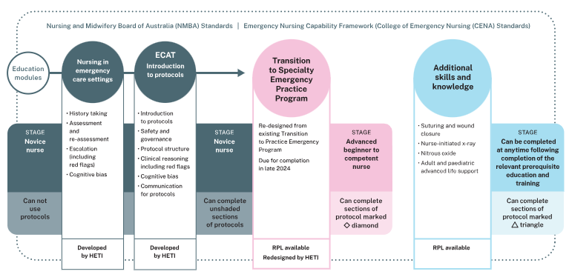
Education requirements to support ECAT Protocols

Slide 11
ECAT workflow and key decision points

