Slide 1
Obstetric Epidural Analgesia chart
NSW Pain Form
December 2023
Emily Edmonds. Co-ordinator NSW Pain Forms.
CNC Acute Pain Service Blacktown Hospital.

Slide 4
Obstetric Epidural Analgesia form - adult
The Obstetric Epidural analgesia prescription and observation form for women receiving an epidural during labour, has been developed in NSW by a team of experts from midwifery, anaesthesia and obstetrics. This form has been revised in 2023.
Standardisation of this chart promotes best practice in the documentation of inserting an epidural, prescribing and administration of medications delivered via the epidural route and documentation of observations associated for women receiving Epidural Analgesia during labour.

Slide 5
Aim of this presentation:
This presentation aims to explain
guidelines on the management of epidural during labour including the management of adverse effects.
How the form is used for prescribing an epidural infusion and documenting the insertion of the epidural.
how to record the administration and discard of medications used for an epidural infusion
how to complete the clinical observations

Slide 6
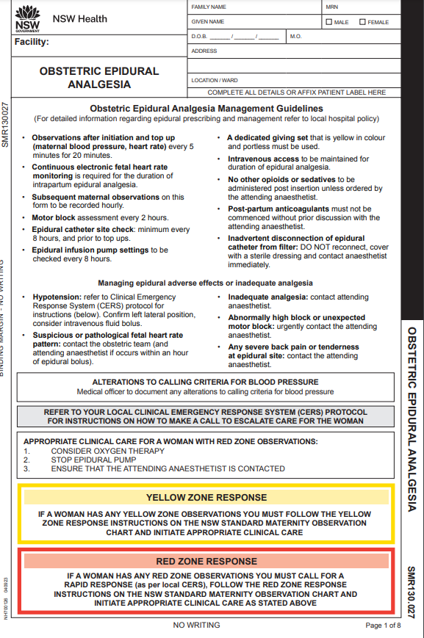
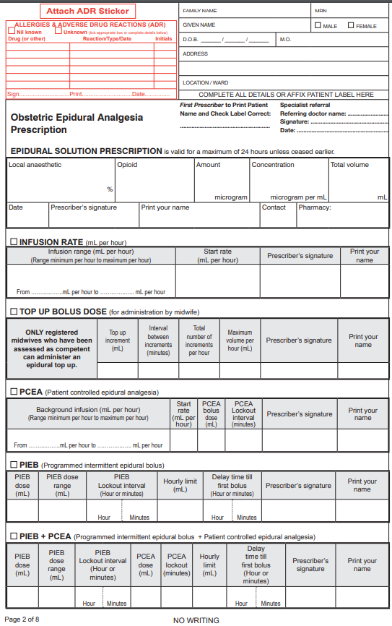
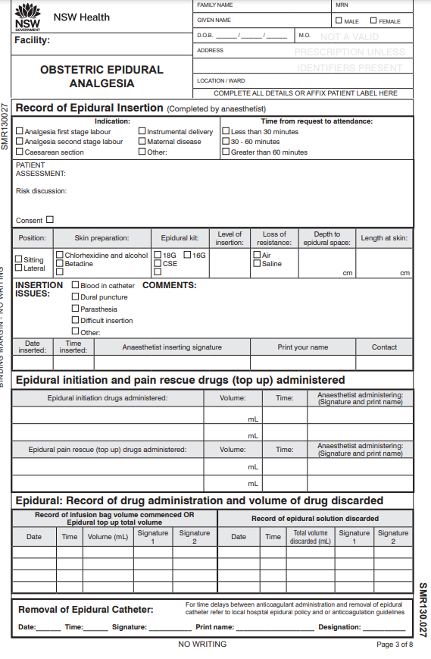
Obstetric Epidural Analgesia form
Booklet format includes: Management Guidelines, Insertion Details, Medication Administration, Clinical Observations
Page 1
Page 2
Page 3
Page 2
Epidural prescription, Epidural programs prescriptions
Page 3
Epidural insertion details, Epidural medication administration, medication discard , removal of epidural catheter
Page 1
Management guidelines
Yellow and Red Zone response instructions

Slide 7
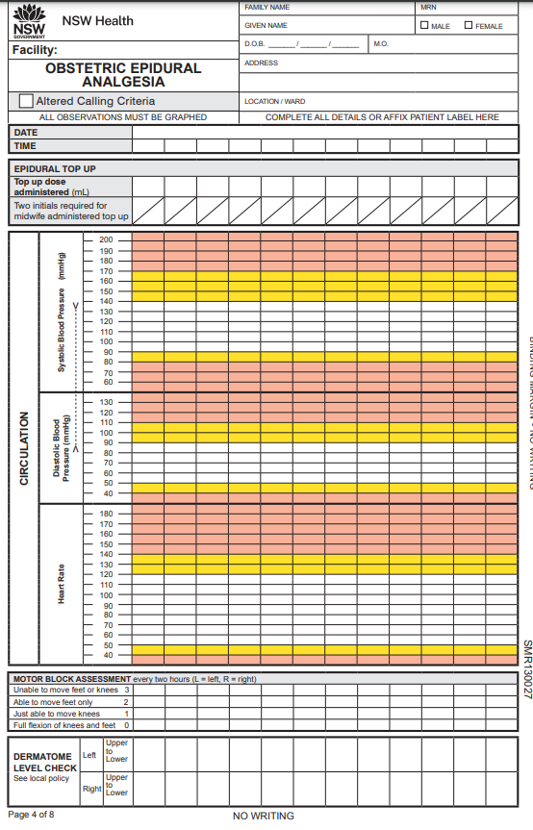
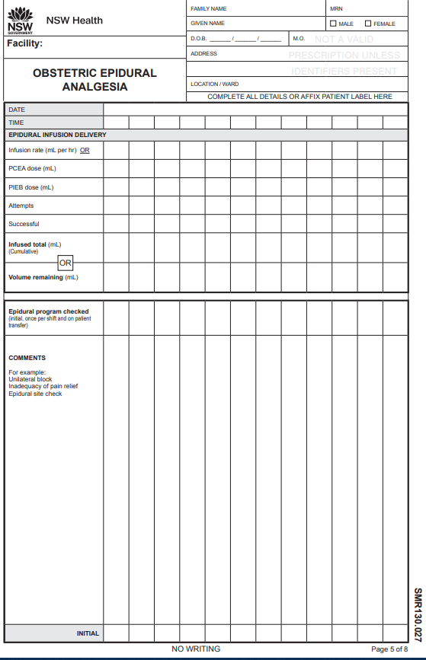
Obstetric Epidural Analgesia form - adult
Observation pages for up to 24 hours.
If an epidural is required for more than 24 hours, a second chart would need to be commenced.

Slide 8
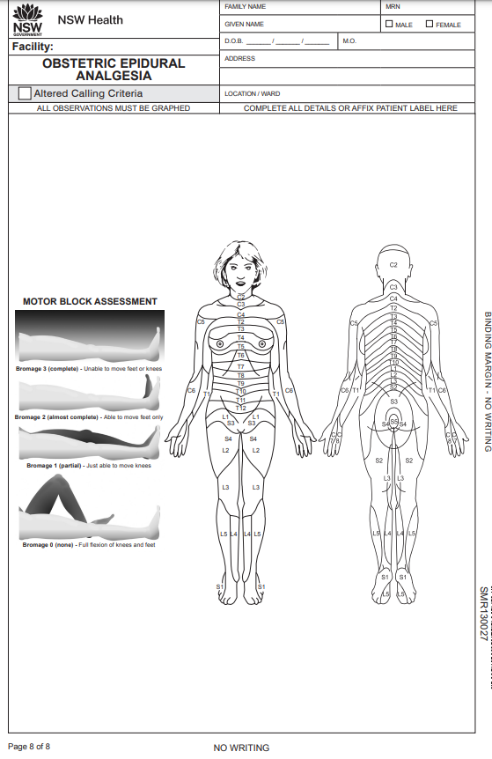
Obstetric Epidural Analgesia form - adult
Back page
Motor Block Assessment Guide (Bromage score). Dermatome diagram.

Slide 9
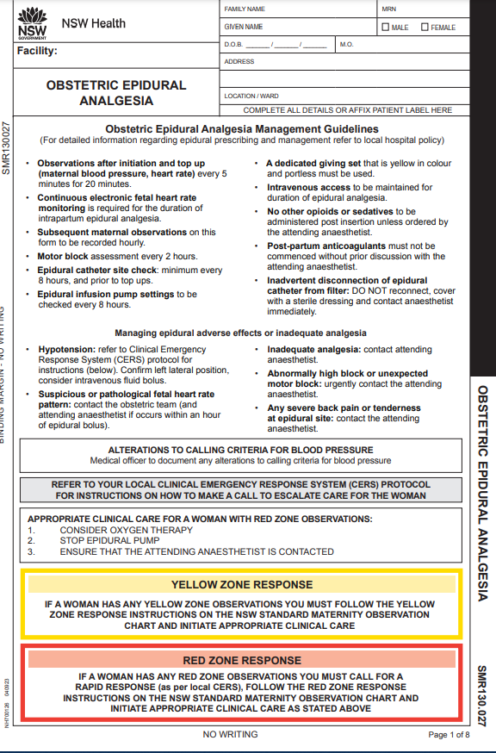
Obstetric Epidural Analgesia form - adult
Refer to your local hospital policy or procedure for management of an epidural during labour
Managing epidural adverse effects
Yellow and Red Zone Response instructions

Slide 10
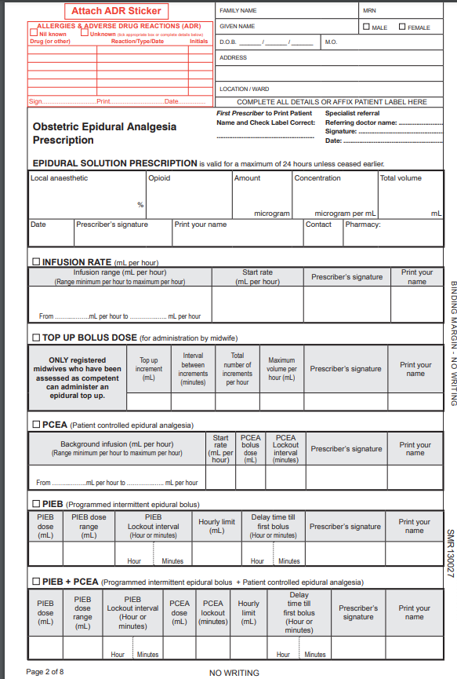
Obstetric Epidural Analgesia form – adult
Prescription and Program options
Patient label and allergy adverse reactions
Private patients:
pain specialist referral for Medicare billing purposes. Name and signature of the doctor making the referral
Page 2
Epidural solution prescription
Program prescription options:
Infusion rate
Top up bolus dose
PCEA (patient controlled epidural bolus)
PIEB (programmed intermittent epidural bolus)
PIEB+PCEA

Slide 11
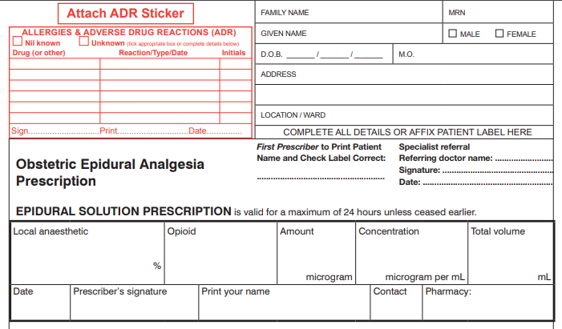
Epidural prescription:
Below is an EXAMPLE epidural prescription
Refer to hospital Obstetric epidural policy for local guidelines on epidural analgesia prescribing for women during labour
Handwrite patient details OR affix patient label
(First prescriber to check patient label is correct)
Prescriber to complete patient allergy and ADR section in full
TSmith
SMITH
10/12/23
PRIVATE PATIENTS:
For Medicare billing purposes a pain specialist referral from the referring doctor (name), signature and date
Ropivacaine 0.1 fentanyl 200 2 100
10/12/23 TSmith SMITH 7511

Slide 12
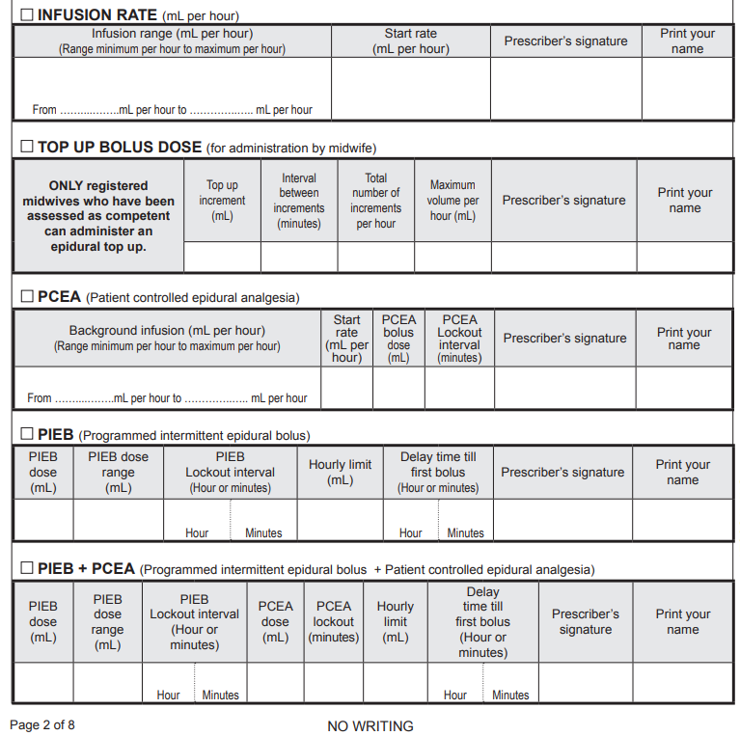
Program options
There are 5 program options available for an epidural during labour:
Infusion rate
Top up bolus dose (by midwife)
PCEA (patient controlled epidural analgesia)
PIEB (programmed intermittent epidural bolus)
PIEB + PCEA.
Generally, only one option will be completed by the prescriber.
(programmed intermittent epidural bolus + patient controlled epidural analgesia)

Slide 13
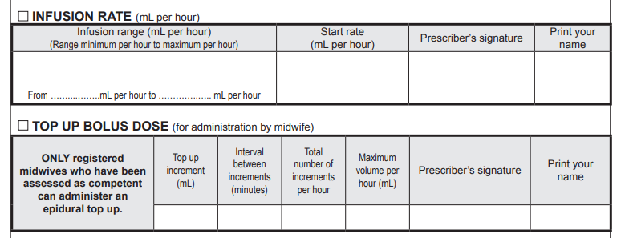
Epidural program options: Infusion rate, top up bolus (for administration by midwife)
Below is an EXAMPLE for an INFUSION ONLY program and a RESCUE BOLUS DOSE for administration by a registered midwife
Refer to hospital epidural policy for local guidelines on epidural program prescribing for women during labour

5 mL / hr
TSmith
SMITH
5 10

2
5 mL 5 minutes 4 20 mL
TSmith
SMITH

Slide 14
Epidural program options: PCEA (patient controlled epidural analgesia)
Below is an EXAMPLE for a PCEA (patient-controlled analgesia). Refer to hospital epidural policy for local guidelines on epidural program prescribing for women during labour

5 10 5 5 20 TSmith SMITH

Slide 15
PIEB (programmed intermittent bolus)
Below is an EXAMPLE for a PIEB (programmed intermittent bolus). Refer to hospital epidural policy for local guidelines on epidural program prescribing for women during labour
PIEB (Programmed intermittent epidural bolus):
This modality of analgesia delivers an automated epidural bolus dose at programmable intervals. Studies have demonstrated less total local anaesthetic consumption ^{1,2}, less motor blockade ^{2,3}, fewer manual bolus doses because of breakthrough pain, greater patient satisfaction ^{1,3} and reduction of instrumental delivery ^{2,3}.

5 5 - 7 1 - 25 mL - 15 TSmith SMITH
Wong, C. et al. (2011) A randomized comparison of programmed intermittent epidural bolus with continuous epidural infusion for labour analgesia. Anesth Anal 102(3): 904-9
Capogna, G. et al. (2011) Programmed intermittent epidural bolus versus continuous epidural infusion for labour analgesia: The effects on maternal motor function and labour outcome. A randomized double-blind study in nulliparous women. Anesth Analg 113(4): 826-31.
George, B. et al. (2013) Intermittent epidural bolus compared with continuous epidural infusions for labor analgesia: a systematic review and meta-analysis. Amesth Anal 116(1): 133-144

Slide 16
PIEB + PCEA (Programmed, intermittent bolus + patient controlled epidural analgesia)
Below is an EXAMPLE for a PIEB + PCEA (programmed intermittent bolus + patient controlled epidural analgesia). Refer to hospital epidural policy for local guidelines on epidural program prescribing for women during labour

5 mL 5 - 7 mL 1 - 5 mL 10 25 mL - 15 TSmith SMITH
mins

Slide 17
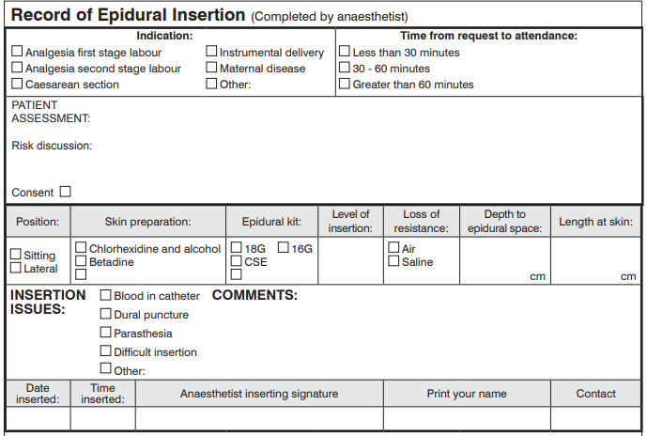
Record of epidural insertion for completion by an anaesthetist
Below is an EXAMPLE of information that may be documented related to the insertion of an epidural during labour


Patient fit, healthy, no bleeding disorder or back problems.
Risks explained including failure, haemorrhage, nerve injury, infection





10/12/23 10:00 TSmith SMITH

Slide 18
Epidural initiation and pain rescue drugs (top up) administered. (completion by an anaesthetist)
Below is an EXAMPLE of documentation related to the administration of drugs delivered via an epidural during the insertion of an epidural during labour.
Epidural initiation drugs: These are the drugs that are administered by an anaesthetist during the insertion of the epidural
Epidural pain rescue (top up) drugs: These are drugs that may be administered by an anaesthetist after the epidural has started where additional pain relief is required due to an ineffective analgesia.
Bupivacaine 0.125% + fentanyl 5mcg/mL 5, 5, 5,5 10:00 TSmith SMITH
Ropivacaine 0.2% 10+10 14:00 TSmith SMITH

Slide 19
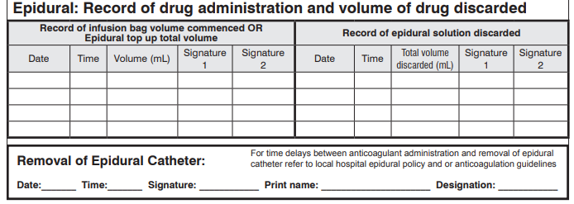
Record of drug administration and volume of drug discarded:
Below is an EXAMPLE of documentation related to drug administration and volume discarded
Record of infusion bag volume commenced OR Epidural top up volume: This refers to the ‘total’ volume of drug solution e.g. 100mL bag of ropivacaine 0.1% + fentanyl which is removed from the S8 drug cupboard.
Record of epidural solution discarded: This refers to recording the final amount of drug/solution remaining in the bag or cartridge when the epidural infusion was ceased. e.g. 50mL discarded.
10/12/23 10:30 100 mL A.Jack M.King 10/12/23 16:00 50mL J.Mather T.Brown

Slide 20
Removal of epidural catheter
10/12/23 16:30 J Mather MATHER RM
Breakage of the epidural catheter tip is an infrequent complication of epidural anaesthesia. ¹
Events involved with this complication have not been studied systematically. In most cases, the catheter broke during a difficult removal, with increased resistance. Resistance during removal might occur due to coiling of the catheter, a knot of the catheter, or entrapment of the catheter by the supraspinous or interspinous ligaments. Vertebral arches and processes, the lumbar fascia, the yellow ligament, posterior vertebral joints, and lumbar nerve roots have been implicated as sites of catheter entrapment. ²
Only gentle traction is needed to remove an epidural catheter. Various patient positions of lumbar flexion or extension may be required to assist in catheter removal. In the event of a difficult catheter removal, the procedure should be stopped, and an anaesthetist contacted to review. Complications associated with difficult catheter removal are rare. If breakage of the epidural catheter is suspected, contact an anaesthetist immediately.
Abu-jajeh, Ra’ed K., et. Al. (2022) Fracture of the epidural catheter tip during epidural anesthesia. Medicine case reports and study protocols. 3(10):p e0257, October 2022.
Hobaika, A.B. (2008) Breakage of epidural catheters: etiology, prevention, and management. Revista Brasilerira de Anestesiologia 58(3) 227-233.

Slide 21
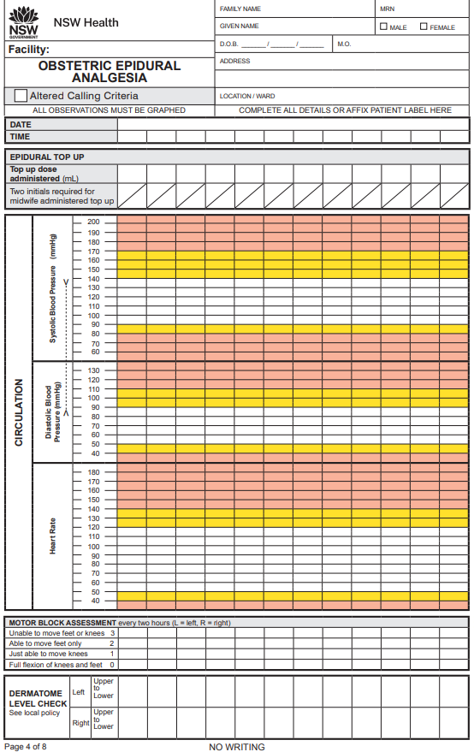
Observation pages 4 and 6 (Left side of chart)
Complete patient details or affix patient identification label
Epidural top up dose (5 minutely for 20 minutes)
10/12/23
1000 1005 1010 1015 1030 1100 1200 1300 1305 1310 1315 1320
10 10 10
Yellow and Red Zones: (Between the Flags) have been incorporated into the chart for the detection of the deteriorating patient related to blood pressure and heart rate.
Blood pressure and heart rate: to be recorded 5 minutely for 20 minutes post commencement of epidural (top up). Blood pressure, heart rate and all other subsequent observations are hourly until epidural is ceased.
Motor block assessment: every 2 hours L=left, R=Right
Dermatome level check: refer to local policy for assessment requirements and frequency.












Blood pressure and heart rate












•
•
•
•
•
•
•
•
•
•
•
•
Motor block assessment
L
Dermatome level check
LR LR R

Slide 22
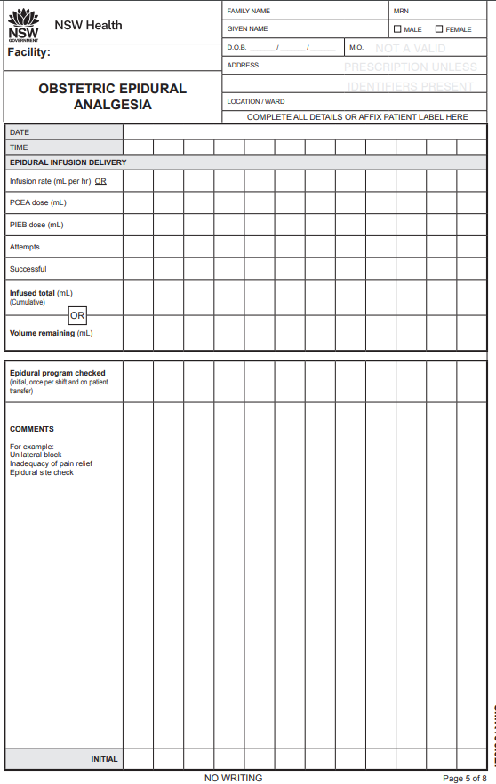
Observations: pages 5 and 7 (right side of chart)
EPIDURAL INFUSION DELIVERY
(complete applicable sections only)
Infusion rate (mL per hour) OR
PCEA dose (mL)
PIEB dose (mL)
Infused total (mL) OR
Volume remaining (mL)
10/12/23
1000 1005 1010 1015 1030 1100 1200 1300 1305 1310 1315 1320
8 8 8 8 10 10 10 10 10
4 12 20 24 29 39 49 59
Epidural program check
CL MT
Epidural dressing intact
Comments (for example):
Unilateral block
Inadequacy of pain relief
Epidural site check
Epidural CEASED
CL CL CL CL CL CL MT MT MT MT

Slide 23
The next 3 slides detail:
Obstetric Epidural Analgesia Management Guidelines (page 1)
Yellow and Red Zone Instructions (page 1)
Motor block assessment and dermatome diagram (page 8)

Slide 24
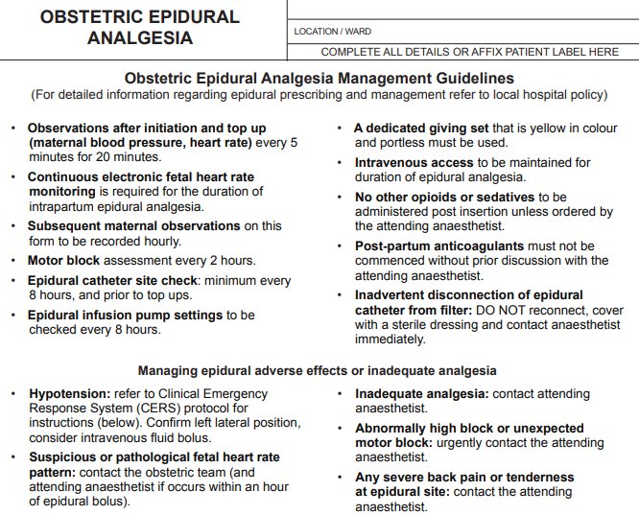
Page 1: Obstetric Epidural Analgesia Management Guidelines

Slide 25
Page 1: Managing epidural adverse effects or inadequate analgesia

Slide 26
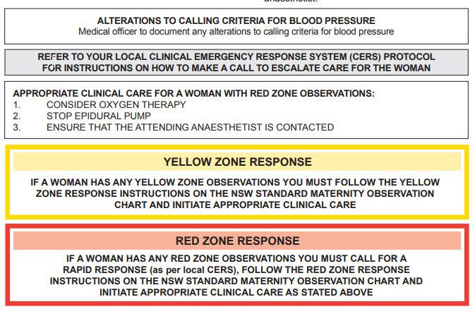
Page 1: Yellow and Red Zone Response

Slide 27
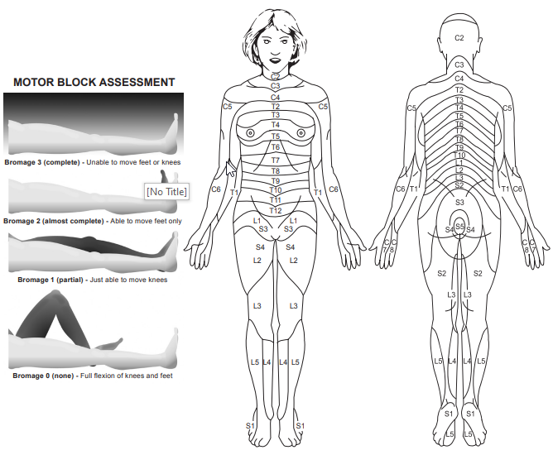
Page 8: Motor block assessment, Dermatome figure

Slide 28
The standardisation of this form promotes best practice in prescribing, pain assessment and management of adverse effects in women receiving an epidural during labour.
Information related to the NSW Pain Forms can be found on the ACI website:
http://www.aci.health.nsw.gov.au/networks/pain-management/acute-pain-forms
Comments or questions can be forwarded to:
Susan Rogers
Manager Pain Management Network
Agency for Clinical Innovation (ACI)
Phone: 0436611400
Email: ACI-PainManagement@health.nsw.gov.au
Emily Edmonds
CNC Acute Pain Service Blacktown Hospital
Phone: 0427074007
Email: emily.edmonds@health.nsw.gov.au
OR

Slide 29
This presentation was first prepared in 2017 in conjunction with the NSW Pregnancy and Newborn Services Network acknowledging the ACI Pain Management Network, State Pain Forms Group and the former NSW Pain Interest Group Nursing Issues who developed Educational and Audit materials for the fleet of NSW Standardised Pain Forms .
This presentation has been updated in 2023 following a review of the NSW Obstetric Epidural Form by the ACI Pain Management Network.

