Slide 1
Template

Slide 2
Project Title :
Facility:
CHR DOC VERSION: 1
Diagnostics Report Date:
Planned Dates
x x x x x
Goal
Objectives
❶ Goal and Objective
Initiation
Diagnostics
Solutions
Implementation
Planning
Evaluation
Current Performance:
Gap:
Actual Dates
x x x x x
Expected Outcome:
❸ Key Messages
Patients
Stakeholders
❷ Case for Change and Key Diagnostic Data
❹ Key Findings
Issue / Focus Area | Measure | # | Root cause analysis | Impact | Priority
❺ Diagnostic Activities
Data analysis | Process Mapping | Patients interviews
❻ Project Risks and Issues
Description | Rating | Owner | Mitigation
Team | Sponsor | CHR
❼ Variance to Scope

Slide 3
Project Title :
Facility:
Instructions
Highlight planned dates versus actual dates. Any delay should be highlighted in the risks/variance to scope section below and have mitigation strategies.
CHR DOC VERSION: 1
Diagnostics Report Date:
Objectives are:
Outcome-based
Focused on achieving the IHI triple aim
Concise
Measurable.
Making no statement of the causes of the problem.
Objectives can be written or graphed on an SPC chart.
If you have more than one measure, the main measure is the one impacted by a change in others:
Planned Dates
x x x x x
Goal
Objectives
❶ Goal and Objective
Initiation
Diagnostics
Solutions
Implementation
Planning
Evaluation
Current Performance:
Gap:
Actual Dates
x x x x x
Expected Outcome:
❸ Key Messages
Patients
Stakeholders
Main measure
Sub measure
Sub measure
Process measure
Process measure
Quantify main comments and feedback from stakeholders. If relevant, break down by specialty / groups, etc.
Include sample of stakeholders consulted.
❷ Case for Change and Key Diagnostic Data
Present main patients’ feedback. You can use the 8 dimensions of care / results from stories or surveys / quotes/ process map to support your analysis. Keep a record of interviews separately.
Include sample of patients consulted.
Briefly present your case for change (why are we changing, what are the benefits and the consequences of not changing?). This section should communicate the pain/urgency to make a change. Highlight connections between data using lines, circles, etc.
Use killer facts.
❹ Key Findings
Issue / Focus Area | Measure | # | Root cause analysis | Impact | Priority
Use prioritisation matrix to classify root causes. You can highlight each row in the appropriate colour (red for high priority, green for medium priority and grey for low priority)
To print on A3, go to print > printer properties > page size and select A3.
Delete the instructions slide once you have completed your report.
Impact of these issues on project’s objective(s)
Show the main issues using data.
Use visual cues and graphs. Don’t forget to highlight graphs' key messages.
Include process map/s and highlight key issues / focus areas.
If you would like to present more data / pictures of your activities, etc., you can include an appendix.
Key issues identified / major areas of focus prioritised. These issues are the ones that will be taken to the solutions phase. Keep a separate record of your issues log. These issues must be supported by your key diagnostics data and key messages.
Changes in focus areas will impact on the objective.
Present key root cause analysis for each issue (record complete list separately)
Impact of these root causes on key issue. You can use different metrics to support this
Click on the Pareto chart to open Excel. You can then plug your data directly in the spreadsheet
❺ Diagnostic Activities
List all the activities undertaken during the diagnostics phase, and the sample size in brackets. You should keep records of the results and be able to provide further information if required
Data analysis | Process Mapping | Patients interviews
❻ Project Risks and Issues
Description | Rating | Owner | Mitigation
Present key risks from your risk register and actionable mitigation strategies. Your risk register should be regularly updated and discussed with your sponsor
Name / title and approval date.
Approval from sponsor represents validation by steering committee.
❼ Variance to Scope
Team | Sponsor | CHR
Use this section to highlight any change in your scope / objectives from the initiation phase + approval process.
Delete this section if N/A

Slide 4
Example

Slide 5
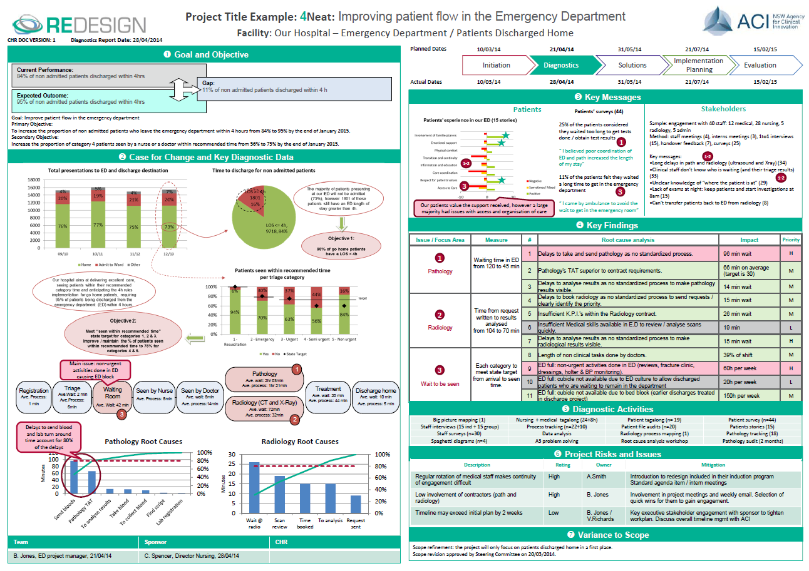
Published Oct 2015. Next review 2025 © State of NSW (Agency for Clinical Innovation) CC-ND-BY

