Slide 1
Ketamine Infusion Prescription and Observation form ADULT
NSW Pain Form
June 2023
Emily Edmonds | Co-ordinator NSW Pain Forms, CNC Acute Pain Service Blacktown Hospital.

Slide 4
Ketamine Infusion NSW Form - adult
The Ketamine Infusion Prescription and Observation Form for adult patients has been developed in NSW by a team of experts in the field of acute pain including clinical nurse consultants, anaesthetists and pharmacy representatives.
This form has been designed for the administration of subcutaneous or intravenous ketamine infusions for patients who may have acute or chronic pain. This form may not be appropriate for ketamine administration in palliative care.
Standardisation of this form promotes best practice in pain assessment and management of adverse effects in those patients who are receiving a ketamine infusion for pain management.

Slide 5
Aim of this presentation
This presentation aims to explain:
how to use the form to record the prescription, administration and discarding of ketamine as a continuous infusion
how to complete the clinical observations
guidelines on the management of patients who are receiving ketamine as a continuous infusion including the management of adverse effects.

Slide 6
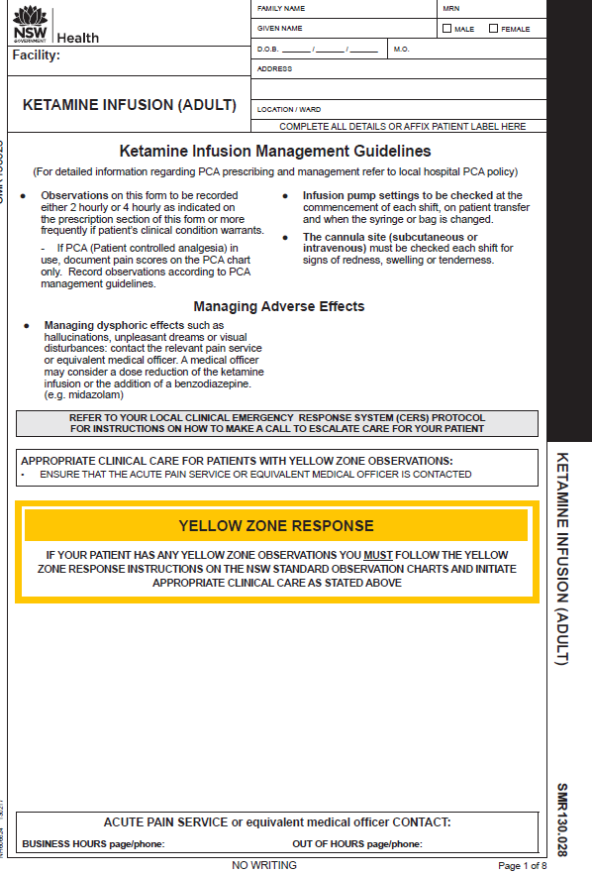
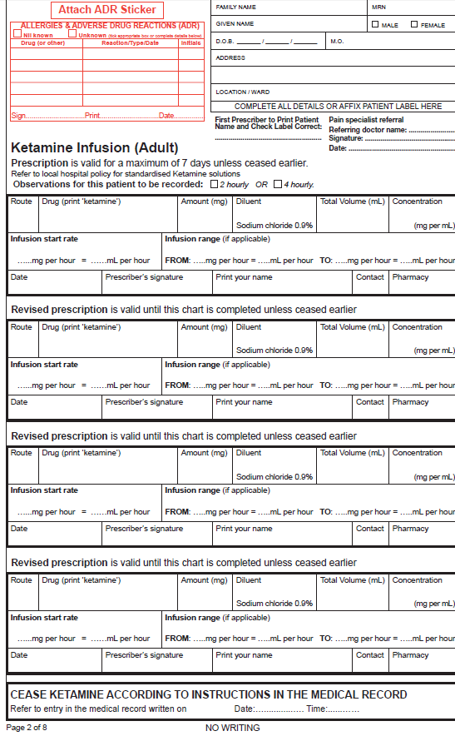
Ketamine Infusion Prescription and Observation form – adult
Page 1
Page 2
Front page: Ketamine Infusion Management Guidelines Yellow Zone response instructions
Page 2 : Ketamine infusion prescriptions (valid for up to 7 days)

Slide 7
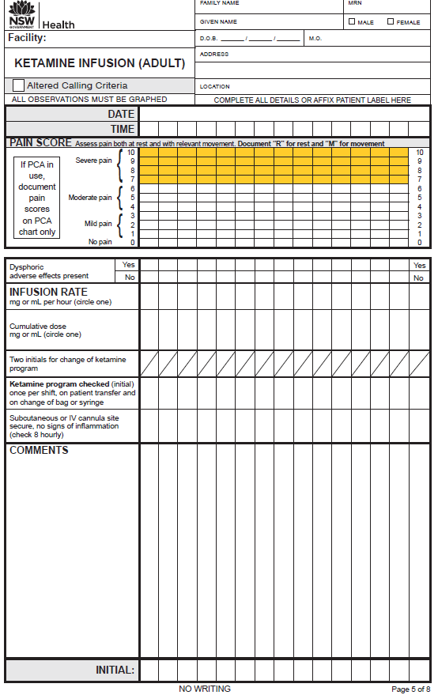
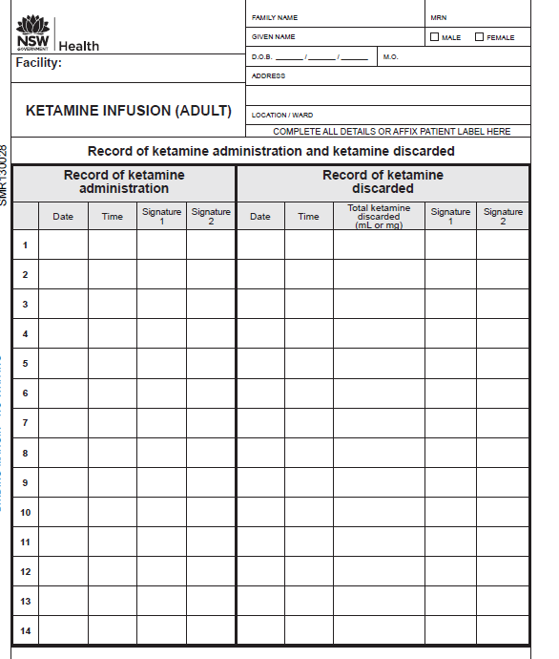
Ketamine infusion form: administration and observation
Observation pages
Page 3
Page 3: Administration/discard
Observation pages

Slide 8
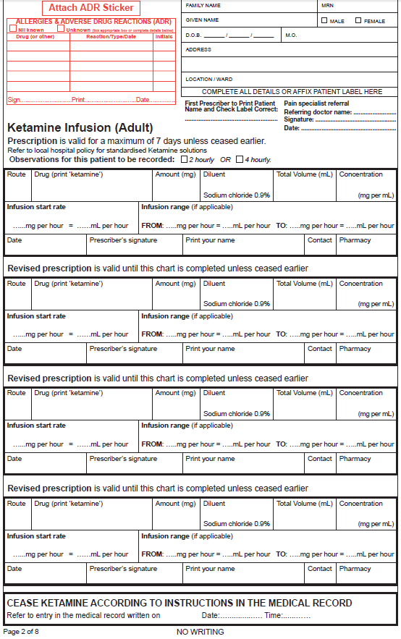
Patient allergy status and patient label
Ketamine infusion form: prescription
Ketamine prescription:
route
amount
diluent
total volume
concentration
infusion start rate
infusion range (if used)
date, prescriber, pharmacy
Page 2
Three revised prescription options for alterations to ketamine prescription
CEASE instructions

Slide 9
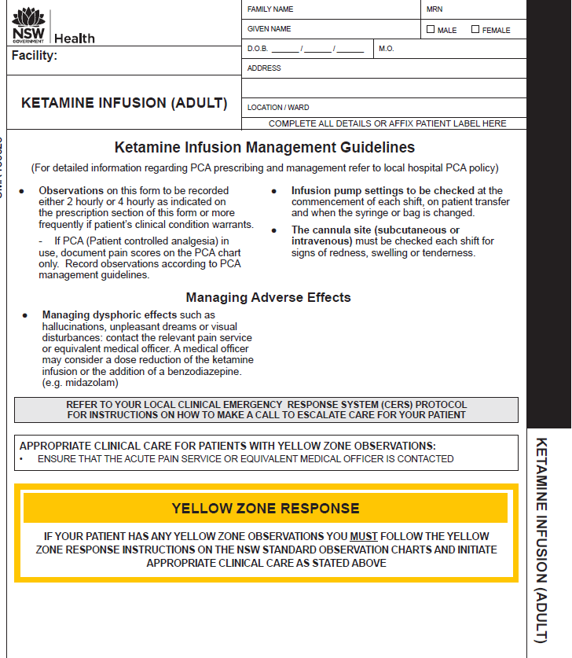
Ketamine infusion form: Management Guidelines
Ketamine Infusion Management Guidelines
Managing adverse effects
Yellow Zone response instructions

Slide 10
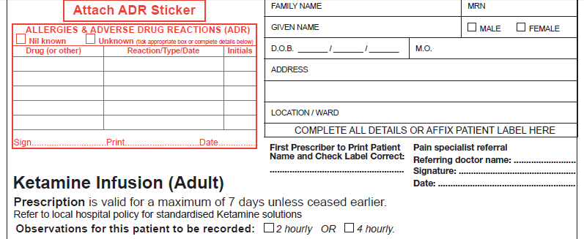
Prescriber to complete patient allergy and ADR section in full
Handwritten patient details or affix patient label (first prescriber to check patient label is correct)
Ketamine infusion form: prescription, patient identification
PRIVATE PATIENTS:
For Medicare billing purposes: A pain specialist referral from the referring doctor (name), signature and date
TSmith SMITH 5/4/17

Prescription is valid for a maximum of 7 days unless ceased earlier
The frequency of observations
(2 hourly or 4 hourly) to be determined by the prescribing medical officer

Slide 11
Ketamine Infusion form: prescription
PLEASE REFER TO YOUR LOCAL HOSPITAL POLICY OR PROCEDURE FOR PREFERRED KETAMINE DELIVERY OPTIONS.
IV Ketamine 200 mg 50mL 4
4 1 4 1 8 2
04/4/17 TSmith SMITH 7511
Three further prescription boxes are provided for when alterations are indicated for the ketamine dose, concentration or infusion rate.

Slide 12
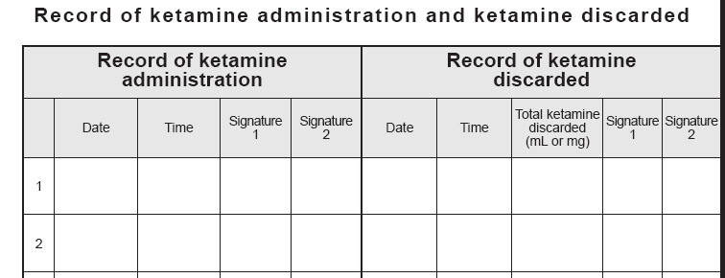
Administration and discard of ketamine
4/4/17
10:00
THall
SRose
05/4/17
10:00
8mL
BLoh
JLucas
Any ketamine remaining from a syringe or bag to be recorded on the discard section.
There are 13 more rows provided for more than one syringe or bag of ketamine that is commenced.

Slide 13
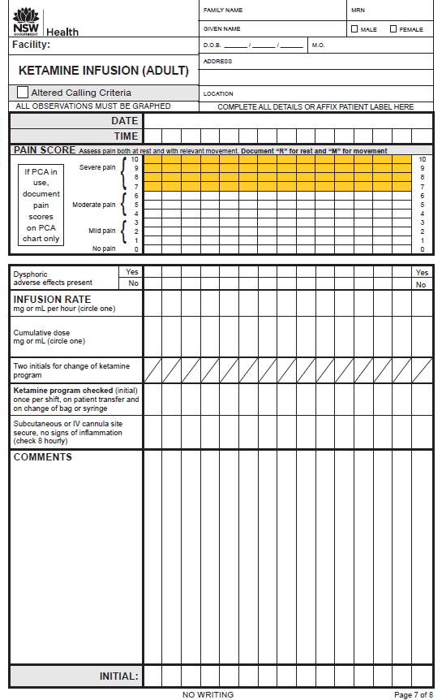
Ketamine infusion form: observations
The ketamine infusion form can provide observations for a maximum of:
7 days when frequency of observations are 4 hourly
4 days when frequency of observations are 2 hourly.
If the infusion continues beyond 4 or 7 days, a new form must be started and a new prescription written.
Observation pages

Slide 14
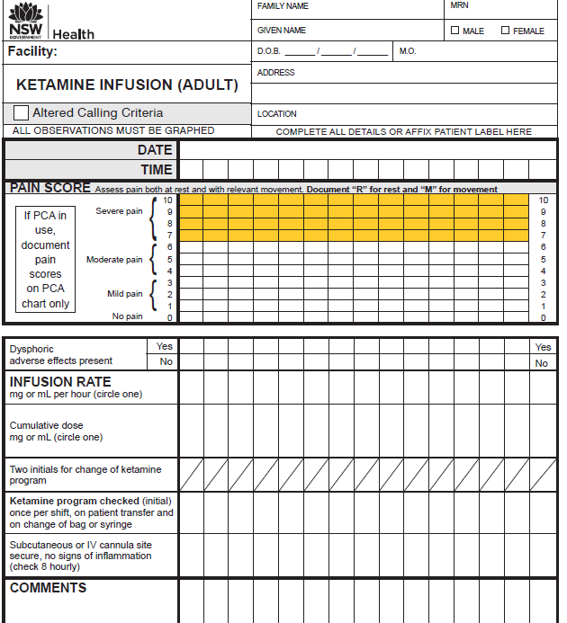
A patient label must be affixed or details handwritten on each page that has recorded observations
Ketamine infusion form: observations
04/04/2017
10
00
12
00
14
00
16
00
18
00
Pain assessment:
R = Rest, M = movement
(If a PCA chart is in use – record pain score on the PCA chart)
Yellow Zone Response:
Have pain scores previously been in the White Zone (0 to 6)? Have additional prescribed analgesics been administered?
Has the patient been reviewed by the Acute Pain Service or equivalent medical officer?
The assessing nurse may need to consult with the NURSE IN CHARGE to decide whether a CLINICAL REVIEW (or other CERS – Clinical Emergency Response) call should be made.
M
M
R
M
M
M
R
R
R
R
R
Dysphoric adverse effects assessment
Infusion rate
Cumulative dose
Ketamine pump program checked
Subcut or IV site checked
Comments
Initial





6
mg
6
mg
8
mg
8
mg
8
mg
12
mg
24
mg
40
mg
56
mg
6
mg
SH
KL
SH
SH
NH
SH
NH
KL
/
AT
SH
SH
SH

Slide 15
The standardisation of this form promotes best practice in pain assessment and management of adverse effects in adult patients receiving a ketamine infusion.
Information related to the NSW Pain Forms can be found on the ACI website:
http://www.aci.health.nsw.gov.au/networks/pain-management/acute-pain-forms
Comments or questions can be forwarded to:
Susan Rogers
Manager Pain Management Network
Agency for Clinical Innovation (ACI)
Phone: 0436611400
Email: ACI-PainManagement@health.nsw.gov.au
Emily Edmonds
Pain Nurses Australia: Director Corporate Governance
CNC Acute Pain Service Blacktown Hospital
Phone: 0427074007
Email: emily.edmonds@health.nsw.gov.au
OR

Slide 16
This presentation was first prepared in 2013-2014 and reviewed in 2017 by the former NSW Pain Interest Group Nursing Issues in association with the ACI Pain Management Network.
A review was undertaken in 2023 by NSW members of Pain Nurses Australia.

Slide 17
Published Jun 2023. Next review 2028.
SHPN: (ACI) 230325 ISBN: 978-1-76023-527-7
ACI/D23/818 [ACI_8121]
© State of NSW (Agency for Clinical Innovation) CC-ND-BY

