Slide 1
Module 4: Goals and plans
Alcohol and drug Cognitive Enhancement (ACE) Program

Slide 2
Revision
What type of attention refers to the ability to focus on two or more things at once?
What type of attention keeps you from getting distracted?
Why do we use the term ‘pay attention’?
Notes:
What type of attention refers to the ability to focus on two or more things at once?
[Answer: divided attention.]
What type of attention keeps you from getting distracted?
[Answer: focused attention.]
Why do we use the term ‘pay attention’?
[Answer: because there is a limited amount to ‘spend’.]

Slide 3
Brainwork outcome
Page 37 in workbook
Attention Strategies
Description | Actual outcome | Predicted outcome | Actual minus Predicted
Read through 16-22 attention strategies, marked which have been helpful in past or may be helpful in the future, and wrote down examples in notebook | 3 | 3 | 1
Read through 11-15 attention strategies as above | 2 | 2
Read through 6-10 attention strategies as above | 1 | 1
Read through 0-5 attention strategies as above | 0 | 0
MINUS
The closer to zero, the more accurate your predictions.
Negative number: you overestimated your performance.
Positive number: you underestimated your performance.
Notes:
[Facilitator Tip: Ask participants to open their notebooks, and volunteer examples of when they have used Attention Strategies in the past or describe a situation when they would use the strategy in the future.
Circle on your Brainwork Prediction Form how much of your brainwork you completed.
How well did you predict your own behaviour?
[Provide assistance to anyone unclear on how to do this but do not spend too long on it.]
[If you find that participants are not accurately predicting their ability to complete their brainwork, praise them for their effort rather than the result. You can remind them that what they get out of the program is directly related to what they put in – and that means coming to each session/module, participating and completing brainwork tasks.]

Slide 4
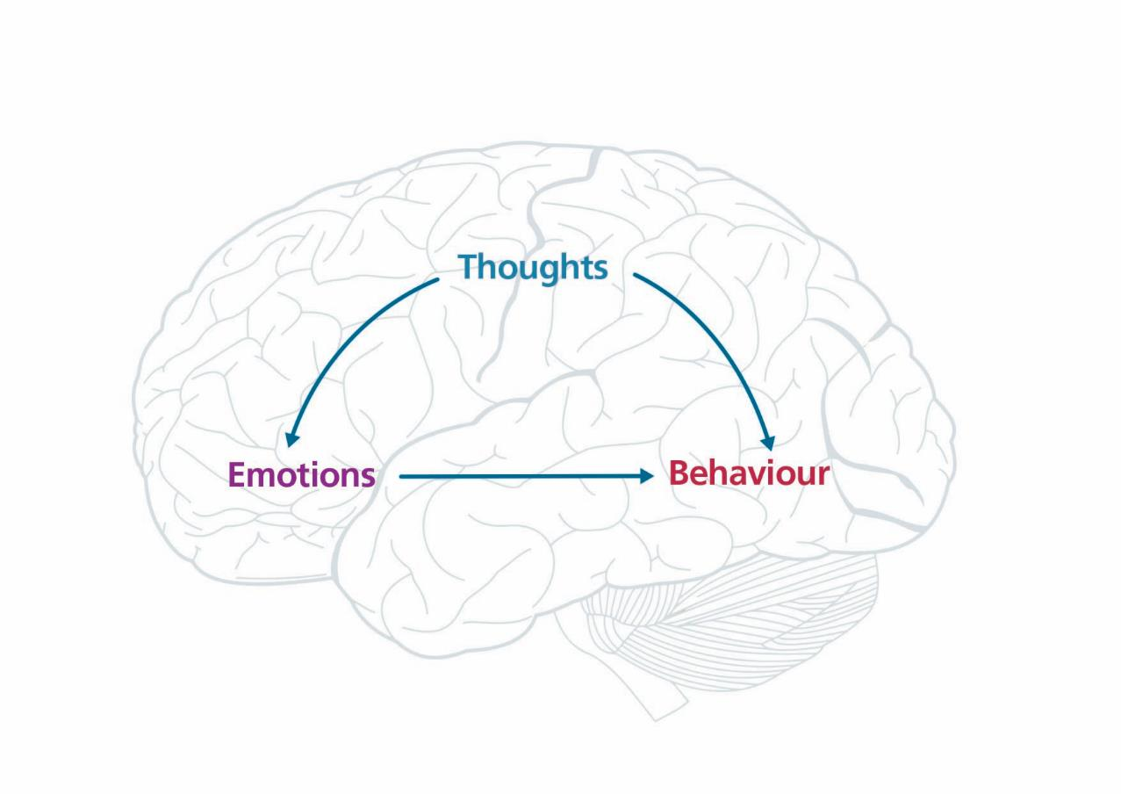
Notes:
In the first session, we discussed how behaviour can be influenced by an environmental trigger (a stimulus) or emotional reactions. We also discussed how thoughts can help over-ride the triggers or control our emotions.
[click to animate slide]
When we respond instinctively or react to things that happen around us in the present moment, we are mainly only using our reptilian brains.
[click to animate slide]
When we react to what has happened to us in the past, we are mainly using our limbic system.
[click to animate slide]
However, when we think about what it is we would like to happen in the future, we are using our neocortex, or human brain, in particular the frontal lobes.

Slide 5
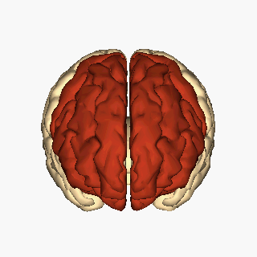
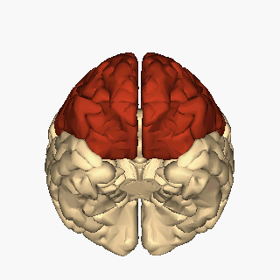
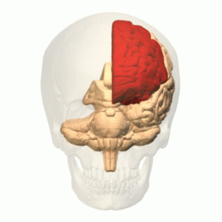
We can change the way our frontal lobes function
Last part of the brain to develop
Does not fully mature until late 20s to mid 30s!
Image credits: Anatomography. Cerebrum - frontal lobe - superior view animation BodyParts 3D. 2012. Database Center Life Science. [CC BY-SA 2.1 jp] via Wikimedia Commons
Anatomography. Cerebrum - frontal lobe - inferior view animation from BodyParts 3D. 2012. Database Center Life Science. [CC BY-SA 2.1 jp] via Wikimedia Commons
Frontal lobe animation from BodyParts 3D. 2010. Database Center Life Science. [CC BY-SA 2.1 jp] via Wikimedia Commons
Notes:
The frontal lobes are the last part of the brain to develop. Often they do not fully mature until our late 20s or early to mid 30s.
The good news is that we can change how well our frontal lobes work, and that is what most of the rest of this program will focus on.

Slide 6
Main function of frontal lobes
To help us see into the future
To set goals
To help us be mindful of the future when we are in the present moment
To keep behaving in ways that are in line with our goals and avoid behaviour that is at odds with our goals
GOAL
PLAN
Notes:
[click to animate slide] - Our frontal lobes essentially help us see into the future and help us set goals.
[click to animate slide] - They also help us be mindful of the future when we are in the present moment, and make plans.

Slide 7
“If you fail to plan, you plan to fail”
Notes:
Speaking of goals. How many of you have ever made a new year’s resolution?
Out of all the people who have made a new year’s resolution, what percentage of them commit to their resolutions throughout the year?
[Ask for estimates.]
[click to animate slide]
The evidence suggests that by Valentine’s Day, only six weeks later, 80% of resolution setters are no longer pursuing their goals!
And fewer than 10% are still pursuing their goals by the end of the year.
This is because a goal is not enough to keep a person committed to a new course of actions. What else do they need?
[Correct answer: a plan.]
And if you don’t have a plan, you know what they say,
[click to animate slide] - “If you fail to plan, you plan to fail” (incidentally this was credited to Benjamin Franklin).

Slide 8
What is the GAP?
How specific is this plan?
GOAL
AND
PLAN
To pass an exam in two weeks
Study every night
Notes:
[IMPORTANT TO NOTE: Facilitators may take a flexible approach to the activities/examples on slides 8-16 by choosing to omit an example or replace it with an alternative example. Consider the time restraints, and sensitivities of the participants. Tips for responding to some of the examples are included in the notes section of these slides]
[FOR EXAMPLE: The ‘weight loss’ goal may be sensitive in some settings, and could be replaced with ‘healthy eating’, ‘physical activity or exercise’ instead.]
GAP stands for Goal and Plan.
We first need to set a goal, like to pass an exam we have to sit in two weeks. The plan for that goal might be to study every night.
In this example the goal is pretty clear. What about the plan? Could it be more specific?
[Answers may include: have a designated study space, have a designated study time, ensure there are no distractions, leave phone in another room, make notes, revise the information with someone else, teach someone else the information, etc.]

Slide 9
What is the GAP?
How specific is this plan?
GOAL
AND
PLAN
To buy a motorcycle valued at $5200
Save $100 per week and buy in one year
Save $200 per week and buy in six months
Notes:
If the goal is to buy a motorbike worth $5200, a specific plan might be to save $100 a week and buy it in one year.
What’s another potential specific plan?
[click to animate slide]
[Support any other specific plans the group comes up with, and/or suggest saving $200 a week and making the purchase in six months.]

Slide 10
What is the GAP?
How specific is this goal?
GOAL
AND
PLAN
To lose weight for a wedding in six months
Eat no more than 8,700 kilojoules per day
Walk at least 10,000 steps per day
Notes:
[USE WITH DISCRETION: The ‘weight loss’ goal may be sensitive in some settings, and could be replaced with ‘healthy eating’, ‘physical activity or exercise’ instead.]
Let’s look at one more goal: losing weight for a wedding in six months. Is this a specific goal?
[correct answer is NO]
How could you make it more specific?
[An example could be to lose 8kg in 6 months]
And what sorts of plans can you develop to help achieve this goal?
[click to animate slide]
You could have plans related to food intake or exercise to help achieve such a goal such as walking 10,000 steps a day.

Slide 11
Goals
Can be:
Immediate (Make an important phone call)
Medium term (Go to party on Saturday night)
Long term (Complete a TAFE course)
Notes:
Goals can have different timeframes. We might set immediate, medium term and long term goals.
What are some examples of immediate goals? Medium term goals? And long term goals?
[click to animate slide for each example]
Examples:
Immediate
Make an important phone call
Medium term
Go to party on Saturday night
Long term
Complete a TAFE course

Slide 12
Plans
A plan is an intention about future actions in order to achieve a goal
Make an important phone call
Wait until break time
Ask if you can leave
Lie about having to leave to do something else (and then make the call)
Notes:
[click to animate slide]
A plan is an intention about future actions in order to achieve a goal.
[click to animate slide]
So, plans we might come up with if we are in a class or a meeting and need to make an important phone call might include:
Wait until break time
Ask facilitator/meeting chair if you can leave
Lie about having to do something else (and then make the call)
These are possibly equally effective plans. Plan A may not work because the phone call is urgent. We might not be comfortable to implement plan B (for whatever reason), and so we might choose plan C - not the most moral of the plans, but still an effective plan.

Slide 13
Plans
The best plans are based on clear and strong goals
When the goals are wishy-washy, the plans will be weak and unreliable
The plans must be directly related to the goals
Notes:
The strength of your plan often depends on the strength of your goal. Plans based on clear goals are more effective. So, it is important to first be able to imagine a clear goal before putting any plans in place.
Plans must also be directly relevant to the goal. So the more clarity you have about the goal, the more effective your plan will be. If any part of the plan is not related to the goal, it will take longer to achieve that goal.

Slide 14
Making plans
Page 8 in workbook
In small groups or pairs, come up with at least 4 or 5 plans for the following goals
Notes:
In small groups or pairs, come up with some plans for the goals described on the following slides: …. [write your ideas on page 8 of the Participant Workbook]

Slide 15
What is the GAP?
GOAL
AND
PLAN
Attending a good friend’s party on Saturday night
Notes:
Attending a good friend’s party on Saturday night
[Allow a few minutes of discussion in small groups, then debrief the activity with the group at large as volunteered by the various small groups. Ideas can be written on page 8 of the participant workbook]
[USE WITH DISCRETION: The ‘going to a party’ goal may be sensitive in some settings or generate questions. For this example you may set the context as someone attending a party not intending to drink, but where others at the party may be drinking. Alternatively, this example can be omitted or replaced with ‘going to a dinner party’ or another more relevant example.
If delivering this session to clients of a drug and alcohol service:
ASK YOURSELF: As a facilitator, do I avoid using this example, or do I work with the participants to develop some skills around that sensitive topic in order to take better actions or make better decisions when they need to?]
FACILITATOR TIPS (for dealing with participants that get caught up on the example):
Allow participants to reflect upon and understand the purpose of the exercise and the underlying messages.
(Answer: Planning a party or being invited to a party are real-life situations that will come up from time to time. By having a plan for that situation you will be better prepared to respond and make better decisions. Incorporate some of the other things that are important for Recovery Plans e.g. tell your sponsor, have a Plan B.
[ASK: What part of the brain or you using when you are feeling challenged by a situation?
(Answer: You are responding from the limbic system (past experiences). You are likely to be invited to a party or event where alcohol will be consumed (by others) and you will need to be prepared. For example, if someone offers you a drink, you could respond by asking for a soft drink instead.

Slide 16
What is the GAP?
GOAL
AND
PLAN
Completing a TAFE course in 6 months
Notes:
Completing a six-month TAFE course
[Allow a few minutes of discussion in small groups, then debrief the activity with the group at large as volunteered by the various small groups. Ideas can be recorded on page 8 of the participant workbook]

Slide 17
Brainwork
Pages 9 and 10 in workbook
Choose a goal from the Goal Menu
Write it out in more detail.
Write down how often you do that now
Then write down the most you could realistically do this
Notes:
(The Goals are listed on Page 9 of the Participant Workbook. The Brainwork Activity is to be completed on Page 10.)
Goal Menu
I would like you to choose one of the 20 goals on the goal menu to work on over the next two weeks.
Once you have chosen your goal, make it more specific and write it out in more detail. For example, if you chose goal eight – to maintain dental hygiene, a more specific goal might be ‘to brush and floss my teeth every night before going to sleep’.
Indicate how often you do that now (e.g. how many times per day or week). For example, you might brush and floss your teeth only two nights per week on average at the moment.
Then indicate the most you could realistically do this – in this case it could be to brush and floss your teeth seven nights per week.

Slide 18
Brainwork prediction
Page 37 in workbook
What is the GAP?
Description | Actual outcome | Predicted outcome | Actual minus Predicted
Selected a goal, wrote it out in more detail, how often you do the goal behaviour per day/week, and the most you could realistically do this | 3 | 3
Selected a goal, wrote it out in more detail, and how often you do the goal behaviour per day or week | 2 | 2
Selected a goal and wrote out the goal in more detail | 1 | 1
Did nothing or selected a goal only | 0 | 0
The closer to zero, the more accurate your predictions.
Negative number: you overestimated your performance.
Positive number: you underestimated your performance.
Notes:
Complete your brainwork prediction form based on how much of your brainwork you predict you will do and write this down now.

Slide 19
End of Module 4
July 2020

Slide 20
Copyright
This presentation is for use as part of the Alcohol and Drug Cognitive Enhancement (ACE) Program. No part may be copied or used for any other purpose without permission from the NSW Agency for Clinical Innovation. Contact via https://www.aci.health.nsw.gov.au/
The examples may be amended to suit local conditions.
Published Mar 2018. Next Review 2028. © State of NSW (Agency for Clinical Innovation)
and Advanced Neuropsychological Treatment Services
Image credits
Shutterstock.com

