Slide 1
Module 3: Attention
Alcohol and drug Cognitive Enhancement (ACE) Program

Slide 2
Revision
Why is automatic memory called automatic?
If something is not encoded (saved) well (e.g. you just put a document anywhere in a filing cabinet), how will this affect retrieval (finding it again)?
What is prospective memory?
Notes:
Why is automatic memory called automatic?
[Answer: because we don’t have to think about it.]
If something is not encoded (saved) well (e.g. just put the document anywhere in the filing cabinet), how will this affect retrieval (finding it again)?
[Answer: it will make retrieval really difficult.]
What is prospective memory?
[Answer: remembering to do something in the future.]

Slide 3
Brainwork and memory strategies
Page 6 in workbook
How did you find the brainwork task?
You have two different types of memory strategies
Writing things in a notebook. This is an external strategy, because the notebook is external to (outside of) you.
Expanding on information you want to remember. This is an internal strategy because it takes place inside your mind.
Notes:
How did you find doing the brainwork task?
Did it help you to ‘encode’ the information from the last session?
So, now you have two different types of memory strategies:
Writing things in a notebook. This is an external strategy, because the notebook is external to (outside of) you.
Expanding on information you want to remember. This is an internal strategy because it takes place inside your mind.
The memory strategies on page 6 of your workbook gives a list of other internal and external strategies that you might find helpful and that we encourage you to use [spend a few minutes discussing one or two of these strategies and encourage participants to review them in their own time].

Slide 4
Brainwork outcome
Page 37 in workbook
Apply expansion strategies
Description | Actual outcome | Predicted outcome | Actual minus Predicted
Used four or more expansion strategies | 3 | 3 | 1
Used three expansion strategies | 2 | 2
Used two expansion strategies | 1 | 1
Used one or no expansion strategies | 0 | 0
MINUS
The closer to zero, the more accurate your predictions.
Negative number: you overestimated your performance.
Positive number: you underestimated your performance.
Notes:
Circle the number for how much of your brainwork you achieved on your Brainwork Prediction Form and calculate your 'Actual minus Predicted' score.
Are you getting closer to zero?

Slide 5
What does ‘PAY ATTENTION’ mean?
Notes:
[Click to animate slide.]
What does ‘pay attention’ mean and why do we ‘pay’ for it?
[Answer: because, like money, it is a limited resource, and if we spend it all in one place, we don’t have enough to spend in other places.]

Slide 6
Another counting game
Count on how many of the following slides you see a black square in the top right corner of the grid
You will have just one second per slide, so make sure you ‘pay attention’
Notes:
[Emphasise that this session will use practical examples using games (like session 2)]
[Read instructions on slide.]
[The next 60 slides will change at the rate of one per second. POINT to top right hand corner of the grid to help participants know where to look.]

Slide 67
How did you go?
17 black squares in the top right corner
Let’s do it again but this time count on how many slides you see a red square in the bottom right corner
Notes:
How many did you count?
[click to animate]
There were 17 black squares in the top right corner.
How did you make sure that you focused where you needed to?
[click to animate]
Let’s do it again but this time count each time you see a red square in the bottom right corner (Point to bottom right corner of grid)
To help you, I will say ‘focus’ out loud every few slides. When I say ‘focus’, that’s what I’d like you to do to make sure you don’t miss any red squares
[The next 60 slides will change at the rate of one per second.]
[Say the word ‘focus’ when it appears on the slide.]

Slide 69
FOCUS
Notes:
[Say “Focus]

Slide 73
FOCUS
Notes:
[Say “Focus]

Slide 78
FOCUS
Notes:
[Say “Focus]

Slide 82
FOCUS
Notes:
[Say “Focus]

Slide 87
FOCUS
Notes:
[Say “Focus]

Slide 93
FOCUS
Notes:
[Say “Focus]

Slide 97
FOCUS
Notes:
[Say “Focus]

Slide 103
FOCUS
Notes:
[Say “Focus]

Slide 108
FOCUS
Notes:
[Say “Focus]

Slide 112
FOCUS
Notes:
[Say “Focus]

Slide 117
FOCUS
Notes:
[Say “Focus]

Slide 121
FOCUS
Notes:
[Say “Focus]

Slide 126
FOCUS
Notes:
[Say “Focus]

Slide 128
How did you go?
There were six red squares in the lower right box
How did you find the ‘focus’ out loud strategy?
Notes:
How did you go? How many did you get?
[click to animate slide]
There were six red squares in the lower right box
[click to animate slide]
How did you find the ‘focus’ out loud strategy? [allow brief discussion]
Research shows that using this strategy to mentally prompt yourself (i.e. saying ‘focus’ in your mind when you need to concentrate) really improves your focused attention, which is the first type of attention we will talk about.

Slide 129
Different types of attention
Focused attention
Sustained attention
Attention span
Divided attention
Notes:
There are four different types of attention: focused, sustained, span and divided.

Slide 130
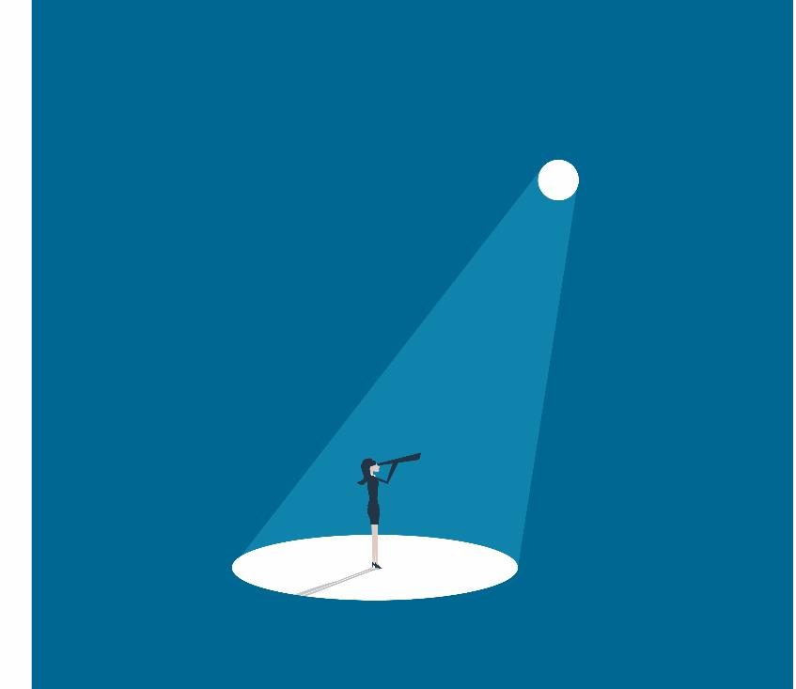
Focused attention
Where is the ‘aim’ of your attention?
something you are doing
sudden changes in the environment
your own internal thoughts
Focused attention
Notes:
[click to animate slide]
Focused attention refers to where the attention is aimed and this was demonstrated in the previous games where attention was focussed in the relevant corners of the square.
Attention can be changed by sudden changes in the environment (e.g. a loud bang behind you), something you intend to do (e.g. read a magazine article), or even your own internal thoughts (like thinking about an embarrassing situation that happened the night before).
There are a number of things that compete for our attention at any one time. This is what makes attention one of our most valuable resources and we need to take care where we choose to focus our attention.
This is all about where the spotlight is pointing.

Slide 131
Sustained attention
The ability to stay focused on one thing over a period of time
Requires being alert
Keeping the spotlight where it should be for long periods of time
Especially when things get boring
Notes:
Sustained attention refers to the ability to stay focused on one thing over a period of time. So, if the spotlight operator gets sleepy after staying focused on the main stage performer, the light might gradually shift away from where it should be (as she falls asleep).
To have good sustained attention, you need to be able to stay alert.
This is all about keeping the spotlight where it should be for long periods of time (especially when things get boring).

Slide 132
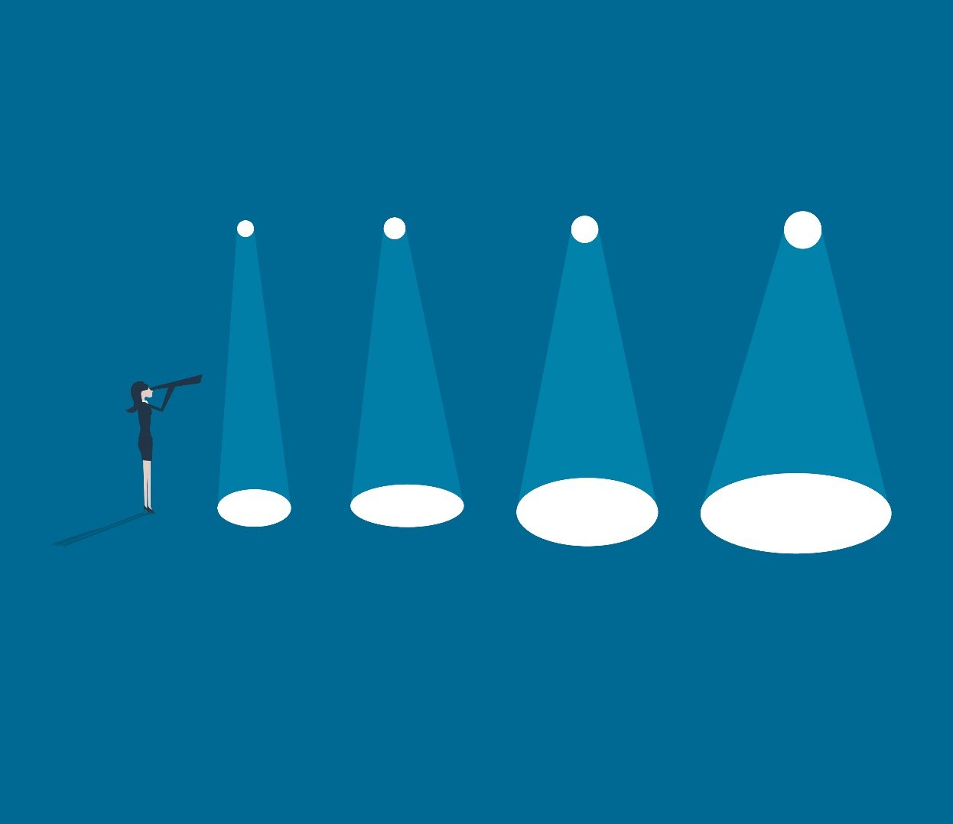
Attention span
How much information can be taken in at one time?
Can be verbal (said to you) or visual (things you see)
All about how big the spotlight is
Notes:
Attention span refers to how much information can be taken in at one time, whether it is verbal (what is said to you or what you hear) or visual (things you see). So, if we are focusing our attention at a band on a stage, how much can we see? Just the guitarist? The guitarist and the bass player? Or can we see and truly pay attention the whole band at once?
This is all about how big the spotlight is.
Think about the games we played earlier. As the slides changed from one to the next, did you only focus on the one square in the grid, or did you notice the other squares in the grid changing too?

Slide 133
Divided attention
The ability to focus on two or more things at the same time.
Examples:
driving and speaking to your passenger at the same time
studying and watching the TV at the same time.
Most difficult type of attention to master.
Notes:
[click to animate slide]
Divided attention refers to the ability to focus on two or more things at the same time. An example might be driving and speaking to your passenger at the same time, or studying and watching the TV at the same time.
This is the most challenging type of attention to master, and the first to give way under pressure. For example, when we are tired, this is one of the first attention skills to slip and we will generally bring our attention back to only one thing. If there is too much to pay attention to at once, we can quickly become overwhelmed and agitated.
This is all about how well you can control two or more spotlights or quickly switch your focus between two or more things.

Slide 134
Open up and divide your attention
I will show you some more pages with grids
Count every time there are exactly three black squares OR one red square OR both
OR
OR
Notes:
[Read instructions on slide.]
This time, count every time the grid includes exactly three black squares, or only one red square or both three black squares and a red square. Some of the grids will include squares with other colours (like example 1 on the slide), count these too.
The three black squares or single red square can have other colours squares in the grid. (e.g. three black squares and three blue squares counts, or 1 red square and four black squares.)
[Start slides 135-194, they will change at the rate of one per second.]

Slide 195
How did you go?
There were 18 grids with either three black squares or one red square or both.
Which types of attention did you use?
Did you happen to tell yourself to ‘focus’ every so often?
Notes:
How did you go? How many did you count?
There were 18 grids with either three black squares, one red square or both.
[Discuss questions on slide]
[Participants will have found this much more challenging, which highlights how hard it is to divide one’s attention and this should be discussed. Some will have had such difficulty doing this task, that the added strategy of self-prompting to ‘focus’ may have been too burdensome. Explain that this is OK and that self-prompting to focus becomes automatic when practiced in lots of different situations.]

Slide 196
Attention training - EXERCISE
We will do an exercise to help you take more control of your attention
Notes:
[Ensure you have the materials needed for the Attention Training exercise and then read through and follow the instructions below. This will take approx. 12 minutes.]
Instructions
[Before starting this exercise, you will need a radio or other device that plays spoken word (e.g. a news broadcast, podcast or talkback radio show.]
[Say to participants: ‘Even though you might find it challenging, the goal is to practice attention skills to get better at them.’]
“Words in inverted commas are to be read out.”
{Words in curly brackets are alternatives, read the correct one, amend as appropriate.}
[Words in square brackets and italics are action instructions.]
Activity
“I would like you to focus your gaze on a dot that I have placed on the {wall or board}. Throughout the exercise try to keep your head in the same position. You may keep your eyes open or close them. I’m going to ask you to focus your attention on different sounds inside this room and outside of this room. I will ask you to focus your attention in different ways. It doesn’t matter if thoughts and feelings come into your mind. The aim is to practice focusing your attention no matter what you might become aware of.”
“To begin with, focus on the sound of my voice. Pay close attention to that sound. No other sound matters. Try to give all of your attention to the sound of my voice. Ignore all of the other sounds around you. You may hear them but try to give all of your attention to the sound of my voice. Focus only on the sound of my voice. No other sound matters. Focus on this one sound.
“Now turn your attention to the sound I am making as I tap on the {desk or clipboard etc.}”
[Tap at the rate of about two taps a second.]
“Pay close attention to that sound, for no other sound matters [pause]. Try to give all of your attention to the tapping sound (pause). Closely monitor the tapping sound [pause]. If your attention begins to stray or is captured by another sound, refocus on the tapping sound [pause]. No other sound matters. Give this one sound all of your attention (pause). Continue to monitor this sound and if you are distracted return your attention to it [pause].”
[Keep tapping and turn on the radio/podcast.]
“Now focus your attention on the sound of the {radio or podcast}. Focus on the sounds of the {voices or music}. Pay close attention to that sound only. Try to give all of your attention to it [pause]. Closely monitor for changes in the sounds on the {radio or podcast} [pause]. You may even be able to make out what they are saying. If your attention begins to stray or is captured by a sound elsewhere, refocus on the radio. No other sound matters. Give all of your attention to the radio and what you might hear there. Continue to monitor and if you are distracted return your attention to it [pause].”
[Keep tapping and keep the radio on.]
“Now focus your attention on sounds that you might hear outside of this room. Focus on the space outside of the room only. Pay close attention to that space and try to detect sounds that might occur there. [If there are specific sounds, draw attention to them]. Even if there are no sounds, keep your attention on that space. Try to give all of your attention to it [pause]. Closely monitor for sounds there [pause]. If your attention begins to stray or is captured by a sound elsewhere, refocus on that place. No other sound matters. Give all of your attention to that place and what you might hear there. Continue to monitor and if you are distracted return your attention to it [pause].”
“Now that ­you have identified and practiced focusing on individual sounds and locations I am going to ask you to quickly shift your attention between them as I call them out [pause]. First, focus on the tapping sound, no other sound matters [pause]. Switch your attention and focus on the space outside of the room [pause]. Pay close attention to the sounds outside, no other sound matters. Now turn your attention to the sound of the tapping, no other sound matters [pause]. Turn your attention again this time to the sound of the radio [pause]. Now switch and focus on the sounds outside [pause]. Now focus on the tapping (pause), now on the sound of the radio [pause].”
“Finally, I want you to expand your attention. Make it as broad and deep as possible.
Try to absorb all of the sounds and all of the locations that you have identified at the same time. Try to focus on and be aware of all the sounds both inside and outside of this room at the same time [pause]. In your mind count the number of sounds that you can hear at the same time [pause]. Try to hear everything simultaneously. Count the number of sounds you can hear this way.”
“This concludes the exercise. How many sounds were you able to hear at the same time?”
[At the end of the exercise, acknowledge how difficult it was and praise participants for staying on task.]
[Participants may need a moment to discuss the exercise at the end/ return to the room as the exercise may have been tiring or difficult]

Slide 197
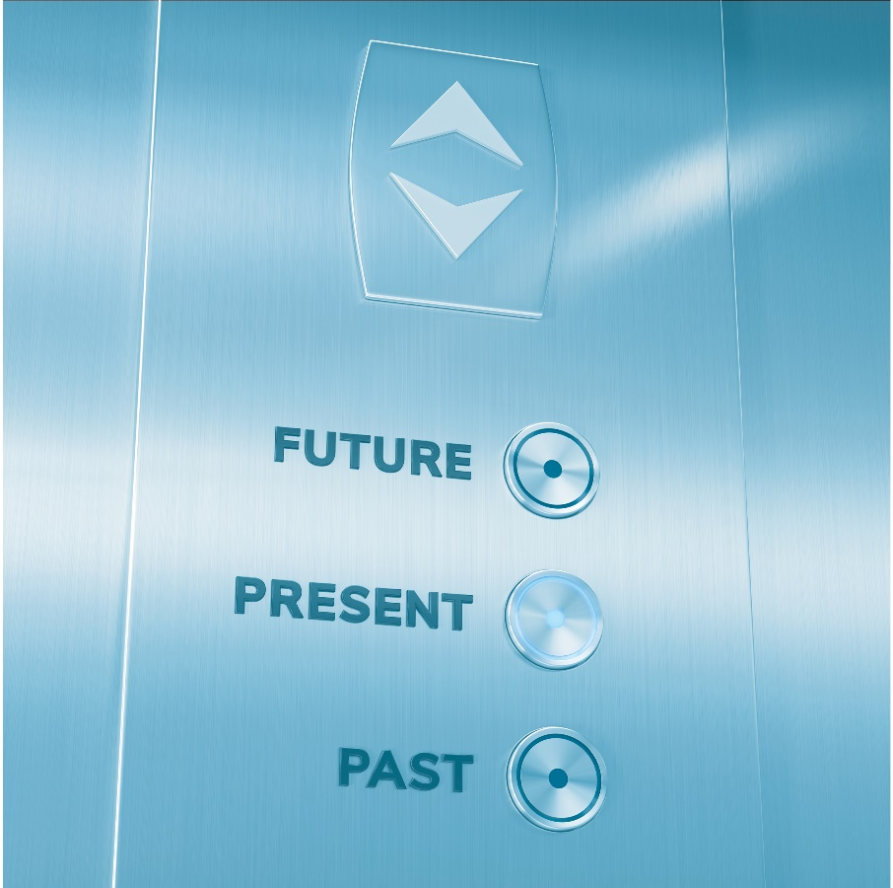
Why attention?
To help us notice good and bad things about the present, past, and future.
Attention allows us to travel through time and space!
Notes:
Now that we’ve reviewed the different types of attention, why do you think we need attention?
What does it help us do?
[click to animate]
[Answer: helps us be aware of what might be good or bad for us in our environment, helps us be aware of what might be good or bad about the past or the future]

Slide 198
Sharpen your attention
Practice deliberately focusing then switching your attention
Use the self-prompting ‘focus’ technique in situations when you have to concentrate
Notes:
[SAY]:
“Practice deliberately focusing then switching your attention between certain sounds during normal activities, like whilst walking or when eating in a group, preferably once a day or more.
Use the self-prompting ‘focus’ technique in situations when you have to concentrate”

Slide 199
Brainwork
Page 7 in Workbook
Tick off attention strategies that:
you have successfully used in the past, and
you think might be helpful to use in the future
(whether or not you have used them before).
Predict how much of your brainwork you will complete!
Practice predicting your own future behavior.
Notes:
Have a look down the list of attention strategies on Page 7 of your workbook. Think about how you could use these in your daily life.
[Ask participants to give some examples of which they may use and in which situations]
For brainwork - tick off attention strategies that:
you have successfully used in the past, and
you think might be helpful to use in the future (whether or not you have used them before).
Predict how much of your brainwork you will complete!
Practice predicting your own future behavior.

Slide 200
Brainwork Prediction
Page 37 in workbook
Attention Strategies
Description | Actual outcome | Predicted outcome | Actual minus Predicted
Read through 16-22 attention strategies, marked which have been helpful in past or may be helpful in the future, and wrote down examples in notebook | 3 | 3
Read through 11-15 attention strategies as above | 2 | 2
Read through 6-10 attention strategies as above | 1 | 1
Read through 0-5 attention strategies as above | 0 | 0
The closer to zero, the more accurate your predictions.
Negative number: you overestimated your performance.
Positive number: you underestimated your performance.
Notes:
Predict how much of the brainwork you think you will complete and write this down now.
[Provide additional explanation or assistance if necessary.]

Slide 201
End of Module 3
July 2020

Slide 202
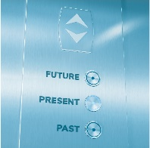
Image credits
Shutterstock.com

Slide 203
Copyright
This presentation is for use as part of the Alcohol and Drug Cognitive Enhancement (ACE) Program. No part may be copied or used for any other purpose without permission from the NSW Agency for Clinical Innovation. Contact via https://www.aci.health.nsw.gov.au/
The examples may be amended to suit local conditions.
Credits
Slide 196 – Attention training technique from:
Wells, A. (2009). Metacognitive therapy for anxiety and depression. New York: Guilford Press. (Contains the ATT treatment manual for therapists).
Published Mar 2018. Next Review 2028. © State of NSW (Agency for Clinical Innovation) and Advanced Neuropsychological Treatment Services

