Slide 1
Module 12: Revision
Alcohol and drug Cognitive Enhancement (ACE) Program
Notes:
[FACILITATOR TIP:
The approach to revision is not intended to be prescriptive. You may choose to revise the key messages in any way that allows for maximum engagement of participants
There are a number of ways to engage participants to make Revision a fun and enjoyable experience. You may choose to select one or more of the following approaches:
Ask participants to volunteer information they learned in each session, and write their answers on a whiteboard or butchers paper
Ask participants to share examples they used in the last 11 sessions - “What was something that stuck with you or worked well for you in the last 11 sessions?”
Participants present the information back to facilitators and the group
Another of your choosing]

Slide 2
Revision
Why is play so important?
What is something you can say to yourself to help you come up with ideas to solve a problem?
What is a good thing to do if your solution is not working?
Notes:
Why is play so important?
[Answer: It helps us survive and thrive.]
What is something you can say to yourself to help you come up with ideas to solve a problem?
[Answer: Think of a specific time and place where you carried out a similar activity in the past.]
What is a good thing to do if your solution is not working?
[Answer: Switch to a different option.]

Slide 3
Brainwork outcome 1
Page 39 in workbook
Solve that problem / Make that decision
Description | Actual outcome | Predicted outcome | Actual minus Predicted
Went through steps 1-4 of the Problem-Solving Guide | 3 | 3 | 1
Went through steps 1-3 of the Problem-Solving Guide | 2 | 2
Went through steps 1-2 of the Problem-Solving Guide | 1 | 1
Did nothing or went through step 1 of the Problem-Solving Guide only | 0 | 0
MINUS
The closer to zero, the more accurate your predictions
Negative number: You overestimated your performance
Positive number: You underestimated your performance
Notes:
Circle on your Brainwork Prediction Form how much of your brainwork you completed.
How well did you predict your own behaviour?
[Provide assistance to anyone unclear on how to do this but do not spend too long on it.]
[Lead a discussion regarding each of the modules of the course as per the following slides.]

Slide 4
Brainwork outcome 2
Page 38 in workbook
Posture diary
Description | Actual outcome | Predicted outcome | Actual minus Predicted
Completed 12-14 out of 14 days of the table | 3 | 3 | 1
Completed 8-11 out of 14 days of the table only | 2 | 2
Completed 4-7 out of 14 days of the table only | 1 | 1
Completed 0-3 out of 14 days of the table only | 0 | 0
MINUS
The closer to zero, the more accurate your predictions
Negative number: You overestimated your performance
Positive number: You underestimated your performance
Notes:
The Posture Diary brainwork task was completed over two separate weeks. Mark how much of it you completed on your brainwork prediction form where it says Module 7 - Brainwork task - Posture diary. What was your pattern of behaviour? Did you have more or less instances of slouchy posture? If you had less as time went on, you perhaps strengthened your Self-reflector and Inhibitor, and in the process changed your behaviour. There is evidence in the scientific literature that suggests improving self-control with things like posture helps increase self control for other things as well. Would anyone like to share what they may have learned from doing this task?

Slide 5
Brainwork prediction progress
Notes:
Now we are going to plot your ‘Actual minus Predicted’ score for each of the 11 brainwork tasks. This will show whether your ability to predict your own behaviour improved during this program. Turn to Page 40 of your Workbook.
So, put a dot for your score (between -3 and +3) on the line underneath each of the brainwork tasks.
[Click to demonstrate by animating the slide.]
“Now, we are going to plot your “Actual minus Predicted” score for each of the 11 brainwork tasks. This will show whether your ability to predict your own behaviour improved during this program.
So, put a dot for your score (between -3 and +3) on the line underneath each of the brainwork tasks.
For example, if you scored -3 for the first brainwork prediction task, Obtaining a Notebook, put a dot at 0 under Module 1 – Obtaining a Notebook
If you got -1 for the second brainwork prediction task, put a dot at -1 under Module 2 – Elaborate on Memory Module Info
Keep going like this until you have put dots on the graph for each of your scores
[click to animate slide]
Then join the dots with lines like this.
[Lead a discussion that promotes reflection on the meaning of the individual curves. Ask participants to share their results, if they want to.
Essentially, if a person gets closer to zero, as in the example on the slide, then they have become better at predicting their future behaviour.
If they haven’t, reassure them that this is OK, but that they might benefit from being more reflective of whether they are setting realistic tasks and goals for themselves and to keep trying to predict their behaviour in everyday life.
You could ask: What would help you improve your score to get closer to zero? If you didn’t get close to zero, what might help you to get closer? What could you have done differently?]
If your scores increased (became more positive) throughout the program, it means you developed an underestimation of your ability to achieve things in the future. This could be because of diminishing self-confidence. If that was the case, it may help you to set yourself easy tasks to begin with as you continue to develop your skill at predicting your future behaviour.
If your scores decreased (became more negative) throughout the program, it means you developed an overestimation of your ability to achieve things in the future. This could be because of over-confidence. If that was the case, it may help you to try to be more realistic about predicting your future behaviour.

Slide 6
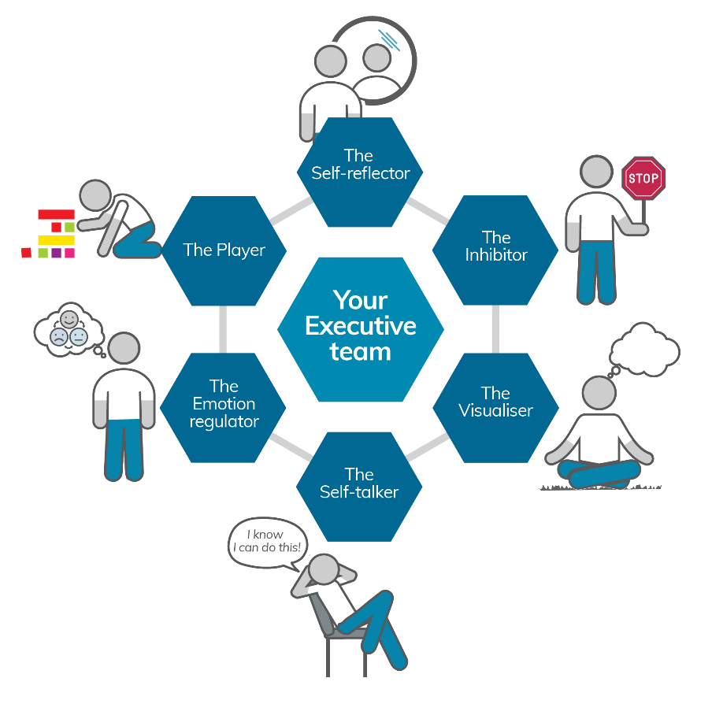
Your Executive team
Notes:
[FACILITATOR TIP: The approach to revision is not intended to be prescriptive. You may choose to revise the key messages in any way that allows for maximum engagement of participants]
We have come a long way since our first session and we have met the six members of your Executive Team.
[Revise the names of the Executive Team members] – We will cover these in more detail later.
For now… [Ask the participants to close their workbooks as individuals will be asked to volunteer what they remember of each session and Executive Team member throughout the remainder of this session]

Slide 7
The three brains
REPTILIAN
LIMBIC SYSTEM
NEOCORTEX
What is good or bad for me right now?
What is good or bad for me right now based on what happened in the past?
What is good or bad for me right now based on what happened in the past and what I want in the future?
Notes:
Module 1 Key Messages:
Understanding how the brain works helps us understand our behaviour and how to change it.
Learning exercises and strategies helps strengthen brain functions that are often weakened in addiction.
Reptile brain The most primitive level of the brain. It processes basic instincts or behaviour. Its functions help us stay alive.
Limbic system The next level of brain evolution. It processes emotions. Its functions help us interact and bond.
Neocortex The most recent level of brain evolution. It processes thoughts. Its functions allow abstract thought, helps us plan and make decisions, and processes and manages information from other areas of the brain.
[Ask the participants to name the ‘three brains’]
Which of these is mainly responsible for emotion? Behaviour? Thoughts?
[Click to animate the text under each of the three brains]
Answers:
Reptilian = Behaviour
Mammalian/Limbic = Emotion
Neocortex = Thoughts

Slide 8
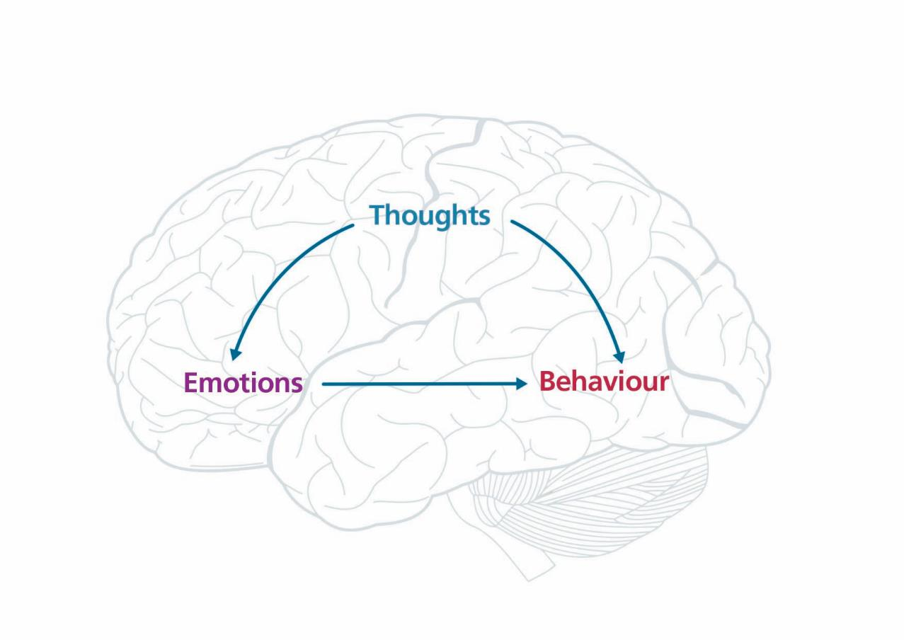
Notes:
In the first session, we discussed how behaviour can be influenced by an environmental trigger (a stimulus) or emotional reactions. We also discussed how thoughts can help over-ride the triggers or control our emotions.
[click to animate slide]
When we live by our instincts or things that happen around us in the present moment, we are mainly using our reptilian brains.
[click to animate slide]
When we react to what has happened to us in the past, we are mainly using our limbic system (or old mammalian brains).
[click to animate slide]
However, when we think about what it is we would like to happen in the future, we are using our neocortex, or human brain, in particular the frontal lobes.

Slide 9
Memory
Types of memory
Automatic
Episodic
Prospective
Memory strategies that worked for you?
Notes:
Key Messages from Module 2:
Learning can happen consciously or subconsciously, depending on how information is processed.
Automatic memory works through subconscious processing – implicit and procedural
Episodic memory works through conscious processing – encoding, storage, and retrieval
Prospective memory refers to how well we can remember to do things in the future.
What are the types of memory?
[Click to animate answer]
[Click to animate slide]
Which memory strategies worked for you?
(Possible answers on page 6 of Participant Workbook)

Slide 10
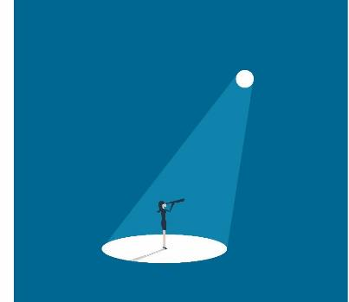
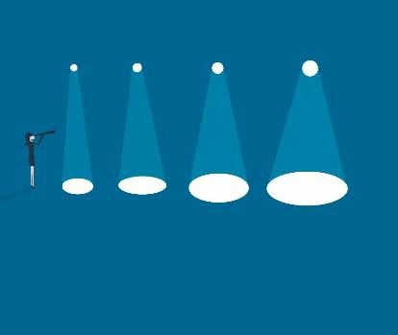
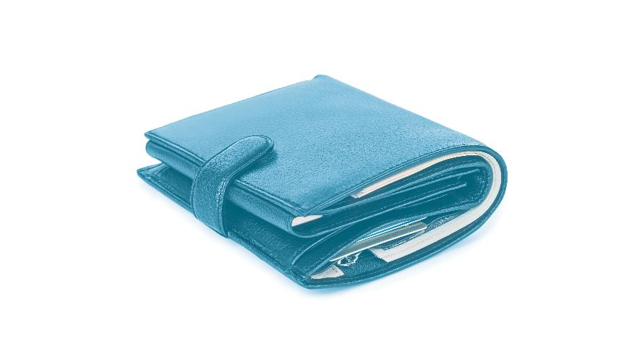
Attention
Types of attention
Attention strategies that worked for you?
Why do we pay for it?
Focused
Attention Span
Sustained
Divided
Notes:
Key Messages for Module 3:
Focused attention and divided attention are the two types of attention we use 'in the moment'.
Divided attention takes much more effort, but exercises and tricks exist for improving all types of attention.
What are the different types of attention?
[Click to animate answer] – focused attention, sustained attention, attention span, divided attention
What attention strategies worked for you?
[Click to animate slide]
(Possible answers on page 7 of Participant Workbook)
[Click to animate image of wallet]
Why do we ‘pay’ for it?
(Answer: because, like money, it is a limited resource, and if we spend it all in one place, we may not have enough to spend in other places.)

Slide 11
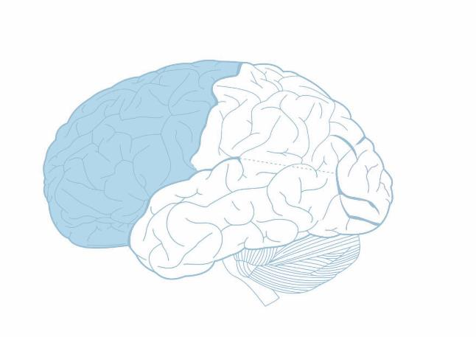
Goals and plans
Function of the frontal lobe?
To see into the future
Align our behavior with our future goals
Goal setting
Immediate
Medium term
Long term
Your GAP: Goal and Plan
GOAL
AND
PLAN
Notes:
Key Messages from Module 4:
The frontal lobes are the key part of the brain that allows for planning for the future and setting goals.
Both the goals set, and plans to achieve them, need to be specific to be effective.
What is the main function of the frontal lobe?
[Click to animate answer] - To help us see into the future and set goals, to help us be mindful of the future when we are in the present moment so that we can behave in ways that align with our goals
What do you remember about goal setting?
[Click to animate answer] - immediate, medium term, long term
What do you remember about Goal and Plan (GAP)?
[Click to animate answer] - Goals and plans need to be specific i.e.: have enough detail so we know whether or not we have achieved our goal or not

Slide 12
Time horizons
What is a time horizon?
Represents how far you can see into the future
As frontal lobe functioning decreases, so too do our time horizons
How do you stretch your time horizon?
Make a plan
Include the short and long terms costs and benefits
Notes:
Key Messages from Module 5:
Addiction can impact how far we can think into the future.
Practicing thinking far ahead can help us 'expand our horizons' as to what is possible.
What do you remember about time horizons?
[Click to animate answer] - A time horizon represents how far you can see into the future. As frontal lobe functioning decreases, so too do our time horizons.
How far ahead is your time horizon? How far into the future can you imagine?
How do you stretch your time horizon?
[Click to animate answer] - Make a plan that considers the short and long terms costs and benefits. Having a plan will help us to realise that our time horizon is not that far away and is achievable.

Slide 13
Your Executive team
Notes:
[FACILITATOR TIP: The approach to revision is not intended to be prescriptive. You may choose to revise the key messages in any way that allows for maximum engagement of participants]
We will cover these in more detail later.
For now… [Ask the participants to close their workbooks, and ask individuals to identify the six members of their Executive Team]
[Click to animate answer] -
Self-reflector
Inhibitor
Visualiser
Self-talker
Emotion regulator
Player
The Executive team (or frontal lobes) will help you set goals, make plans and solve problems along the way to achieving the goals that you create within your time horizons.
They are linked to control of the executive functions.
The frontal lobes take in all the information from the back of the brain (being sensory input and memories) to determine what the next action should be.
However, the frontal lobes also give us the ability to look into the future and imagine a future we want.
Once we know the future we want, the frontal lobes tell the parts at the back of the brain what to pay attention to in order to achieve those goals.
This is also the part of the brain that goes on holiday during addiction, so it's important that we get the executive team back up to speed by putting them to work (use it or lose it).

Slide 14
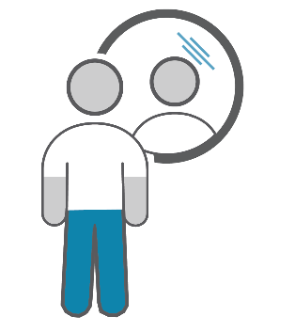
Self-reflector
Function
It helps us to check and adjust our behaviour
Time Pressure Management
‘Let me give myself enough time to do the task’
Task Orientation
What am I doing NOW, what was I doing BEFORE THIS, what do I do NEXT?
Notes:
Key Messages from Module 6:
Self-reflection gives us a sense of our own identity and our own goals, separate from other people.
It also makes us aware of what others think about us, which we 'internalise' to monitor ourselves.
One thing we need to be aware of is how we manage our own time.
Knowing our own weaknesses around time estimation means we can allow ourselves extra time to do things well.
[Ask individuals to volunteer what they remember of this Executive Team member]
What are the functions of the self reflector?
[Click to animate answer] - It helps us check and adjust our behaviour]
What can help you manage time pressure?
[Click to animate answer] – “Let me give myself enough time to do the task”, Recognise-Prevent-Deal
What is the strategy you can use to help orientate yourself to a task?
[Click to animate answer] - What am I doing NOW, what was I doing BEFORE THIS, what do I do NEXT?

Slide 15
Inhibitor
Function
Helps us to put the brakes on unhelpful behaviour
Temptation Tempering Tactics
(From the marshmallow experiment)
Stop and Think Technique
What are the likely consequences?
How will this affect me and others?
How will this affect my goals?
Notes:
Key Messages from Module 7:
Managing temptation or other impulses is a skill we first learn as a child from others' prompts.
As we grow in adolescence, these prompts from others are not enough and need to come from within us.
Being able to 'put the brakes on' our own emotional reactions and impulsive responses helps us navigate life more successfully.
[Ask individuals to volunteer what they remember of this Executive Team member]
What the functions of the inhibitor?
[Click to animate answer] - Helps us to put the brakes on unhelpful behaviour
What were some temptation tempering tactics?
[Click to animate answer] – possible answers on page 19 of participant Workbook
What were some Stop and Think Techniques
[Click to animate answer] – “If I do what I feel the urge to do right now…. STOP and THINK. What are the likely consequences? How will this affect me and others? How will this affect my goals?”

Slide 16
Visualiser
Functions
Helps us imagine a different future
Visualisation of your goals
Mentally rehearse the behaviour you intend
Notes:
Key Messages from Module 8:
The Visualiser helps us re-create a picture in our mind of something that has happened or imagine something we want to happen in the future.
It uses our visual working memory to hold a picture in our mind.
We can use that picture to practice something or imagine a future that we want and what we need to do to make that happen.
[Ask individuals to volunteer what they remember of this Executive Team member]
What are the functions of the visualiser?
[Click to animate answer] - Helps us imagine a different future, Visualisation of your goals, Mentally rehearse the behaviour you intend

Slide 17
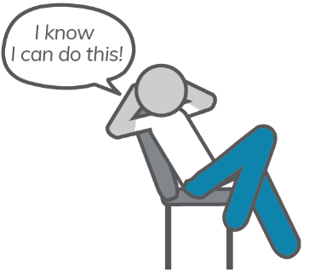
Self-talker
Functions
Helps us to stay committed to our goals and plans
“Talk yourself out of it!”
Positive self-statements
What are some examples?
If-Then Plans
What are some examples?
Notes:
Key Messages from Module 9:
Talking ourselves through situations or problem solving can help us stay focused on what we need to do.
What we say to ourselves can affect our emotions as well as behaviour so we need to make sure our self-talk is helpful and positive.
We can use self-talk alongside visualisation to help us plan ahead and overcome obstacles.
[Ask individuals to volunteer what they remember of this Executive Team member]
What are the functions of the Self-Talker?
[Click to animate answers] – Helps us to stay committed to our goals and plans, “Talk yourself out of it!”
What are some examples of positive self-statements?
[Click to animate answer] – possible answers on page 27 of Participant Workbook
What are some examples of If-Then Plans?

Slide 18
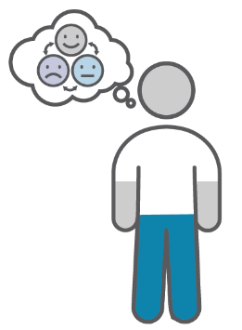
Emotion regulator
Function
Helps prevent us from being overwhelmed, and use our emotions to move us closer to our goals
Primary emotions
Fear, Happiness, Anger, Disgust, Surprise, Sadness
POP Technique
Prioritise – Organise – Plan
Make your emotions work for you
Notes:
Key Messages from Module 10:
Feeling overwhelmed can prevent us from engaging with what we need to do and lead to impulsive behaviours.
Planning and organising can protect us from feeling overwhelmed.
Emotions move us away from what's bad for us and towards what's good for us, so focusing strongly on our future goals can shift our emotional reaction to move us towards things that are aligned with our goal.
[Ask individuals to volunteer what they remember of this Executive Team member]
What are the functions of the emotion regulator?
[Click to animate answer] - Helps prevent us from being overwhelmed, and use our emotions to move us closer to our goals. Emotions move us toward things that are good for us, and away from things that are bad for us
What is are the primary emotions and what are their functions?
[Click to animate answer] – Fear, Happiness, Anger, Disgust, Surprise, Sadness
What is the POP technique?
[Click to animate answer] – Prioritise – Organise – Plan
Has anyone got an example of when they used this?
How do you make your emotions work for you? What are some examples of this?

Slide 19
Player
Function
Helps us to survive and thrive
Problem Solving Approaches
Define
Options or solutions
Pros and Cons
Choose one and DO IT!
Check
Switch (if needed)
Notes:
Key Messages from Module 11:
Playing is a fun way to learn the skills we need to survive and thrive.
As adults, we use play to develop the skills we need to solve adult problems.
Following logical steps to solve problems (and make decisions) helps us develop high-order thinking skills.
[Ask individuals to volunteer what they remember of this Executive Team member]
What are the functions of The Player?
[Click to animate answer] - Helps us to survive and thrive
What some approaches to Problem Solving?
[Click to animate answers] – Define, Options or solutions, Pros and Cons, Choose one and DO IT!, Check, Switch (if needed)

Slide 20
Your Executive Team
Module 12
20
Alcohol and Drug Cognitive Enhancement (ACE) Program
Notes:
So, now that you are well acquainted with the members of your executive team, may you sail off into your time (and space) horizon, equipped with a number of valuable strategies and other tools to help you achieve your goals.
Thanks for participating in this program. We hope it has provided you with some knowledge and skills that you will find valuable in the future.
How did you find the program?
Are there any final thoughts or questions?

Slide 21
The End
Well Done!
July 2020

Slide 22
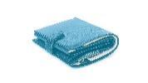
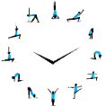
Copyright
This presentation is for use as part of the Alcohol and Drug Cognitive Enhancement (ACE) Program. No part may be copied or used for any other purpose without permission from the NSW Agency for Clinical Innovation. Contact via https://www.aci.health.nsw.gov.au/
The examples may be amended to suit local conditions.
Image credits
Shutterstock.com
Published Mar 2018. Next Review 2028. © State of NSW (Agency for Clinical Innovation) and Advanced Neuropsychological Treatment Services

