Slide 1
Module 11: The Player
Alcohol and drug Cognitive Enhancement (ACE) Program

Slide 2
Revision
What is the function of anger?
What is the function of fear?
What does it mean to be organised?
Notes:
What is the function of anger?
[Answer: to address injustice.]
What is the function of fear?
[Answer: to avoid danger.]
What does it mean to be organised?
[Answer: to have all the materials or objects you need in the right place.]

Slide 3
Brainwork outcome
Page 39 in workbook
Goals changing emotions
Description | Actual outcome | Predicted outcome | Actual minus Predicted
Wrote down and described emotion changes for 4 situations | 3 | 3 | 1
Wrote down and described emotion changes for 3 situations | 2 | 2
Wrote down and described emotion changes for 2 situations | 1 | 1
Wrote down and described emotion changes for 0-1 situations | 0 | 0
MINUS
The closer to zero, the more accurate your predictions
Negative number: You overestimated your performance
Positive number: You underestimated your performance
Notes:
Circle on your Brainwork Prediction Form how much of your brainwork you completed.
How well did you predict your own behaviour?
[Provide assistance to anyone unclear on how to do this but do not spend too long on it.]

Slide 4
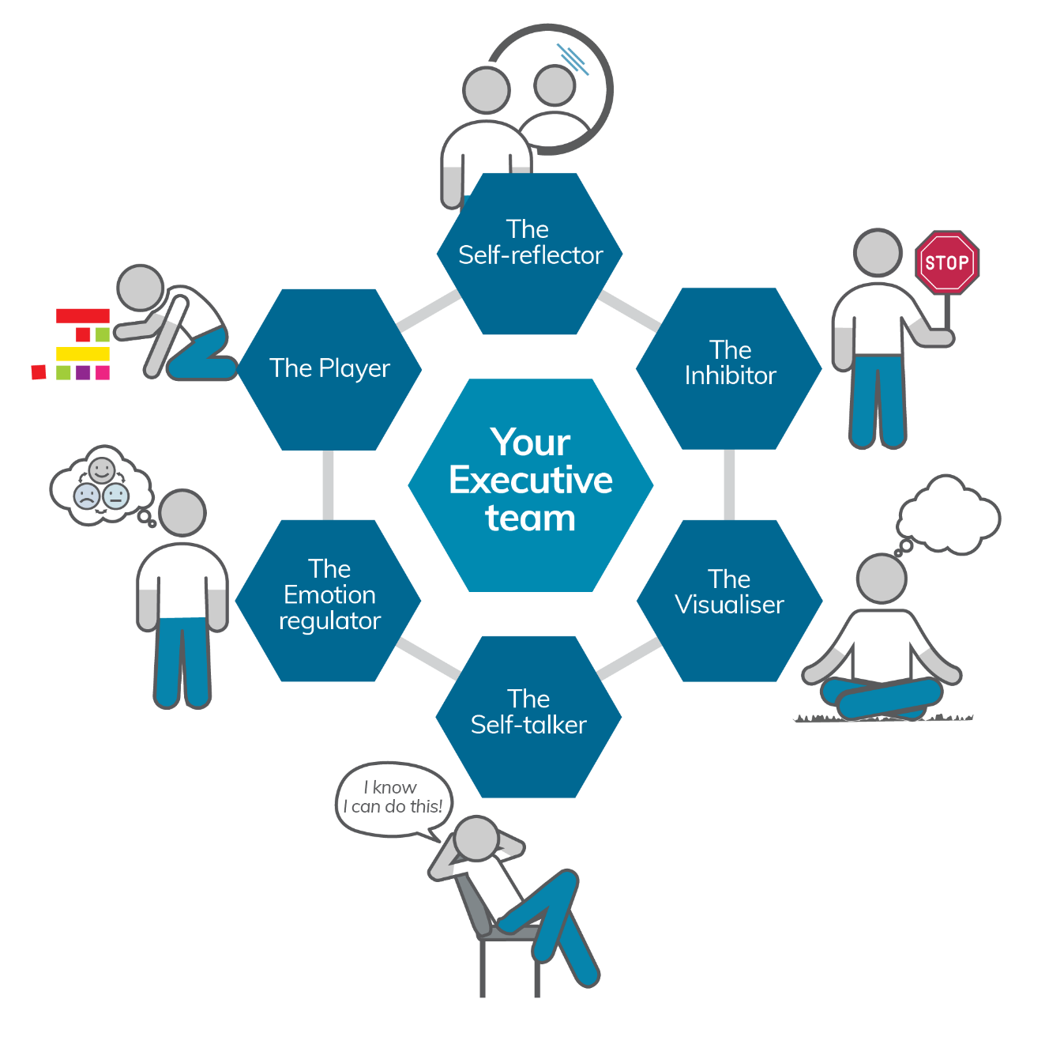
Your Executive team
Notes:
You have now met five members of your Executive Team and today you will meet the last one, The Player.
Review the five executive team members introduced so far - ask the participants what each does.

Slide 5
Le(t’s) go
Build something found in a house
Use at least three pieces
Notes:
[Co-facilitator to put Lego in a pile that is easily accessible by participants, either in a circle or spill out on the floor or on a desk, so no one is left out when choosing pieces.]
[Click to animate slide] x 2
“We are now going to do an activity involving some lego. I’d like you to come forward and choose at least 3 pieces of lego from the pile. The aim of this activity is for you to make something that is found in a house.”
(A limit can be put on the number of pieces each person takes, e.g., no more than 10 pieces, but this is usually not needed).
[Give the participants five minutes to build something.]
[Ask each participant to describe briefly what they have made and praise or thank them for their efforts.]

Slide 6
Brainstorm - What is play?
Play is:
any activity that helps us develop the skills necessary
to survive or thrive
Notes:
[Brainstorm answers to this question with the participants – write responses on board.]
[click to animate slide] - There are many different ways to define play. One is that it is any activity that helps us to develop the skills necessary to survive or thrive.

Slide 7
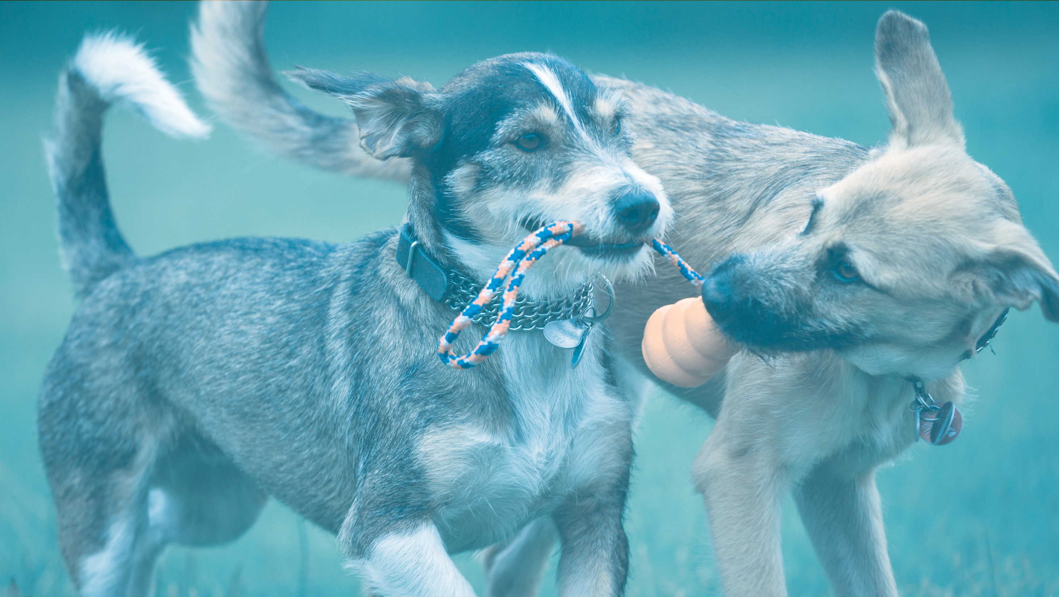
Animal play
Is there an image of puppies/dogs being more competitive in play to match the script?
When dogs play, it is all about competing physically.
Module 11
7
Alcohol and Drug Cognitive Enhancement (ACE) Program
Notes:
When dogs play, it is all about competing physically. Dogs chase each other and then pretend to attack one another, as though they are competitive rivals or predator/prey.
This is how dogs develop the skills they need to hunt and fend off rival competitors.

Slide 8
Children’s play
When children play, they experiment with the language and skills they need for when they are adults.
What are some examples?
Module 11
8
Alcohol and Drug Cognitive Enhancement (ACE) Program
Notes:
When children play, they experiment with the language and skills they need for when they are adults.
For example, children often learn to play in general stereotypical or culture-based gender roles. What are some examples?
[Facilitator Tip: You may wish to show a short video clip of children problem solving using play.]

Slide 9
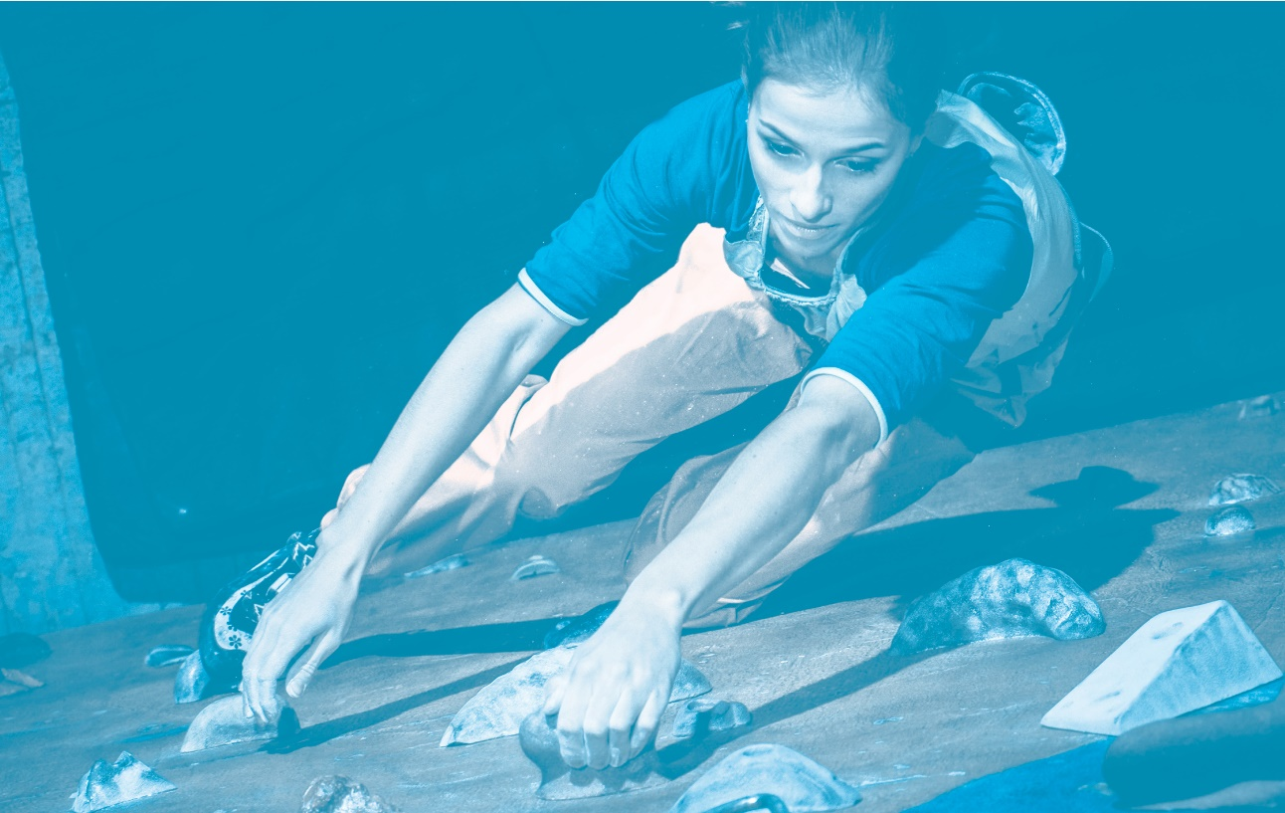
Adult play
Adult play is almost always about problem-solving.
Notes:
Adult play is almost always about problem-solving because problem-solving is our main tool to survive or thrive.
[Ask about games that participants like to play.]

Slide 10
Adult play
10
Notes:
Games like crosswords and Sudoku help us improve our language and mathematical skills, because these are skills that can help us survive or thrive.

Slide 11
Play in kids and adults
When children play, they:
Generate ideas or collect objects or toys
Pick the best ones for the game at hand
Put them together in ways they may never have thought of or done before
Test out whether the way they have put them together and used them helps them play the game they want
If it doesn’t help them play the game they want, they modify their use of the ideas, toys or objects or start again with other ideas, toys or objects.
When adults problem-solve, they:
Generate ideas or collect objects
Pick the best ones for the problem at hand
Put them together in ways they may never have thought of or done before
Test out whether the way they have put them together and used them solves the problem they want
If it doesn’t solve the problem, they modify their use of ideas, concepts or objects, or start again with other ideas, concepts or objects.
Notes:
You can see how similar children’s play and adult problem-solving are.
[Animate one point at a time and discuss.]
When children play, they:
Collect objects or toys
Pick the best ones for the game at hand
Put them together in ways they may never have thought of or done before
Test out whether the way they have put them together and used them helps them play the game they want
If it doesn’t help them play the game they want, they modify their use of the toys or objects or start again with other toys or objects.
When we as adults play mentally (i.e., problem-solve), this is exactly what we do too:
Generate or collect ideas, thoughts, or objects
Pick the best ones for the problem at hand
Put them together in ways we may never have thought of or done before
Test out whether the way we have put them together and used them solves the problem
If it doesn’t solve the problem, we modify our use of ideas, concepts or objects, or start again with other ideas, concepts or objects.

Slide 12
Problem solving
Define the problem
Brainstorm ideas, options or solutions
‘Think of a specific time and place where you carried out a similar activity in the past’
Weigh up the PROs and CONs of each idea, option or solution
Notes:
There is a general pattern we follow when we solve problems, even if we aren’t aware of it.
[click to animate slide for each]
Define the problem
Come up with ideas, options or solutions
One of the best ways of coming up with ideas for a problem you need to solve is to think about similar problems and how you solved them in the past. It is important to think of a specific time and place where you carried out a similar activity in the past.
3. Weigh up the PROs and CONs of each idea, option or solution
Often, we think for a long time about which of the available options we are going to choose. The best way to choose between the options is to list some pros and cons for each. This will often help us be clear about which of the options is best. However, this can be very painful, especially if all the options seem equally good or bad. If the options seem equally good or bad, then just choose any of them and test them out. Once you have made your choice, love your decision.

Slide 13
Problem solving
Choose ONE and DO IT!
Love your decision
Check
Check in with your Self-Reflector to keep track of whether the solution works
Switch
If your solution is not working start again with a different option
Notes:
[click to animate slide for each]
4. Choose ONE and DO IT!
Love your decision
Either put your choice into action right away or wait until the right moment
Form an if-then plan if the action you need to take is at some point in the future
5. Check
Check in with your Self-reflector to keep track of whether the solution works
6. Switch
If your solution is not working, don’t worry too much about it, just start again with a different option
When certain options get blocked, cost too much or otherwise don't work, it is best to develop alternative options. This is referred to as 'cognitive flexibility'. Poor flexibility is seen as a breakdown in the ability to adapt to changes.

Slide 14
Problem solving examples
Page 35 of workbook
Think of some examples of problems you could apply this approach to:
Define the problem
Brainstorm ideas
Weigh up the pros and cons
Choose one and do it!
Check
Switch
Notes:
Problem Solving Guide
[Ask participants to suggest a few examples of problems they could apply this approach to. Choose one of them to work through with the group, or break into small groups of 3-4 participants. The example should be one where at least three different options or solutions might be possible.]
[Clearly define the problem as per point 1, brainstorming options as per point 2 and weighing up the pros and cons as per point 3.]
[If no suitable example is available to choose from, use the following example or make up and use a similar one:
You have agreed to organise a summer BBQ get-together with a group of close friends. You need to choose somewhere to have the BBQ and make sure everyone gets invited by the end of the week. The day picked for the BBQ is two weeks from today. Where will you have the BBQ?]
[Go through points 1-4 of the problem-solvingworksheet, then introduce a new problem, e.g.
It is now two days before the BBQ and the weather forecast says there will be heavy rain on the day of the BBQ. What will you do now?]
[Highlight the importance of steps 5 and 6 and being able to adapt and go through steps 1-4 again when circumstances change.]

Slide 15
Higher level thinking skills
The six step problem-solving guide can also help with decision-making.
Use this form every time you are have a complex problem or decision to make, and practice the steps to develop better higher level thinking skills.
Notes:
The six step problem-solving guide can also help with decision-making.
Problem-solving and decision-making are considered two of the highest-order functions of human thinking skills.
This is because they require good lower level skills, like attention and memory, and the ability to think about tricky issues to help you achieve your goals.
So, use this form every time you are faced with a complex problem or decision, and practice the steps to develop better higher level thinking skills.

Slide 16
Brainwork
Page 35 of workbook
Apply steps 1-4 of the problem solving guide to a
specific problem or decision that you need to deal
with currently.
Also
Ensure your Brainwork Prediction Form is completed
Ensure your Posture Diary is finalised
Notes:
Apply steps 1-4 of the problem solving guide to a specific problem or decision that you need to deal with currently (Page 35 of the participant workbook)
Also:
Ensure your brainwork prediction form is completed
Ensure your posture diary is finalised

Slide 17
Brainwork prediction
Page 39 in workbook
Solve that problem / Make that decision
Description | Actual outcome | Predicted outcome | Actual minus Predicted
Went through steps 1-4 of the Problem-Solving Guide | 3 | 3
Went through steps 1-3 of the Problem-Solving Guide | 2 | 2
Went through steps 1-2 of the Problem-Solving Guide | 1 | 1
Did nothing or went through step 1 of the Problem-Solving Guide only | 0 | 0
The closer to zero, the more accurate your predictions
Negative number: You overestimated your performance
Positive number: You underestimated your performance
Notes:
Predict how much of the brainwork you think you will complete and write this down now.

Slide 18
End of Module 11
July 2020

Slide 19
Copyright
This presentation is for use as part of the Alcohol and Drug Cognitive Enhancement (ACE) Program. No part may be copied or used for any other purpose without permission from the NSW Agency for Clinical Innovation. Contact via https://www.aci.health.nsw.gov.au/
The examples may be amended to suit local conditions.
Image credits
Shutterstock.com
Published Mar 2018. Next Review 2028. © State of NSW (Agency for Clinical Innovation) and
Advanced Neuropsychological Treatment Services

