Slide 1
NSW Paediatric PCA or NCA chart [SMR130.026]
Pain Management Network

Slide 4
Aim
This presentation aims to explain:
Who can use the chart
Guidelines on the management of patients receiving PCA or NCA including the management of adverse effects
How to use the chart for prescribing a PCA or NCA
How to record the administration and discard of opioids used for PCA
How to complete the clinical observations

Slide 5
NSW paediatric PCA or NCA chart – revised 2023
The NSW Paediatric PCA or NCA chart was first developed in 2015-16.
It was revised in 2023 by a team of experts in the field of paediatrics, acute pain, anaesthetics and pharmacy.
The chart is primarily for use in non-tertiary paediatric facilities.
Using a standard chart promotes best practice in prescribing, administration, pain assessment and management of adverse effects in paediatric patients receiving an opioid via PCA or NCA.

Slide 6
Local governance
Paediatric PCA or NCA chart is only to be used in facilities with local governance structures in place to ensure its safe and effective use in children.
These structures must include a PCA or NCA guideline (including specific paediatric information), appropriate environment, staff training, supervision and support.

Slide 7
Local health district governance
Local governance guidelines and policy must include these elements.
An endorsed policy or guideline for PCA (including specific paediatric information)
A dedicated paediatric inpatient area (level 4 paediatric facilities)
Adequate provision of onsite 24/7 medical cover
Escalation of care procedures
Adequate provision of nursing staff to provide paediatric high or close observation care
Appropriately trained staff in care of paediatric patients and PCA or NCA
Specification of the range of procedures and criteria to be supported through PCA or NCA
Selection criteria of patient suitable or unsuitable for paediatric PCA/NCA e.g. cognitive ability of the child
Appropriate paediatric oxygen therapy
Continuous oxygen saturation monitoring
Accurate monitoring of fluid infusion rate and balance
Accurate monitoring of intravenous (IV) lines for occlusion
Background IV fluids (TKVO) running with paediatric PCA or NCA
Administration of paediatric PCA using syringes and/or bags
No other opioids or sedatives to be administered unless ordered by the Acute Pain Service or equivalent medical officer
Provision of naloxone
Regular auditing of Paediatric PCA or NCA charts
Clinical incidence reviews
Minimum of daily review of patients by the Acute Pain Service or equivalent medical officer

Slide 8
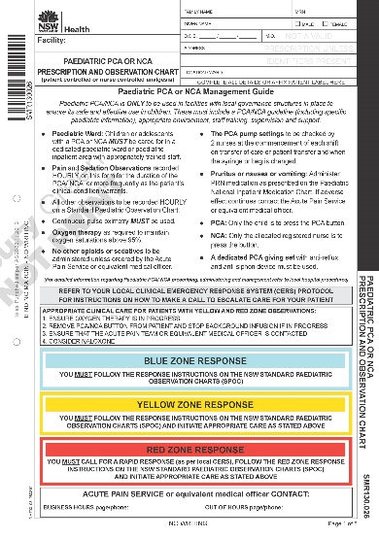
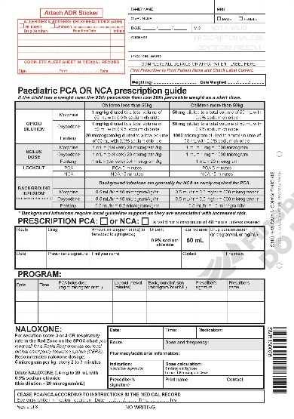
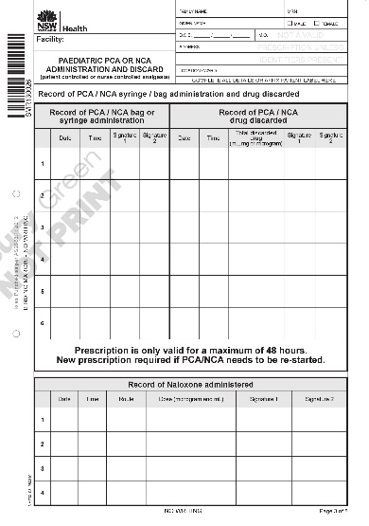
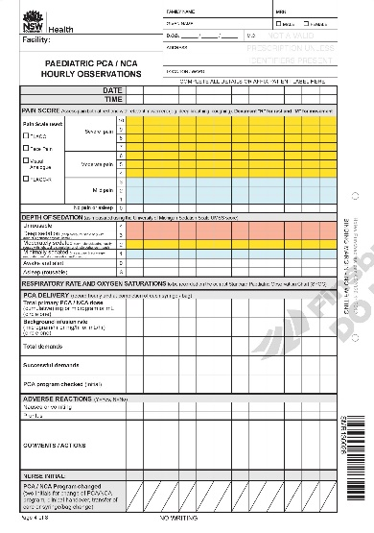
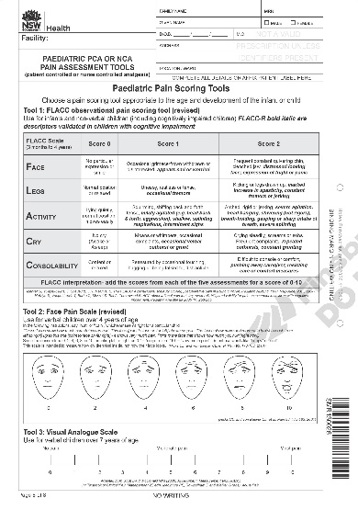
Booklet format (8 pages)
Page 1
Management guidelines and escalation of care
Page 2
Prescription guide and prescription for PCA, NCA and naloxone
Page 3
Administration and discard of PCA/NCA medication
Pages 4-7
Hourly observations
(up to 48 hours)
Page 8
Paediatric pain assessment tools
NSW Paediatric PCA or NCA chart format

Slide 9
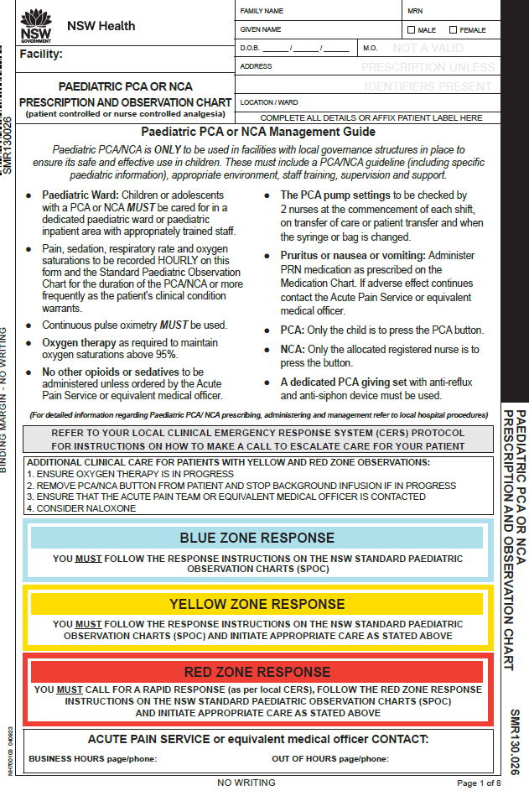
Management guidance
Paediatric PCA or NCA management guide
(in addition to local hospital policy or procedure)
Instructions for escalating care for patients whose observations are in the blue, yellow or red zones
Space for the contact details of your Acute Pain Service or equivalent medical officer who manages PCA

Slide 10
Management guide
Paediatric ward: Children or adolescents with a PCA or NCA MUST be cared for in a dedicated paediatric ward or paediatric inpatient area with appropriately trained staff
Pain, sedation, respiratory rate and oxygen saturations to be recorded HOURLY on this form and the Standard Paediatric Observation Chart for the duration of the PCA or NCA or more frequently as the patient's clinical condition warrants
Continuous pulse oximetry MUST be used
Oxygen therapy as required to maintain oxygen saturations above 95%
No other opioids or sedatives to be administered unless ordered by the Acute Pain Service or equivalent medical officer
The PCA pump settings to be checked by 2 nurses at the commencement of each shift, on transfer of care or patient transfer and when the syringe or bag is changed
Pruritus or nausea or vomiting: Administer PRN medication as prescribed on the medication chart. If adverse effect continues contact the Acute Pain Service or equivalent medical officer
PCA: Only the child is to press the PCA button
NCA: Only the allocated registered nurse is to press the button
A dedicated PCA giving set with anti-reflux and anti-siphon device must be used

Slide 11
Paediatric PCA or NCA: Management guide
Refer to local hospital procedures for detailed information regarding paediatric PCA or NCA prescription, administration and management.

Slide 12
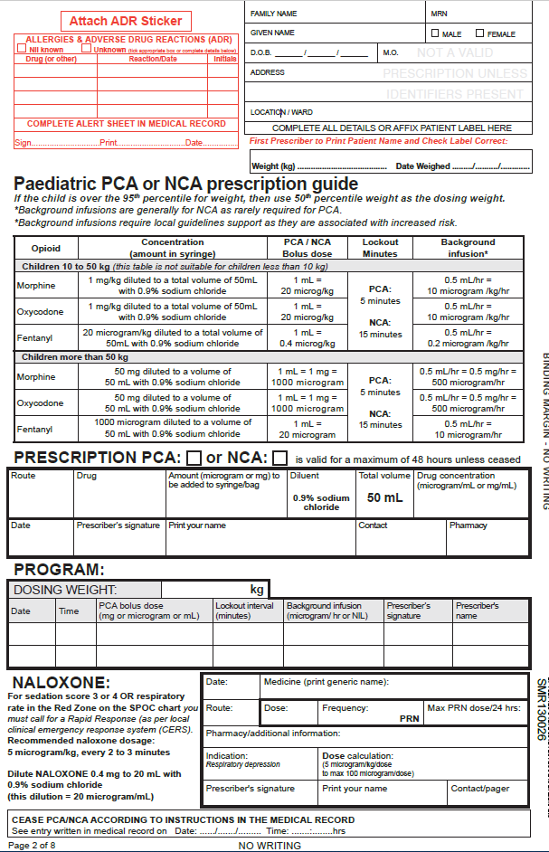
Prescription page
Patient label, allergies and adverse reactions
Paediatric PCA or NCA prescription guide with dosage information for children 10 to 50kg and children over 50kg
Prescription for PCA or NCA
Program: allows for 1 further change to the program
Naloxone prescription
Cease instruction

Slide 13
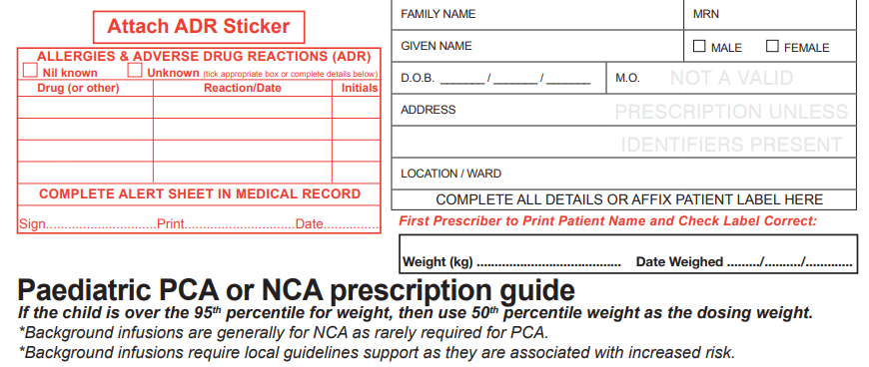
Below is an EXAMPLE prescription
Refer to hospital PCA policy for local guidelines on PCA or NCA prescribing
PCA or NCA prescription
Handwrite patient details or affix patient label (Prescriber to check patient label is correct)
Prescriber to complete patient allergy and ADR section in full
X
PSmith
P. SMITH
5/10/23
Additional information about overweight children and background infusions
43 kg
5 10 23
MUST have accurate weight recorded

Slide 14
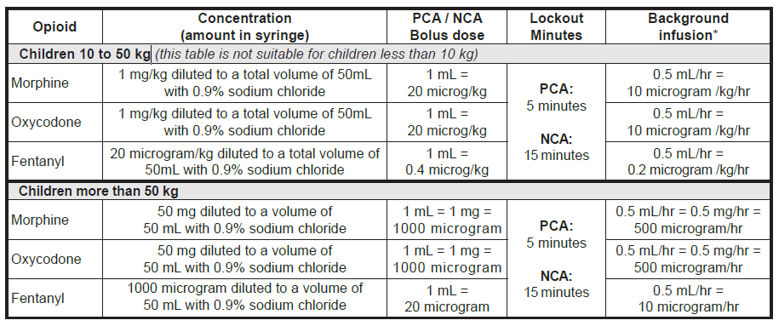
Below is an EXAMPLE prescription
Refer to hospital PCA policy for local guidelines on PCA or NCA prescribing
Prescription guidance table
Opioid
Concentration: how to prepare the syringe
PCA or NCA bolus dose
Lockout
Background infusion
Children 10 to 50kg
Children more than 50kg

Slide 15
Below is an EXAMPLE prescription.
Refer to hospital PCA policy for local guidelines on PCA or NCA prescribing.
PCA or NCA prescription
Prescriber to tick box for PCA or NCA
IV Morphine 50 mg 1 mg / mL
Prescriber’s signature, printed name and contact
5/10/23 PSmith SMITH pager or phone
PCA or NCA prescription to include:
route
drug (morphine, oxycodone or fentanyl)
amount in mg or microgram
total volume and primary drug concentration
A PCA or NCA prescription is for one opioid only
When changing from one opioid to another, a new PCA form must be commenced
Space provided for pharmacist reconciliation

Slide 16
Below is an EXAMPLE prescription.
Refer to hospital PCA policy for local guidelines on PCA or NCA prescribing.
PCA or NCA program
Dosing weight of the child to be documented This may be different from the actual weight
5/10/23 1000 1 mL = 500 microgram 5 minutes NIL P Smith SMITH
6/10/23 0930 1 mL = 500 microgram 5 minutes 0.5 mL = 250 microgram S Jack JACK
An additional row is provided for 1 change to the program
If more changes are required, a new PCA form is needed
If changing from one opioid to a different opioid, a new PCA form must be commenced
Prescriber’s signature and printed name

Slide 17
Below is an EXAMPLE prescription.
Refer to hospital PCA policy for local guidelines on PCA or NCA prescribing.
Naloxone prescription
Naloxone indications and dilution guidance
Naloxone
5/10/23
IV 100 mcg 2-3 minutes 100 microgram
5 microgram x 25kg = 125 mcg
= 100 microgram max dose
P Smith SMITH number

Slide 18
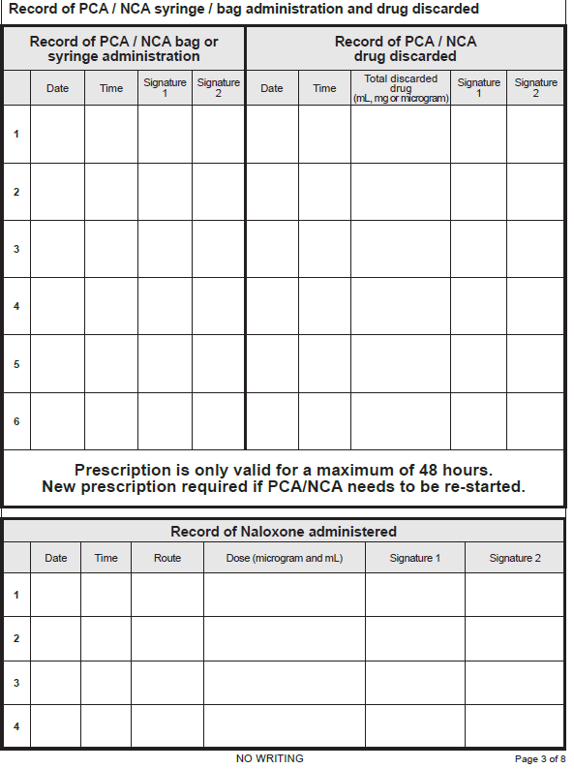
Record of administration and discard of PCA opioid
Administration of naloxone
Record of PCA or NCA commenced
Record of PCA opioid discarded
Prescription is valid for a maximum of 48 hours
A new prescription is required if PCA or NCA is to be continued beyond 48 hours
Naloxone that may have been administered

Slide 19
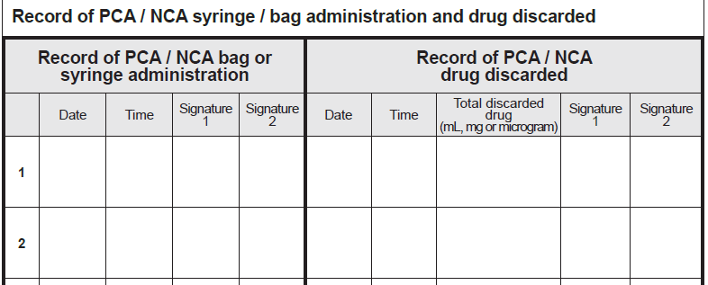
Administration and discard of PCA or NCA opioid
5/10/23 1015 THall JRose 5/10/23 23:30 NIL BLoh JLucas
5/10/23 2330 BLoh JLucas 6/10/23 0900 30 mL PLam TBuckley
Any opioid remaining from a syringe or bag to be recorded on the corresponding row from its administration
IF a syringe or bag is completely empty, document ‘NIL’ discarded
There are 14 rows provided to record PCA or NCA administration and discard

Slide 20
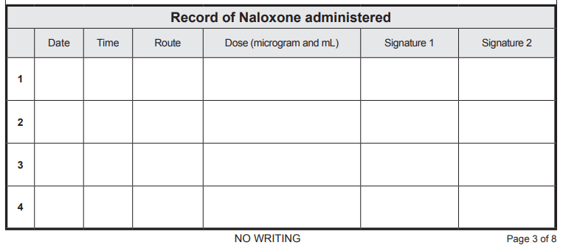
Naloxone administration
5/10/23 1800 IV 100 microgram THall JRose

Slide 21
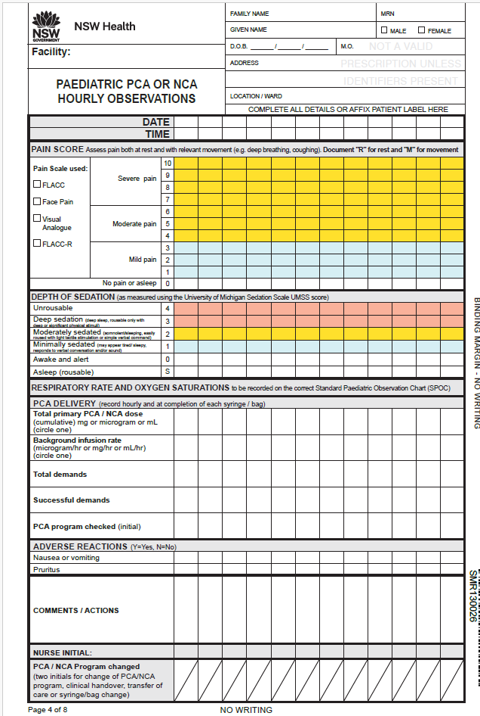
Paediatric PCA or NCA observations
The PCA or NCA chart provides space for the documentation of observations for a maximum of 48 hours.
If the PCA or NCA continues beyond 48 hours, a new PCA or NCA chart must be started and a new prescription written.

Slide 22
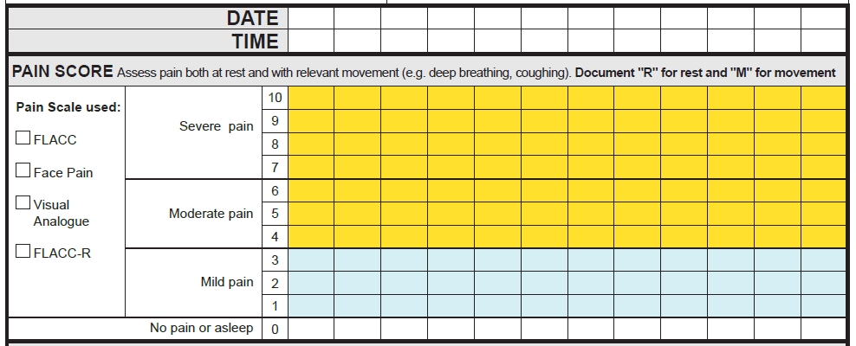
Documenting pain score
05/10/23
1100
1200
1300
1400
1500
Tick pain assessment tool used
M
M
M
M
R
M
R
R
R
R
Record “R” for pain assessed at REST
Record “M” for pain assessed on MOVEMENT

Slide 23
Depth of sedation observations (University of Michigan Sedation Scale UMSS score)
BLUE ZONE RESPONSE
YELLOW ZONE RESPONSE
RED ZONE RESPONSE
YOU MUST FOLLOW THE RESPONSE INSTRUCTIONS ON THE NSW STANDARD PAEDIATRIC
OBSERVATION CHARTS (SPOC)
YOU MUST FOLLOW THE RESPONSE INSTRUCTIONS ON THE NSW STANDARD PAEDIATRIC OBSERVATION CHARTS (SPOC) AND INITIATE APPROPRIATE CLINICAL CARE as stated on the front page of the PCA / NCA CHART
YOU MUST CALL FOR A RAPID RESPONSE
(as per local CERS), FOLLOW THE RED ZONE RESPONSE INSTRUCTIONS ON THE
NSW SPOC AND INITIATE APPROPRIATE CARE as stated on the front page of the PCA or NCA chart

Slide 24
Pain, depth of sedation, respiratory rate, Sp02 observations
Pain and depth of sedation on PCA form and in the eMR.
Respiratory rate, Sp02 observations to be recorded in the eMR.

Slide 25
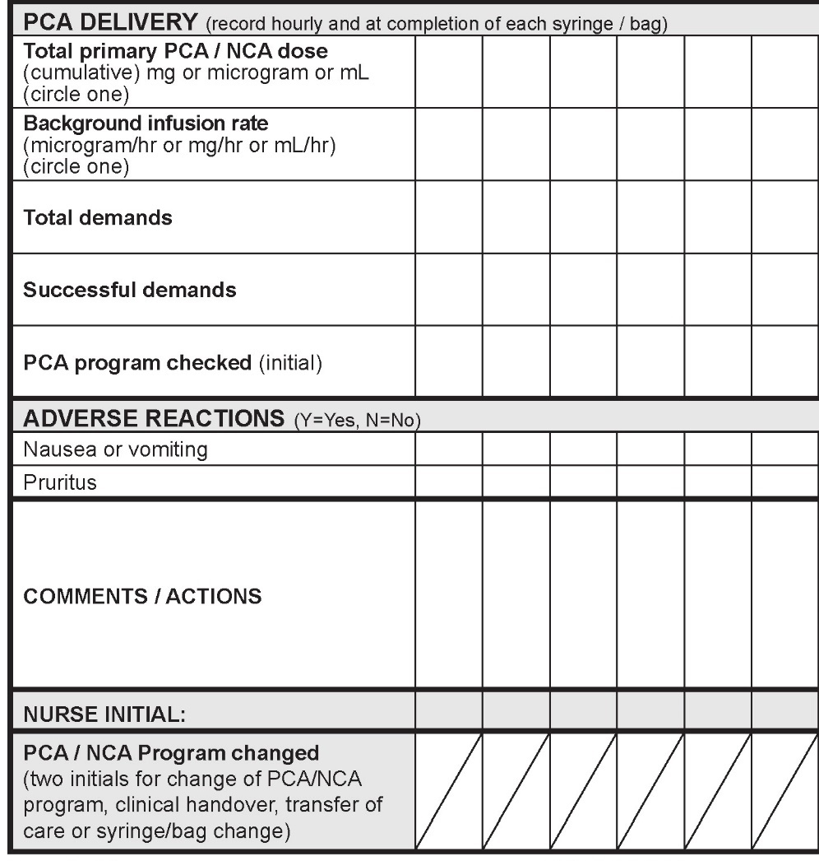
Total primary PCA or NCA dose
1mL 2mL 5mL 8mL 10mL
PCA delivery observations
Background infusion
NIL
1 3 9 14 17
Total demands and successful demands
1 2 5 8 10
PCA program checked
JS
Adverse reactions: nausea or vomiting and pruritus
N N N N N
N N N N N
Comments and/or actions
Nurse initial
JS JS JS JS
JS
Two initials for change of program, clinical handover, transfer of care or syringe/bag change
TJ

Slide 26
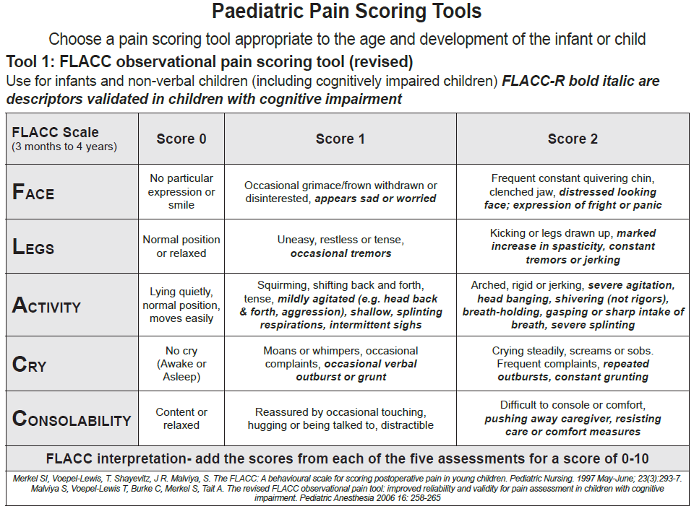
Paediatric pain scoring tools
Tool 1: FLACC observational pain scoring tool

Slide 27
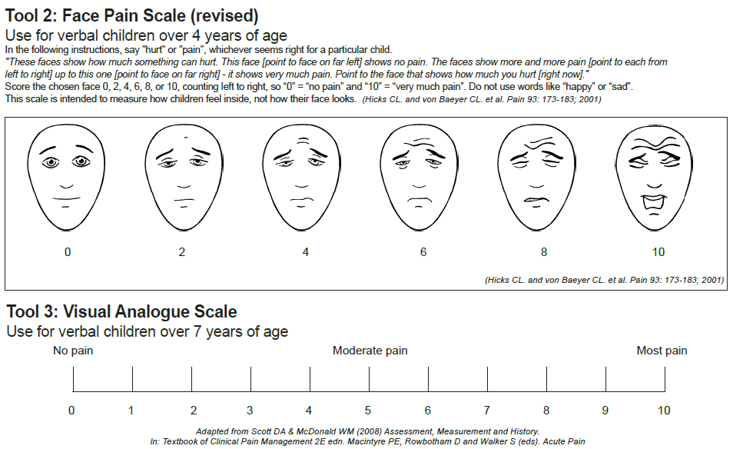
Paediatric pain scoring tools
Tool 2: Face Pain Scale
Tool 3: Visual Analogue Scale

Slide 28
Thank You
ACI-Pain Management Network
ACI-PainManagement@health.nsw.gov.au
Published date: Mar 2024. Next review: 2029. (ACI) 230958 ACI/D24/419

